Slide 1
So Much More Than An Apple.

Slide 2
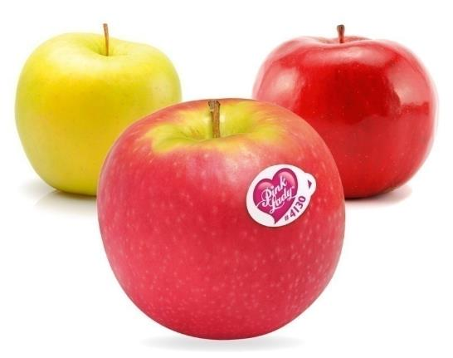
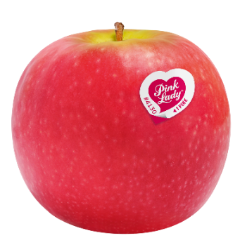
AN APPLE
AN INSPIRED NATURAL CROSS
EXCEPTIONAL ORGANOLEPTIC QUALITIES
1973
The Pink Lady® apple is a natural cross between the Golden Delicious apple
and the Lady Williams apple.
Inimitable colouring
Creation of Pink Lady®
Exceptional aromatic richness
1994-95
The perfect balance between sweetness and acidity
The first Pink Lady® trees are planted
in Europe
Crunchy, juicy flesh
A special round shape
1997
Unique flavours
blending honey, vanilla, rose and spices
Creation of the Pink Lady® Europe Association
Very rich
in antioxidants
Notes:
First of all a short presentation of the aple Pink Lady®
This apple is from a natural cros between the eGolden Delicious apple and the Lady Williams
She is well known for her colouring, the aromatic richness and the crunchy and juicy flesh
The creation of the variety is from 73 in Australia,
then in 94-95 the first trees were planted in Europe for some tests,
And in 97 they created the Association Pink Lady Europe

Slide 3
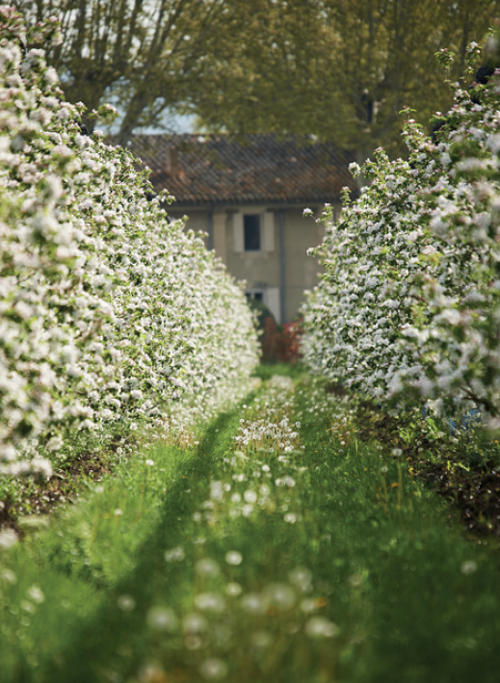
AN ASSOCIATION-BASED MODEL
THE STAKEHOLDERS
HOW IT WORKS
11
Nursery gardeners
They produce the trees thanks to natural selection and reproduction in the nursery.
Every year, the board of directors:
14
> elects a chair
Approved distributors
They supervise the packing and sell the Pink Lady® apples in stores.
> defines the strategic guidelines and quality policy for the apple
100
Packing houses
They are in charge of preserving, selecting and packing the apples that will become Pink Lady® apples.
> proposes the budget investment policy to the general meeting
2,827
Apple growers
They take every step to produce a high quality Pink Lady® apple respectful of people, the planet and time.
Notes:
So as I said, in Europe, Pink Lady works in an association-based model. It’s an unique model in the word
We have for diferent members of the association :
The 11 nurseries that produce trees
The nearly 3000 apple growers
Arround 100 packhouse stations to pack and send the apples
And 14 approved distributors to sell the apples
It works like a standard association, with an electing board, with representative of each of our kind of members
So the association is mainly directed by producers like a cooperative
We are arround 30 amployees in the association and our job is to promote the brand, control the quality, and for me improve the pratices and propose a CSR strategy.

Slide 4
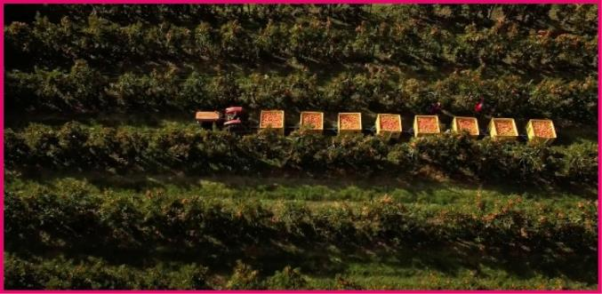
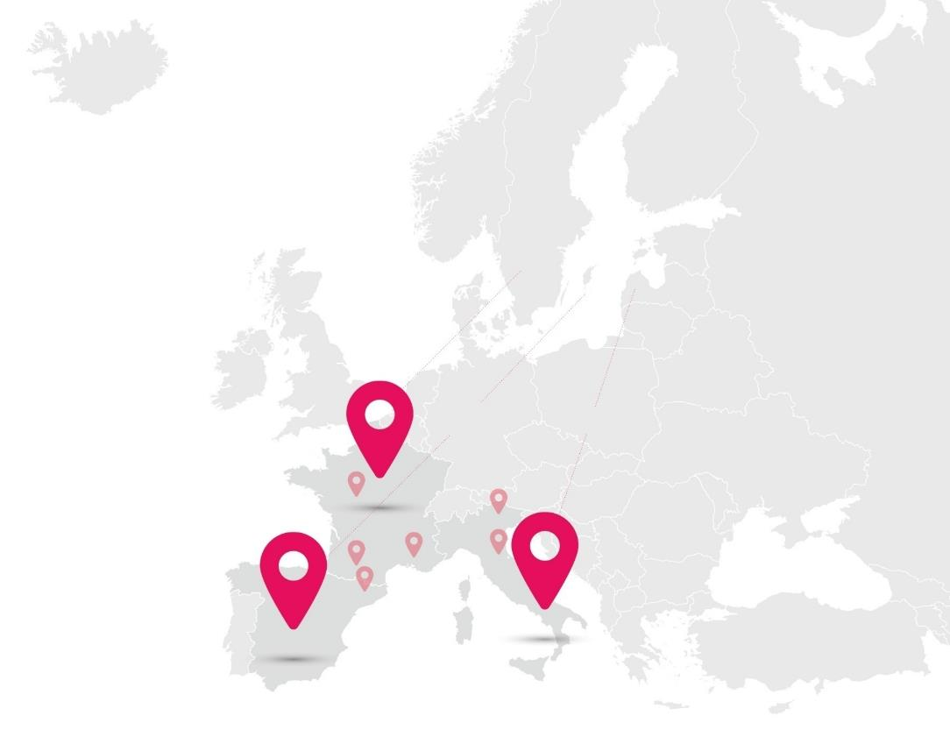
GROWING AREAS
Pink Lady® only grows in superior growing areas combining a suitable soil quality with good sun exposure.
IN FRANCE
FRANCE
South-East, South-West, Val de Loire
807
farms in the South-East, South-West and Val de Loire
IN SPAIN
ITALY
Emilia-Romagna, South Tyrol
81
farms in Catalonia
IN ITALY
1,939
farms in Emilia-Romagna and South Tyrol
SPAIN
Catalonia
Notes:
The growing areas in Europe are in France, Spain and Italy. Nearly half / half for France and Italy, and a little production in Spain.
There are much more producers in Italy, but they have micro farms, arround 2 hectares per producers for all varieties.

Slide 5
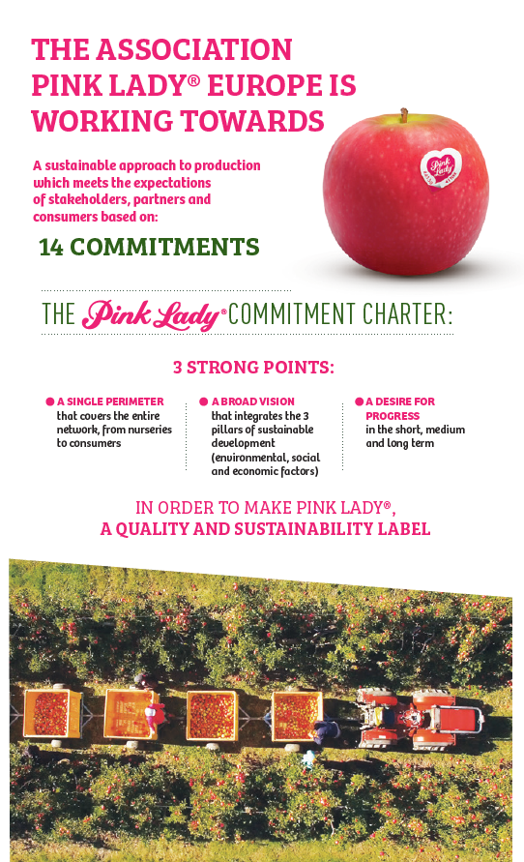
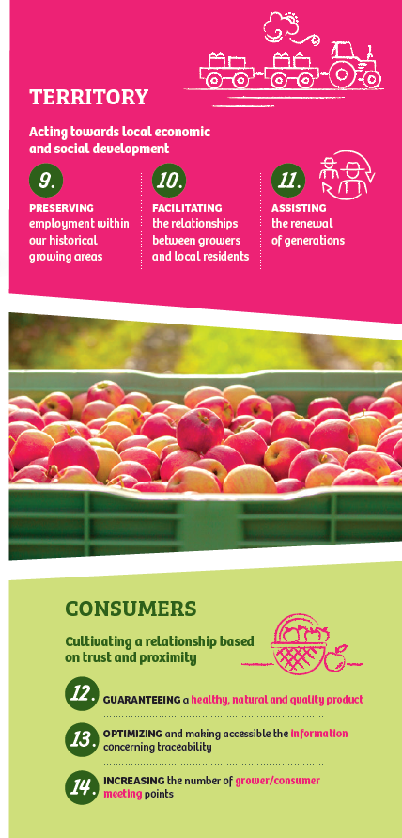
Pink Lady® Commitment Charter
Notes:
Last Year in December we published our Commitment charter
14 commitments dispached in 4 axes as you can see.
I will only detailed the first commitment that is about developing the agro-ecological praticies by 2021

Slide 6
Agro-ecological commitment
Developing agro-ecological practices by 2021
Growers that are all committed to sustainable and environmentally - friendly practices via certification
A new edition of the production guide for the development of biological control techniques
Setting up a tool for the inventory of agroecological infrastructure
Access to regular training for the protection of pollinators
Notes:
So in this commitment we have 4 different works to acheive our goal.
It’s about certifications, technical guides, programm about the bee protections, and … Then a way to inventory the agroecological infrastructures and to mesure the biodiversity → That is for this one that we choose to test the Biodiversity performance Tool

Slide 7
Biodiversity Performance Tool
OUR NEEDS
OUR FEEDBACK
OUR NEXT STEPS
Improve the practices
Good tool for a first version, easy to understand and to answer
The tool needs to be translated in Italian and to be recognized in Europe to convince our grower to use it
> To measure the actual situation
Not enough specific about orchards activity
If improvements are done, we will decide to deploy the tool for our growers
> To make the producers aware of the biodiversity subjects
> To propose solution to improve the biodiversity in orchards
Too many questions about animal breeding (or crops) when not concerned
How to deploy the tool : every 3 years ? 10% of growers each year ? Etc.
> To use a tool recognized in Europe
No clear synthetic action plan to improve his biodiversity performance
Pink Lady® goal : to start deploying the tool in 2021

