Slide 1
So Much More Than An Apple.

Slide 2

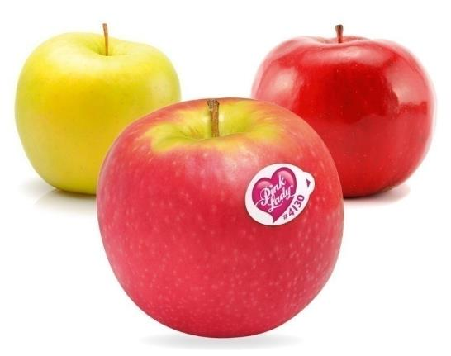
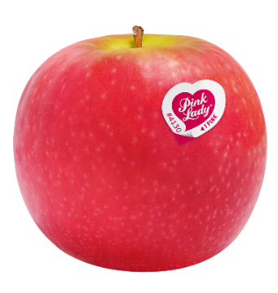
AN APPLE
AN INSPIRED NATURAL CROSS
EXCEPTIONAL ORGANOLEPTIC QUALITIES
The Pink Lady® apple is a natural cross between the Golden Delicious apple
and the Lady Williams apple.
Inimitable colouring
Exceptional aromatic richness
The perfect balance between sweetness and acidity
Crunchy, juicy flesh
A special round shape
Unique flavours
blending honey, vanilla, rose and spices
Very rich
in antioxidants

Slide 3
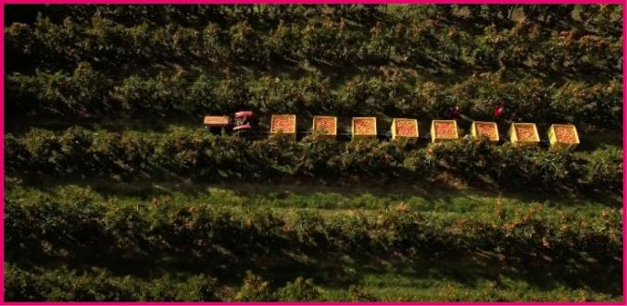
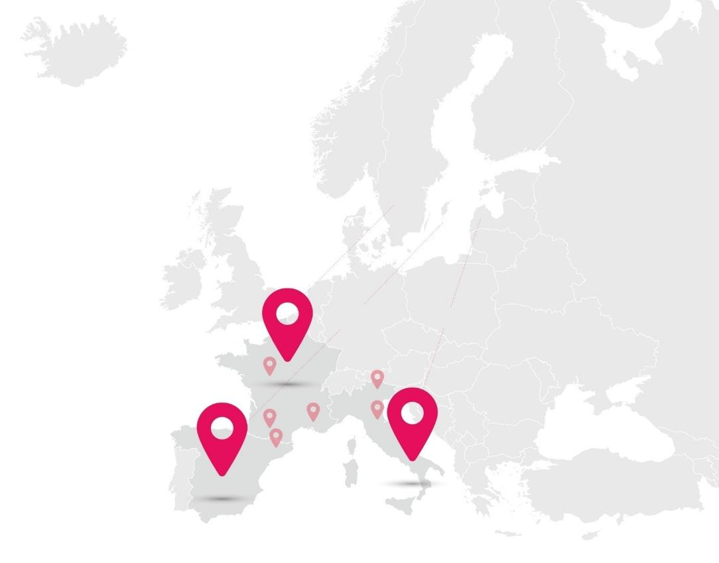
GROWING AREAS
Pink Lady® only grows in superior growing areas combining a suitable soil quality with good sun exposure.
IN FRANCE
FRANCE
South-East, South-West, Val de Loire
807
farms in the South-East, South-West and Val de Loire
IN SPAIN
ITALY
Emilia-Romagna, South Tyrol
81
farms in Catalonia
IN ITALY
1,939
farms in Emilia-Romagna and South Tyrol
SPAIN
Catalonia

Slide 4






AN ASSOCIATION-BASED MODEL
1973
THE STAKEHOLDERS
Creation
of Pink Lady®
HOW IT WORKS
11
Nursery gardeners
They produce the trees thanks to natural selection
and reproduction in the nursery.
Every year, the board of directors:
1994-95
15
> elects a chair
The first Pink Lady® trees are planted
in Europe
Approved distributors
They supervise the packing and sell the Pink Lady® apples in stores.
> defines the strategic guidelines and quality policy for the apple
100
1997
Packing houses
They are in charge of preserving, selecting and packing
the apples that will become Pink Lady® apples.
> proposes the budget investment policy to the general meeting
Creation of the Pink Lady® Europe Association
2,827
Apple growers
They take every step to produce a high quality Pink Lady® apple respectful of people, the planet and time.

Slide 5
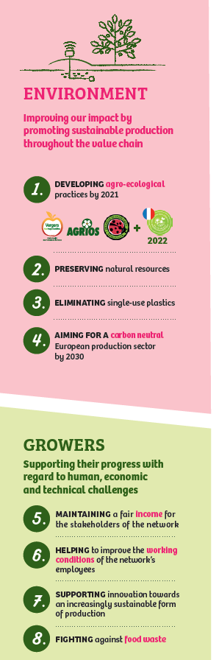
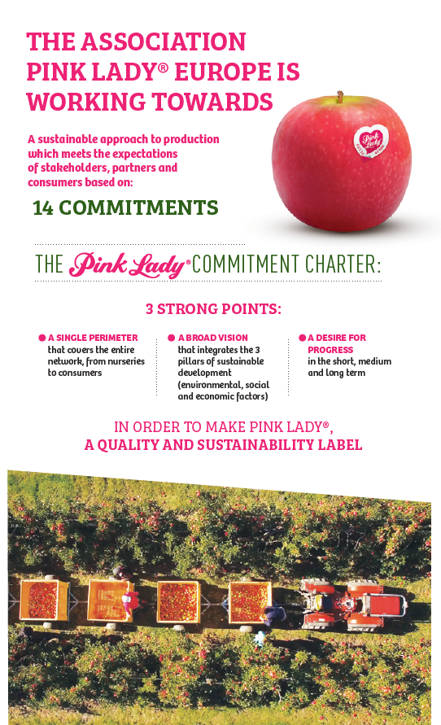
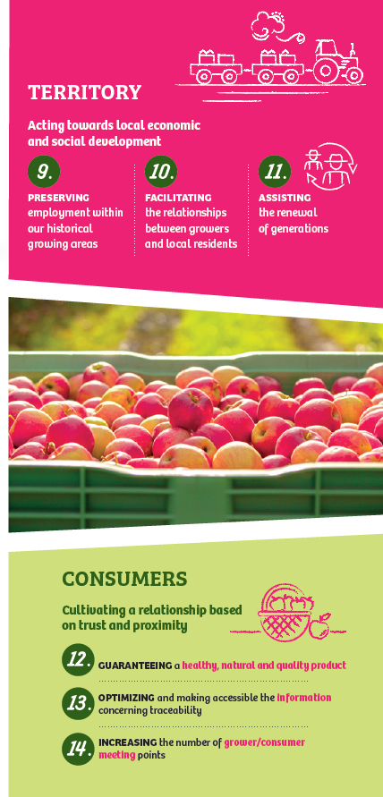
Pink Lady® Commitment Charter

Slide 6








Agro-ecological commitment
Developing agro-ecological practices by 2021
Growers that are all committed to sustainable and environmentally - friendly practices via certification
A new edition of the production guide for the development of biological control techniques
Setting up a tool for the inventory of agroecological infrastructure
Access to regular training for the protection of pollinators

Slide 7





Biodiversity Performance Tool
OUR NEEDS
OUR FEEDBACK
OUR NEXT STEPS
Improve the practices
Good tool for a first version, easy to understand and to answer
The tool needs to be translated in Italian and to be recognized in Europe to convince our grower to use it
> To measure the actual situation
Not enough specific about orchards activity
If improvements are done, we will decide to deploy the tool for our growers
> To make the producers aware of the biodiversity subjects
> To propose solution to improve the biodiversity in orchards
Too many questions about animal breeding (or crops) when not concerned
How to deploy the tool : every 3 years ? 10% of growers each year ? Etc.
> To use a tool recognized in Europe
No clear synthetic action plan to improve his biodiversity performance
Pink Lady® goal : to start deploying the tool in 2021

