Slide 1
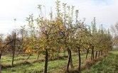

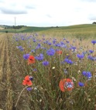

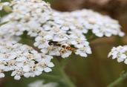
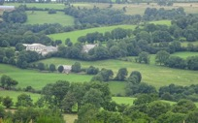

Presentation of the
Biodiversity Performance Tool
LIFE Food & Biodiversity
https://bpt.biodiversity-performance.eu
Caroline GIBERT
Marine GIMARET
Frédéric COULON
Philippe POINTEREAU
    Web Series on Biodiversity and the Food Sector
    Session III: Biodiversity in Food Production and Retail Applying the Biodiversity Performance Tool
    28 September 2020

Slide 2

Poll #1 Result

Slide 3
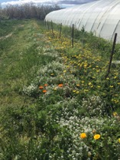
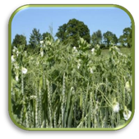
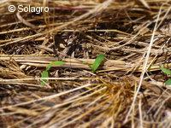
Biodiversity Performance Tool (BPT)
A common decision farm tool: objectives and specifications
Perform functional biodiversity performance assessment at farm level
  Priorize biodiversity improvement at farm level through a scoring method
  Based on agronomic, environment and socio-economic indicators
Suitable for the 4 European agro-climatic zones
Able to assess different farm types
  Grain production farms
  Livestock farms: dairy and meat cattle
  Perennial productions: olive trees
  Vegetable farms
Able to reduce impacts on functional biodiversity by suggesting sustainable actions
©Solagro
Notes:
BPT should help farmers and farm advisors to elaborate and implement sound Biodiversity Action Plans which contribute substantially to a better biodiversity performance on farm level.
The tool will support auditors and certifiers of standards as well as product, quality and sourcing managers of food companies to better assess the preservation and improvement of integration of biodiversity at farm level.

Slide 4
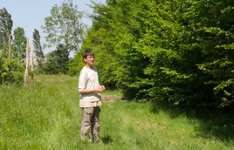
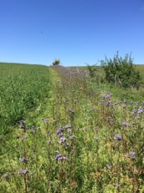
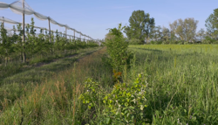
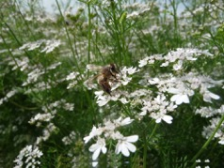
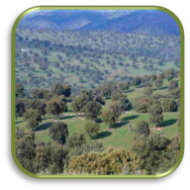
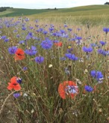
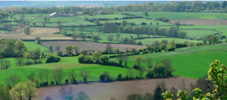
Biodiversity Performance Tool (BPT)
A learning process from farmers to certifiers
Co-elaboration of the Biodiversity Action Plan
  With the farmer(s) individually or collectively
Sustainable measures classified in
  Efficiency, Substitution or Redesign strategy
  Multi-criteria assessment:
    Environmental benefits
    Technical, Economical and social feasibility
    Deadline for completion
©Solagro
©Solagro
©Solagro
©Solagro
©Solagro
©Solagro

Slide 5
Biodiversity Performance Tool (BPT)
A common decision farm tool: target groups
  Farmers / agricultural advisors:
  Supports the elaboration and implementation of sound
  Biodiversity Action Plans on farm level
  Auditors and certifiers:
  Facilitates the assessment of conservation and improvement of biological diversity at farm level
  Product- and quality manager and purchasers in food companies:
  Orientation for assessing Biodiversity Performance of producers and suppliers
Notes:
BPT should help farmers and farm advisors to elaborate and implement sound Biodiversity Action Plans which contribute substantially to a better biodiversity performance on farm level.
The tool will support auditors and certifiers of standards as well as product, quality and sourcing managers of food companies to better assess the preservation and improvement of integration of biodiversity at farm level.
Target groups
Farmers, farm advisors and assessors : to elaborate and implement sound Biodiversity Action Plans which contribute substantially to a better biodiversity performance on farm level.
Auditors and certifiers of standards as well as product, quality and sourcing managers of food companies : to better assess the preservation and improvement of integration of biodiversity at farm level.

Slide 6
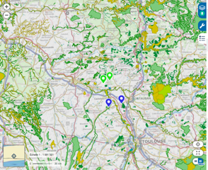






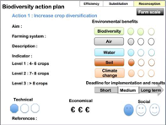
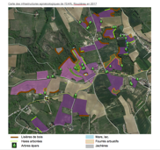
Biodiversity Performance Tool (BPT)
General approach
1
IDENTIFICATION OF LOCAL BIODIVERSITY ISSUES
Collective
Landscape
© Alain Chappuis
Individual
Farm
Strengths | Weakness
Importance of SNH Configuration of plots Agrobiodiversity Soil fertility | Quality of SNH Short crop rotation No action to reduce water consumption No livestock
3
2
BIODIVERSITY ACTION PLAN
FARMER INTERVIEW & ASSESSMENT
Notes:
avec la flèche + Réponses à d’autres enjeux (Erosion, Zone vulnérable, Qualité de l’eau, Adaptation au CC…)

Slide 7


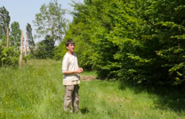
Biodiversity Performance Tool (BPT)
Methodology to assess biodiversity performance
Biodiversity performance
Farming practices
Farm environment (semi-natural habitats)
Awareness, involvement
+
+
©Solagro
©Solagro
©Solagro
Notes:
L‘évaluation de la biodiversité à l‘échelle de la ferme combine ces 3 éléments représentant le potentiel d‘accueil de la faune auxiliaire aux abords et dans les parcelles agricoles et l‘implication et le degré de sensibilité de l‘agriculteur face à l‘enjeu biodiversité

Slide 8

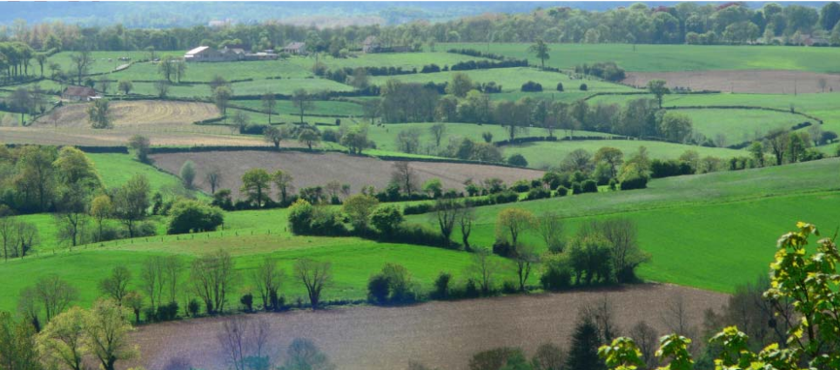



Biodiversity Performance Tool (BPT)
Methodology to assess biodiversity performance – Data entry & results (1)
Quantity of SNH
24 basic indicators
Farm environment
Diversity of SNH
Functional composition of SNH
©Solagro
Functional management of SNH
Notes:
What are the conclusion of the assessment of 20 existing tools ?
There is a weak of tools that assess functionnal biodiversity (though landscape and farming practices), allows continuous improvment, that are free of charge and that integrates biodiversity action plan.

Slide 9
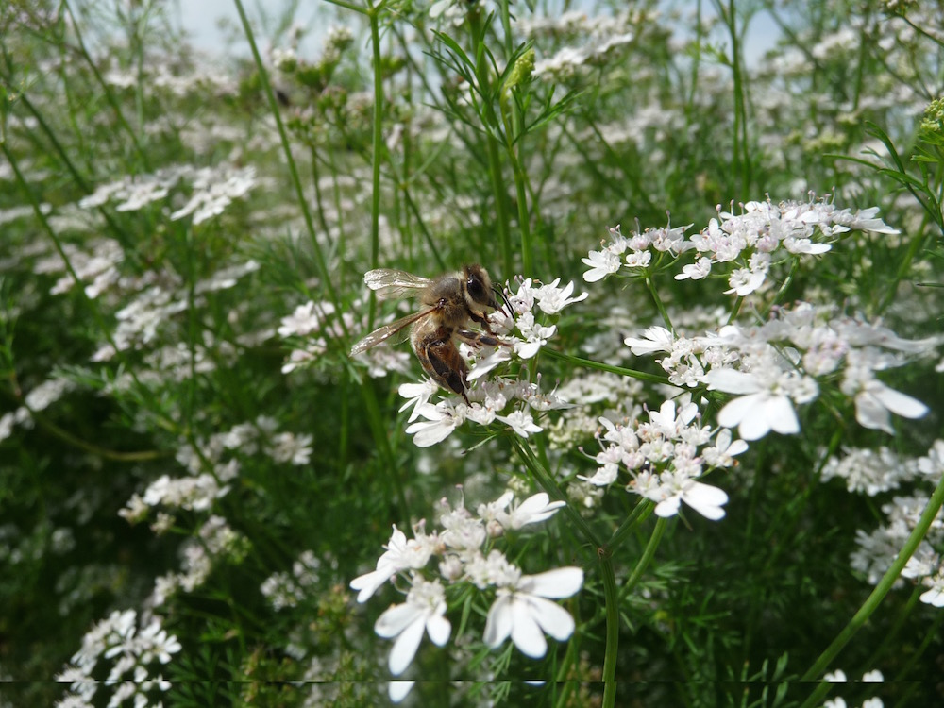
Biodiversity Performance Tool (BPT)
Methodology to assess biodiversity performance – Data entry & results (2)
Soil protection
Farming practices
42 basic indicators
Inputs management
(fertilizers, pesticides,...)
Agrobiodiversity
Livestock
Water management
©Solagro
Notes:
Agrobiodiversité, taille des parcelles, prophylaxie, protection des cultures, qualité de l’alimentation, preservation des sols…
What are the conclusion of the assessment of 20 existing tools ?
There is a weak of tools that assess functionnal biodiversity (though landscape and farming practices), allows continuous improvment, that are free of charge and that integrates biodiversity action plan.

Slide 10
Biodiversity Performance Tool (BPT)
Methodology to assess biodiversity performance – Data entry & results (3)
Farm performances monitoring
12 basic indicators
Awareness, involvement
Awareness of farmer & worker
©Solagro
Cooperation
Notes:
What are the conclusion of the assessment of 20 existing tools ?
There is a weak of tools that assess functionnal biodiversity (though landscape and farming practices), allows continuous improvment, that are free of charge and that integrates biodiversity action plan.

Slide 11
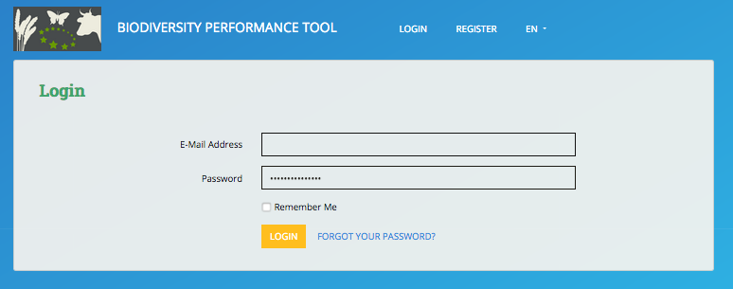
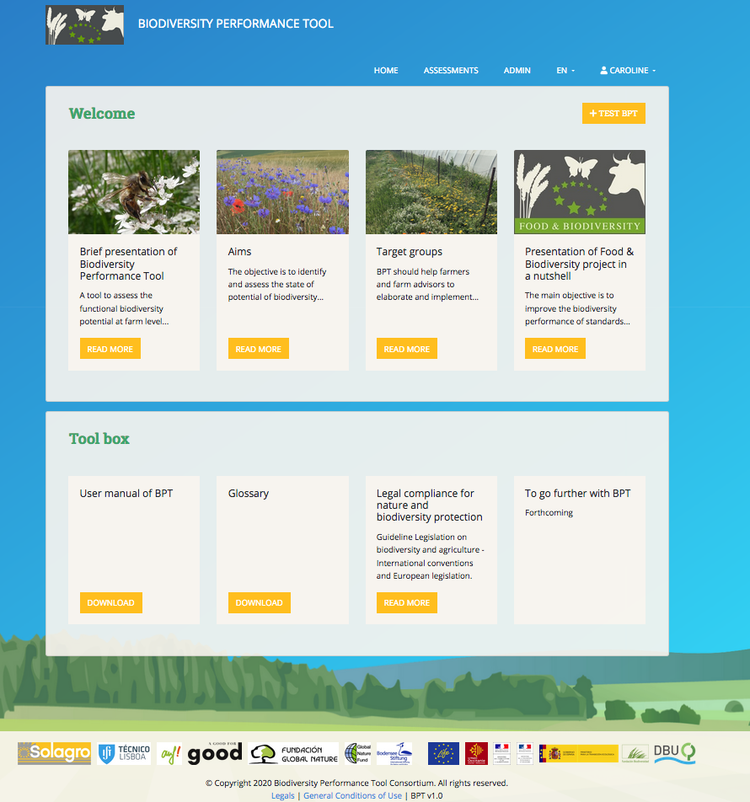
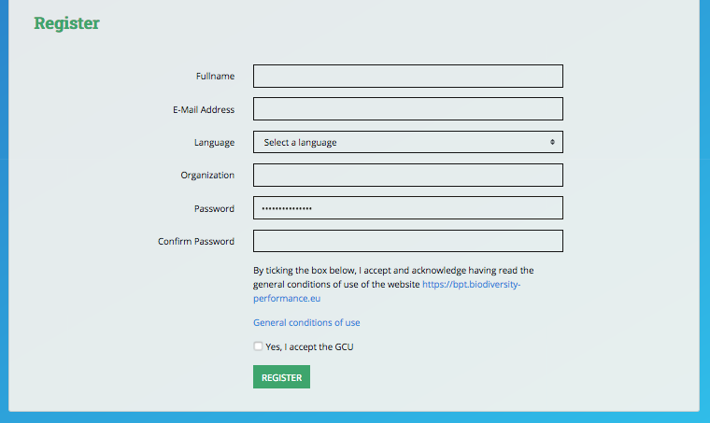
BPT Homepage
Registration & login
Step 1 : Register you
Step 2 : Once logged

Slide 12
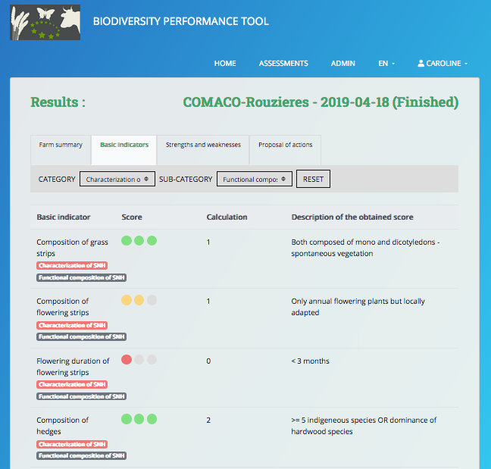
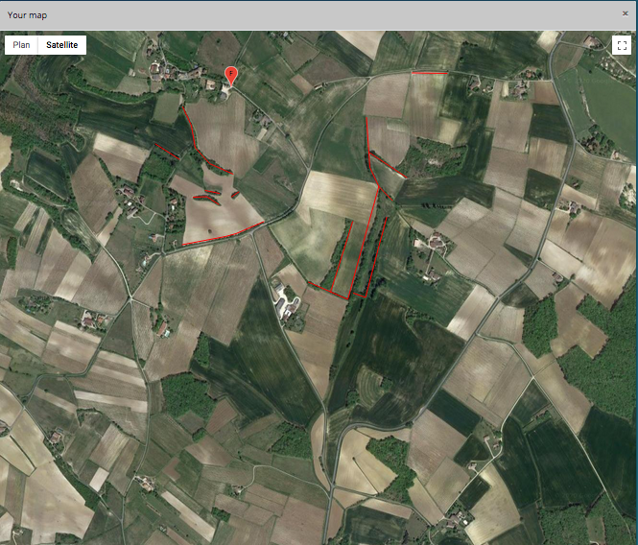
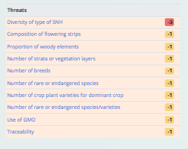
BPT in a nutshell
Report on the current situation of biodiversity on the farm (Baseline) - Traffic light system
Biodiversity Performance Tool
(BPT)
For farmers, farmers cooperatives, assessors, certifiers
Map of Semi-Natural Habitats
Visualisation of strenghts, weaknesses and opportunities
Possibility to extract results
Supported by a database.
78 Key data and indicators.
Ca. 100 questions on habitats, species protection, invasive species … (= management of biodiversity), agricultural practises, capacity building, cooperation with authorities, NGOs.
Main aim: Input for a sound Biodiversity Action Plan
Recommendations regarding measures to improve potential and to reduce negative impacts
= Biodiversity Action Plan
Updating of the data in the BPT = Degradation and improvement of basic indicators
Monitoring of the implementation of Biodiversity Action Plan
https://bpt.biodiversity-performance.eu

Slide 13


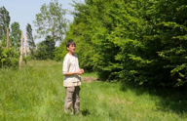


BPT https://bpt.biodiversity-performance.eu/
For a first assessment : ½ day to 1 day ½ including mapping
For updating : less than ½ day (2 hours)
Results : < one minute
Data inputs
Characterization of SNH
Outpouts & Visualisation
Maps
Score of basic indicators (max. 78)
Strengths & Weakness matrix
Opportunities
Characterization of Farming Practices
Characterization of Involvement and awareness
©Solagro
©Solagro
©Solagro

Slide 14
Poll #2

Slide 15

Persective for Biodiversity Performance Tool
Long life and operationality
BPT is corresponding to ours target public’s demand…
Improvements are still on-going to better anwser it…
BPT can be adapted
for specific mode of production
  Organic system (FNAB, France)
for subtropical and tropical regions as well as for specific crops. Examples:
  BPT Café with Rainforest Alliance
  BPT Spices in India with UEBT and GIZ
  BPT Banana and Pineapple with GIZ
  BPT Cocoa in Ghana with Fairtrade
Fee-system implementation in 2021
  To maintain and to update the tool
  Fair and reasonable fee
Close contact with
  Potential synergies are explored

Slide 16
Biodiversity Performance Tool
Please contact-us to test the BPT caroline.gibert@solagro.asso.fr marine.gimaret@solagro.asso.fr
LIFE Food&Biodiversity – Thank you for your attention and your questions
Caroline GIBERT
Marine GIMARET
Frédéric COULON
Philippe POINTEREAU
https://bpt.biodiversity-performance.eu

Slide 17

Timeline of BPT development
Development of BPT and internal test phase
2017 - 2018 : Beta version
oct 2018 - february 2019: IT Specification and choice of IT developers
External Test phase of BPT
August-September 2020 : Online form / Analysis of feedbacks
February - August 2019: BPT online (internal test phase)
End of September 2019: BPT V1 online
22nd November 2019: Webinar of BPT presentation in France
October 2020: BPT V2.
December 2019-May 2020: Test
April and July 2020: Webinar 2 and 3 on BPT (France)
08/2016
12/2019
09/2020
LIFE PROJECT

