Slide 1
German Initiative “Biodiversity in the German Food Sector”
Marion Hammerl, Lake Constance Foundation
Kai Stober, Kaufland

Slide 2
Biodiversity - The basis of our food systems under serious threat
FAO’s Director- General:
“Biodiversity is critical for safeguarding global food security, underpinning healthy and nutritious diets, improving rural livelihoods, and enhancing the resilience of people and communities. We need to use biodiversity in a sustainable way, so that we can better respond to rising climate change challenges and produce food in a way that doesn’t harm our environment”
“Less biodiversity means that plants and animals are more vulnerable to pests and diseases. Compounded by our reliance on fewer and fewer species to feed ourselves, the increasing loss of biodiversity for food and agriculture puts food security and nutrition at risk”

Slide 3
Group to build the Initiative composed by 15 actors: Food companies and retailers Food standards Agricultural organisations Environmental NGOs Scientific institutions
German Food Sector Initiative
Motivation to take biodiversity protection serious
Implementation of a basis-set of biodiversity criteria and appropiate share of costs for the implementation of measures
Biodiversity monitoring system
Training of farmers, assessors, certifiers, managers ….
Awareness raising final consumers
Joint research and pilot projects
Influencing the legal /political framework towards effective biodiversity protection
Association
Starting in January 2021
Statutes
Self-Commitment

Slide 4
Effective Biodiversity protection requires two lines of action
Biodiversity Responsible Agriculture
Biodiversity Management:
Protection, restoration, creation of natural and semi-natural habitats
maintenance of habitats, biological corridors and species protection...
VERY GOOD agricultural practices:
To avoid or reduce negative impacts on biodiversity: reduced use of pesticides, sustainable fertilization, soil protection, sustainable use of water

Slide 5
Is not a Biodiversity Standard!! Criteria should be considered in existing standards, sourcing rules, requirements for members of an cooperative .....
Basis-Set of Biodiversity Criteria
60 requirements for standards /companies and for farmers
Very good agricultural practise
Protection of soil and sound fertilization management
Variety of crops; crop rotation
Complete implementation of Integrated Pest Management
Efficient use of water; protection of water sources
Origen of feed and density of animals
Agrobiodiversity
Biodiversity management, e.g.
Baseline and Biodiversity Action Plan
Minimum % of natural vegetation
Protection of habitats
Creation of biotope corridors
Measures against invasive alien species

Slide 6
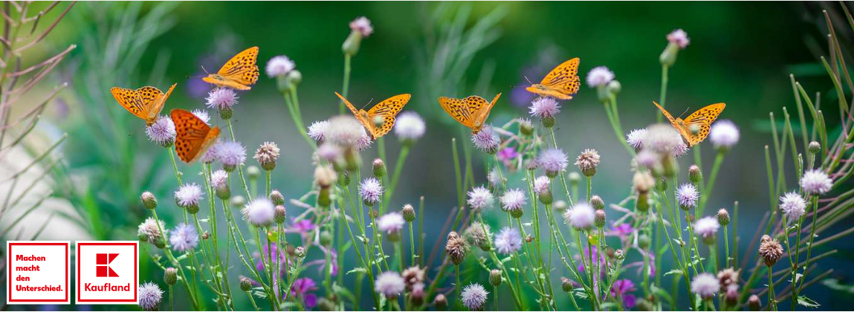

Slide 7
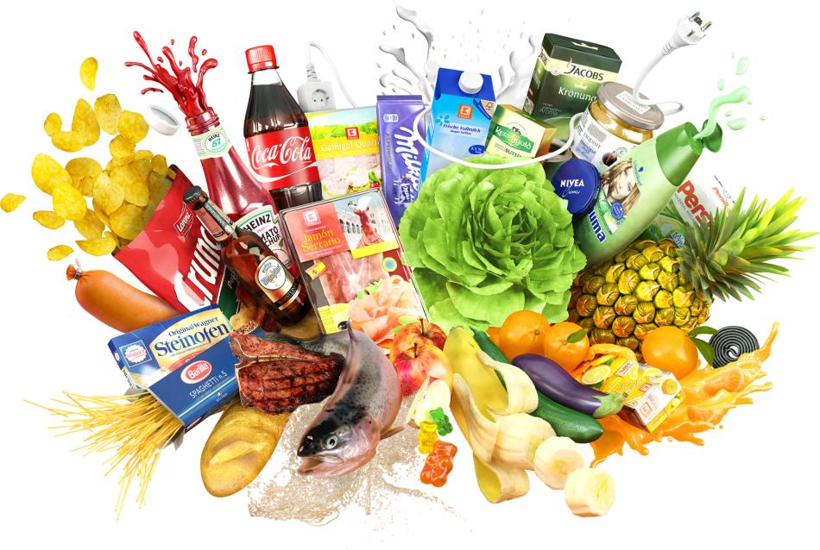
Kaufland offers its customers a wide range of food and everything for daily needs.
Notes:
Kaufland offers its customers a wide range of food products, with the focus on the fresh produce departments fruit and vegetables, dairy products as well as meat, sausage, cheese and fish - also in service.
Christiana

Slide 8
In Europe
Kaufland
Countries
8
Stores
1,300
Employees
132,000
DE
PL
CZ
SL
MDA
Distribution Centre
17
HR
RO
BG
Meat processing plants
5
Notes:
1968 Germany
1998 Czech Republic
2000 Slovakia
2001 Croatia
2001 Poland
2005 Romania
2006 Bulgaria
2019 Republic of Moldova
Christiana

Slide 9
Biodiversity management
Kaufland
Initiativ-Management
Project Management
Pesticide Management
Communication- and Assortment Management
Notes:
Christiana

Slide 10
Biodiversity management
Kaufland
Initiativ-Management
Create framework conditions
Initiative: Biodiversity in the food sector
Notes:
Create framework conditions with everyone involved in the supply chain, including the industry and other stakeholder
Christiana

Slide 11
Biodiversity management
Kaufland
Project Management
Biodiversity Performance Tool (BPT)
Project to promote our precious soil
Projects flowering areas
Projects for the near-natural redesign of Kaufland locations such as logistics centers
…
Notes:
Christiana

Slide 12
Biodiversity management
Kaufland
Pesticide Management
Long-term supply relationships
based on partnership
Clearly defined Kaufland standards
Effective and preventive control on site
Notes:
Christiana

Slide 13
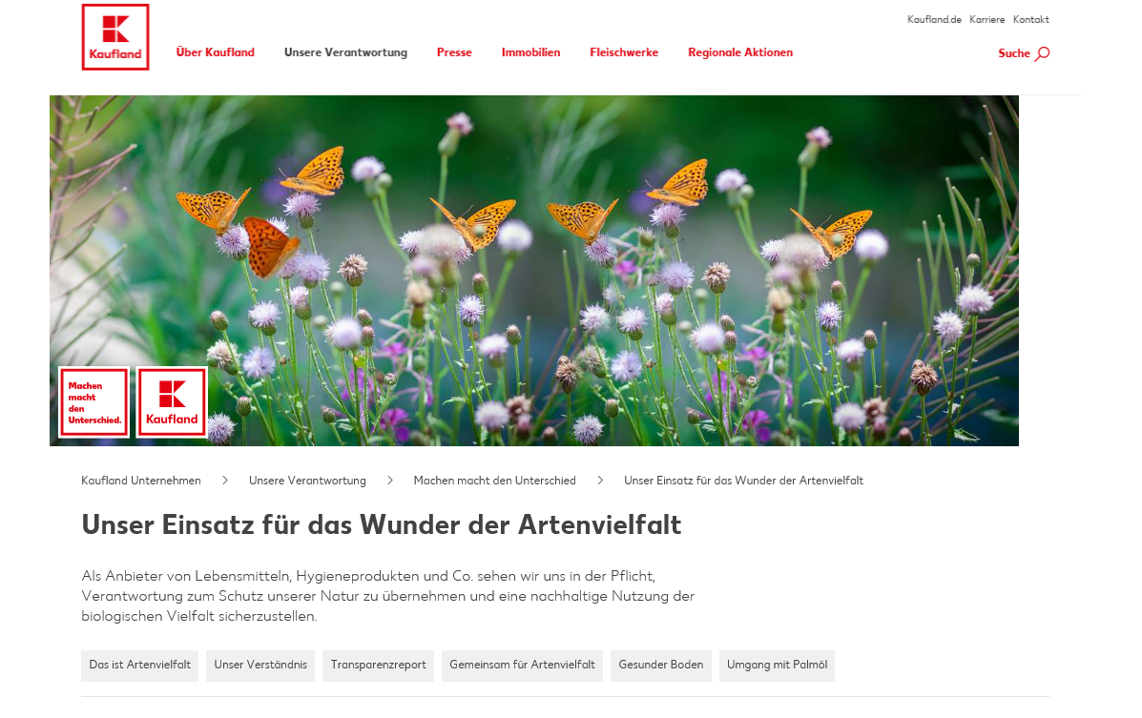
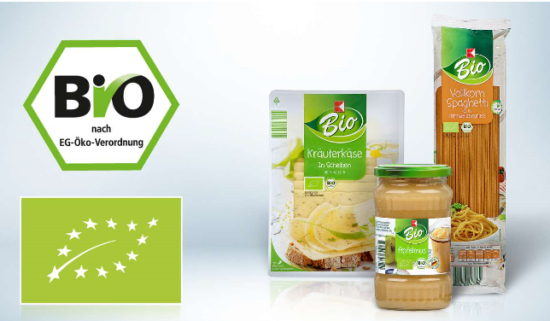
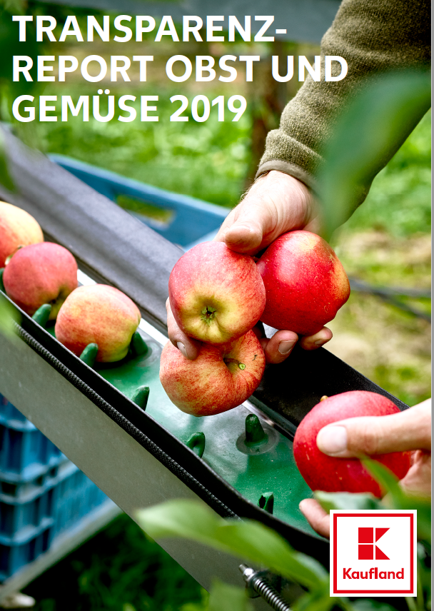
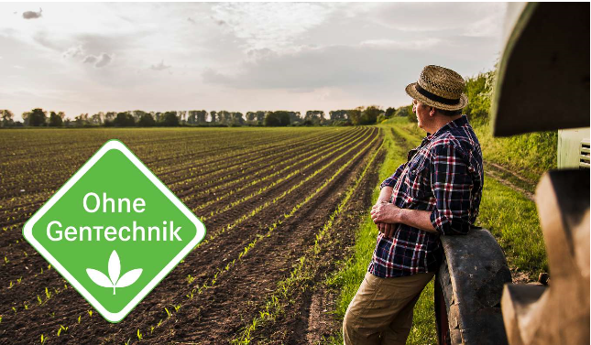
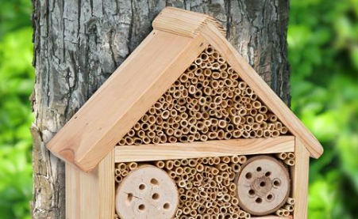
Biodiversity management
Kaufland
Communication- and Assortment management
Notes:
Christiana

