Slide 1


Mejores prácticas agrícolas
© pictures: pixabay

Slide 2
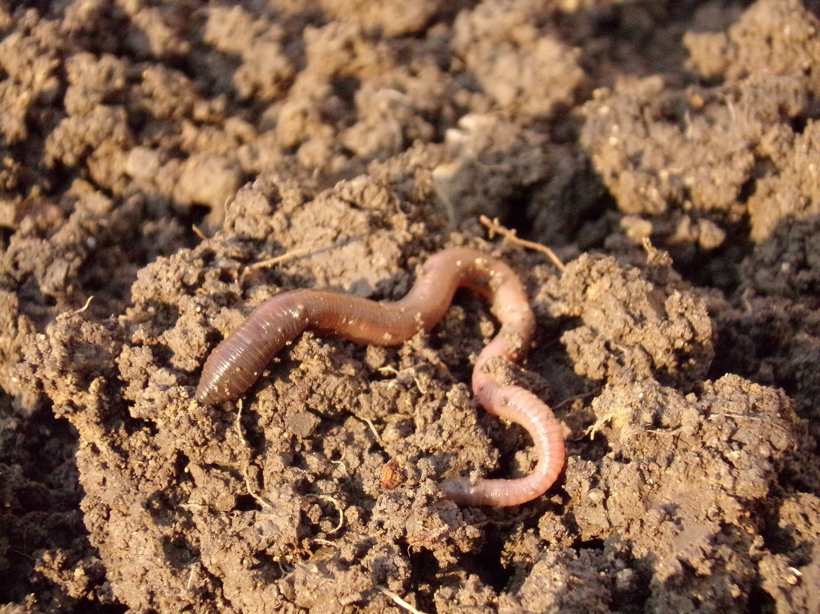

Mejores prácticas agrícolas
Suelo y fertilización
© pictures: pixabay

Slide 3
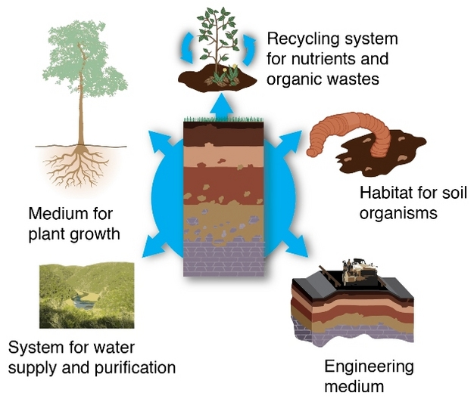
Soil and Fertilization
Fuente: Nature.com, Soil as ecosystem providers; https://www.nature.com/scitable/knowledge/library/what-are-soils-67647639 (September 2018)
Notes:
Why is soil important for Biodiversity?
Soil is a fundamental and irreplaceable natural resource. It performs a number of functions essential for human life, e.g. producing food and fibre; interlinking earth, air and water; storing, filtering and transforming water, nitrogen and carbon. Soil is the most important carbon store in the world and it takes hundreds of year for a thin layer of soil to develop. It is classified as a “non-renewable resource”. A resource, which is at risk.

Slide 4
Suelo y fertilización
115 Millones de hectáreas se ven afectadas por la erosión hídrica / 42 millones de hectáreas sufren erosión eólica en la UE
36% de los suelos europeos se consideran vulnerables a la compactación
45% Los suelos en Europa tienen bajo o muy bajo contenido de materia orgánica.
En Europa, alrededor de 3.8 millones de hectáreas se ven afectadas por la salinización.
Las infraestructuras ocupan un 9 % de la superficie total de los Estados miembros de la UE
Notes:
The European Commission addresses the threats to soil on several fronts trying to sustain the precious resource beneath our feet. However, there is no overarching, strategic framework on EU level, yet. This gap had been intended to be filled by the Soil Framework Directive proposal, which was withdrawn by the commission in 2014. In the absence of a common policy framework, soils are casually addressed in many policy instruments.

Slide 5
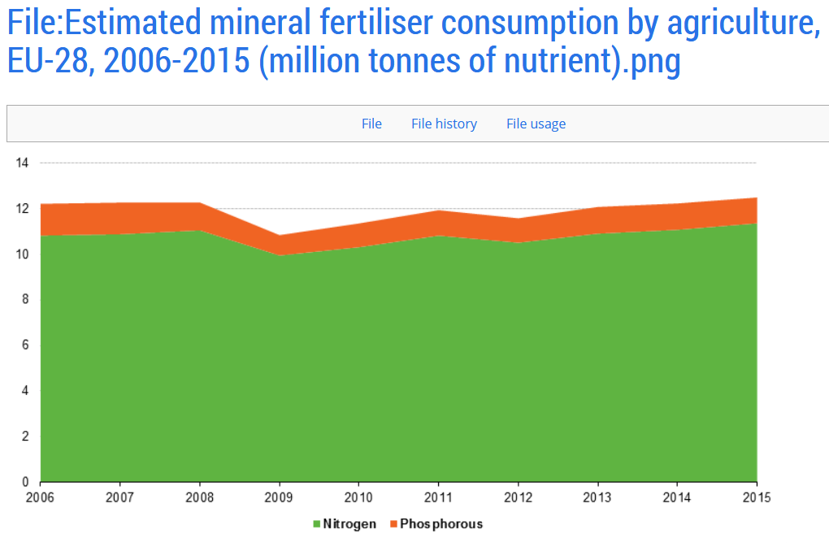
Suelo y fertilización
Balances y límites de Nitrógeno
Fuente: https://ec.europa.eu/eurostat/statistics-explained/index.php?title=File:Estimated_mineral_fertiliser_consumption_by_agriculture,_EU-28,_2006-2015_(million_tonnes_of_nutrient).png#file
Notes:
Today, common agricultural practices include the use of nitrogen balances as a planning tool for nutrient management prior to the use of fertilizer. Nitrogen balances compare nitrogen inputs (fertilizing, nitrogen fixation and nitrogen deposition among other things) and nitrogen outputs (denitrification and the emission of ammonia among other things) and thus reflect a major part of the nitrogen cycle and the impact of farm management on the hydrosphere and atmosphere.

Slide 6
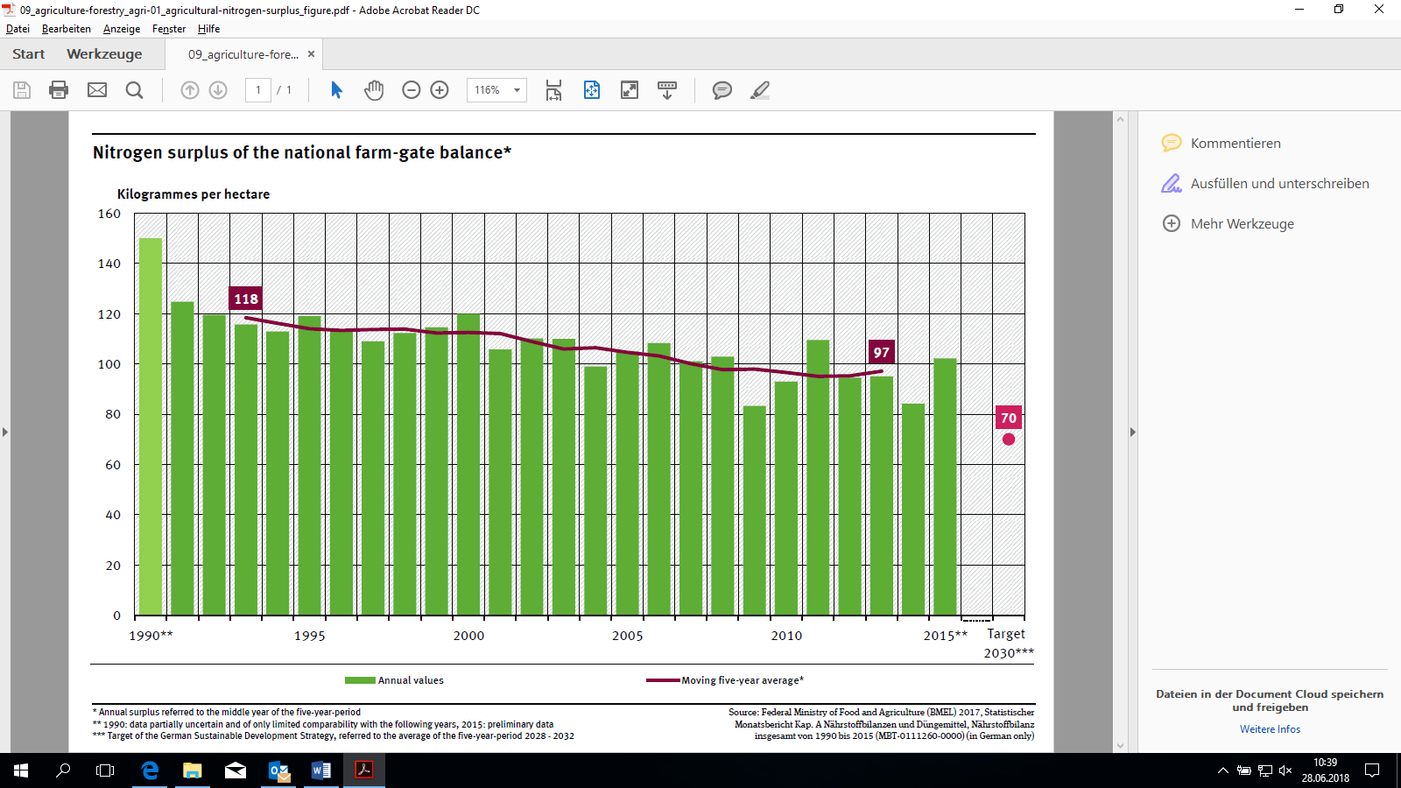
Suelo y fertilización
Balances y límites de Nitrógeno
Statu Quo
Notes:
Today, common agricultural practices include the use of nitrogen balances as a planning tool for nutrient management prior to the use of fertilizer. Nitrogen balances compare nitrogen inputs (fertilizing, nitrogen fixation and nitrogen deposition among other things) and nitrogen outputs (denitrification and the emission of ammonia among other things) and thus reflect a major part of the nitrogen cycle and the impact of farm management on the hydrosphere and atmosphere.

Slide 7
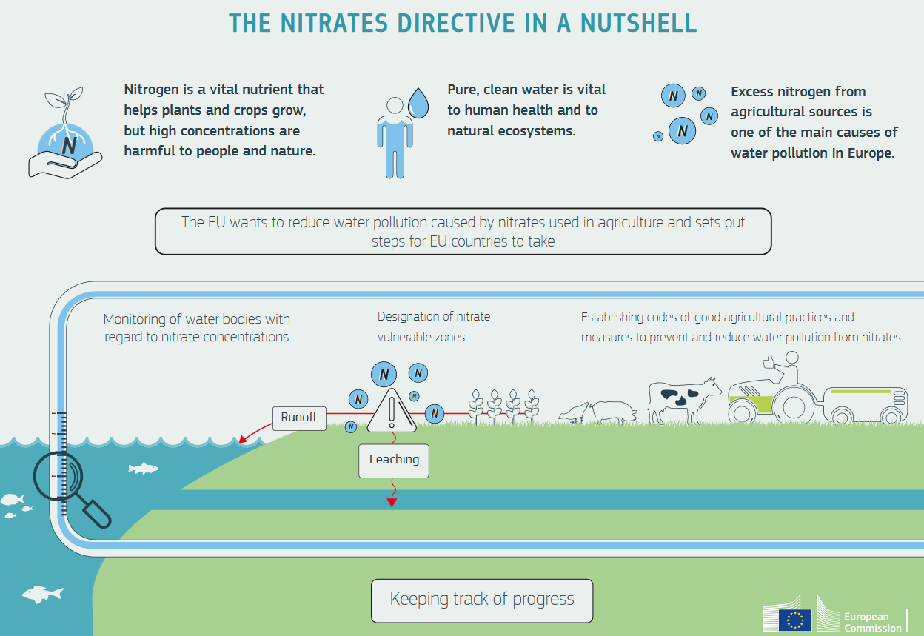
Suelo y fertilización
Directiva Europea sobre Nitratos
FUENTE: http://ec.europa.eu/environment/water/water-nitrates/index_en.html
Notes:
All the extra nitrogen mankind is extracting from the air has to end up somewhere. Some of it passes through our bodies, and those of our animals, and is flushed away in sewage.
Still more is washed straight off the fields into rivers by heavy rain, or leaches into groundwater. All this causes ecosystems to become overloaded with nitrogen, a process known as "eutrophication". What happens is great blooms of algae, and then bacteria, feed on the surplus nitrogen. In the process, they suck all the oxygen from the water, killing fish and other organisms.

Slide 8
Suelo y fertilización
Balances y límites de Nitrógeno
Statu quo
Entrada de nitrógeno
Excedente de nitrógeno
Salida de nitrógeno
Abonos orgánicos y minerales
Balance bruto
Cosecha
Fijación de N
Estimaciones e incertidumbres
Notes:
With the so called “Gross balance” a potential surplus of nitrogen on agricultural land is calculated. Therefore, all inputs of nitrogen to an agricultural system and outputs from nitrogen removed from the system are compared per hectare of agricultural land. The application of organic and mineral fertilizer, the atmospheric deposition of N and the biological nitrogen fixation are taken into account as inputs to the system. Harvested corps are seen as outputs. The data used for the calculations of the gross nutrient balance are partly based on expert’s estimates of different physical relations. In reality, some of these data vary greatly from region to region. Also among Member States the N-coefficients used for the calculations differ. This creates a set of uncertainties that are carried through the total N-balance.
The Farm-gate nutrient balance treats the farm (or national agricultural industry) as an entity. Nitrogen recycled within the entity is ignored. This type of balance takes into account the amount of nitrogen imported into the farm or national agricultural industry (i.e. in fertilizers, feedstuffs, etc.) and exported from the farm or the national agricultural industry, i.e. in animal products (e.g. milk, eggs, meat) and crops, excluding fodder crops and grass which are consumed on the farm. The difference between imports and exports is the nitrogen surplus or deficit. In general, the farm-gate nutrient balance leaves less space for uncertainties as all inputs to the farm and all outputs are documented data, falling back on receipts and verifiable quantities of outputs and inputs. Thus, a farm gate nutrient balance should be preferred and carried out annually. Due to its high data quality (evidence of acquisitions and sales), farm gate nutrient balances provide reliable information and can be used to draw up farm comparisons and regional and national balances.
At all times, application of nutrients should be oriented at the nutrient demand of the crop. To verify this, a nutrient demand determination is a helpful tool. Aiming at reducing the amount of nutrient leaching the amount of needed fertilizer at plot-scale need to be calculated, setting the estimated yields in relation. The fertilizer requirement of a crop, focusing on nitrogen (N) and phosphorous (P) must be determined in writing according to a specified scheme. The nitrogen fertilizer requirement is the quantity of nutrients, which covers the requirement of the crop after deduction of other available quantities of nutrients and taking into account the nutrient supply of the soil. The calculated nitrogen fertilizer requirement is the site-related upper limit that applies to the crop throughout the vegetation. The requirement may be divided up into partial applications. A nutrient demand determination should be applied prior to the application of essential nutrient amounts (50 kg/N/ha or 30 Kg/P/ha). The determination of fertilizer requirements must be carried out in writing for each crop and for each management unit /field.

Slide 9
Suelo y fertilización
Balances y límites de Nitrógeno
Recomendación
Entrada de nitrógeno
Excedente de nitrógeno
Salida de nitrógeno
Balance a la salida de la explotación
Entrada total de N en la explotación
Salida total de N en la explotación
Solo datos documentados
Notes:
With the so called “Gross balance” a potential surplus of nitrogen on agricultural land is calculated. Therefore, all inputs of nitrogen to an agricultural system and outputs from nitrogen removed from the system are compared per hectare of agricultural land. The application of organic and mineral fertilizer, the atmospheric deposition of N and the biological nitrogen fixation are taken into account as inputs to the system. Harvested corps are seen as outputs. The data used for the calculations of the gross nutrient balance are partly based on expert’s estimates of different physical relations. In reality, some of these data vary greatly from region to region. Also among Member States the N-coefficients used for the calculations differ. This creates a set of uncertainties that are carried through the total N-balance.
The Farm-gate nutrient balance treats the farm (or national agricultural industry) as an entity. Nitrogen recycled within the entity is ignored. This type of balance takes into account the amount of nitrogen imported into the farm or national agricultural industry (i.e. in fertilizers, feedstuffs, etc.) and exported from the farm or the national agricultural industry, i.e. in animal products (e.g. milk, eggs, meat) and crops, excluding fodder crops and grass which are consumed on the farm. The difference between imports and exports is the nitrogen surplus or deficit. In general, the farm-gate nutrient balance leaves less space for uncertainties as all inputs to the farm and all outputs are documented data, falling back on receipts and verifiable quantities of outputs and inputs. Thus, a farm gate nutrient balance should be preferred and carried out annually. Due to its high data quality (evidence of acquisitions and sales), farm gate nutrient balances provide reliable information and can be used to draw up farm comparisons and regional and national balances.
At all times, application of nutrients should be oriented at the nutrient demand of the crop. To verify this, a nutrient demand determination is a helpful tool. Aiming at reducing the amount of nutrient leaching the amount of needed fertilizer at plot-scale need to be calculated, setting the estimated yields in relation. The fertilizer requirement of a crop, focusing on nitrogen (N) and phosphorous (P) must be determined in writing according to a specified scheme. The nitrogen fertilizer requirement is the quantity of nutrients, which covers the requirement of the crop after deduction of other available quantities of nutrients and taking into account the nutrient supply of the soil. The calculated nitrogen fertilizer requirement is the site-related upper limit that applies to the crop throughout the vegetation. The requirement may be divided up into partial applications. A nutrient demand determination should be applied prior to the application of essential nutrient amounts (50 kg/N/ha or 30 Kg/P/ha). The determination of fertilizer requirements must be carried out in writing for each crop and for each management unit /field.

Slide 10
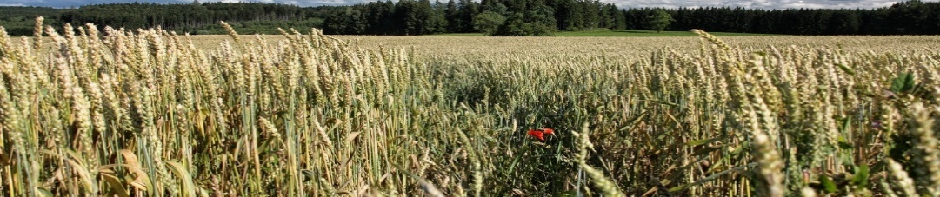
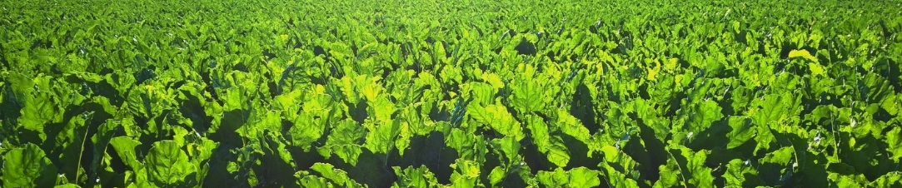

Suelo y fertilización
Rotación de cultivos
Statu quo
Rotación de cultivos
Diversificación de cultivos
Recomendaciones
En regions climáticas templadas, el agricultor debe rotar cultivos por lo menos cuatro años en la misma parcela. Esto incluye cuatro cultivos principals así como el cultivo de cubiertas verdes.
En regions semi áridas, el agricultor debe rotar los cultivos al menos tres años en la misma parcela. Incluyendo tres cultivos principals y las cubiertas verdes.
Es obligatoria la rotación anual en una misma parcela. Los cultivos principals necesariamente deben pertenecer a distintos grupos de plantas.
© pictures: pixabay
Notes:
The CAP, with its area based payments, has consistent effects on crop rotation, favoring high-input crops which are more harmful to the environment. Mandatory Cross-Compliance was one of the major changes to the CAP, linking full payments to the respect of requirements regarding environment, animal welfare, animal, plant and public health, as well as standards of Good Agricultural and Environmental Conditions (GAEC)
GAEC for crop rotation are to be defined by Member States according to local conditions. Focusing on soil organic matter levels. Various approaches are being taken by Member States (MS) in respecting soil organic matter and thus for the crop rotation standard.
France and Luxemburg promote crop diversification by growing “at least 3 crops on arable lands” in the same year. Finland and Austria defined standards limiting monocultures. In Germany, soil analysis on soil organic matter have to be done and humus balances are calculated. Incorporating organic matter in the soil, supplements crop rotations and provide a better soil structure, reducing erosion and enhancing water retention. In Sweden, cover crops are promoted.
The Greening, introduced by the European Commission in 2013, aims at making soil & ecosystems more resilient by growing a greater variety of crops, conserving soil carbon & grassland habitats associated with permanent grassland and protecting water & habitats by establishing ecological focus areas. Besides other, this means that the farmers with more than 10 ha of arable land have to follow a crop diversification, demanding:
Up to 30 ha: farmers have to grow at least 2 crops and the main crop cannot cover more than 75% of the land
Over 30 ha: farmers have to grow at least 3 crops, the main crop covering at most 75% of the land and the 2 main crops at most 95%
The rules for the crop diversification measure are straightforward, with no flexibilities given to the Member States in terms of choosing how to implement it. They do not prescribe a crop rotation on plot level, but rather focuses on a farm scale.
More specific measures to foster a crop rotation are given by Agri-Environmental Measures (AEM). AEM focus on reducing environmental risk and negative pressure of farming practices, promoting sustainable farming activities. These measures are adapted to local situations and bind farmers for a time of five years. The environmental issues mainly concern biodiversity, landscape and natural resources.
The standard organisation /company provides guidelines for
crop rotation (excluding permanent crops). Diversified crop rotations
improve soil biodiversity and soil fertility, while simultaneously
reducing the intensity of pests and plant diseases.
• ! On the total utilized agricultural area (UAA) of the farm, a
minimum of three different crops will be grown. The main crop
is grown at a maximum of 75% of the total UAA of the farm. The
first two main crops make up a maximum amount of 90% of the
total UAA. Legumes and mixtures with legumes are grown on at
least 10% of the farms' UAA.
• ! Fields, plots, and parts of fields that can't easily be accessed
by machinery are used for nature conservation.
• ! In temperate climatic regions, the farmer must follow a crop
rotation of at least four years on the same plot. This includes the
cultivation of four main crops as well as the cultivation of cover
crops.
• ! In semi-arid regions, the farmer must follow a crop rotation of
at least three years on the same plot. It includes the cultivation
of three main crops as well as the cultivation of cover crops.
• ! Annual obligatory crop rotation of the main crop on the same
plot. The main crops need to belong to different functional plant
groups.
• ! Farm operations must integrate catch crops or intertillages
such as grasses, oilseeds, or legumes into their crop rotation.
• A balanced crop rotation includes >10% grain legumes or other
crops with recognized positive impacts.
• ! Semi-natural habitats and fallow land must not be fertilized.

Slide 11
Suelo y fertilización
Erosión y compactación
Statu quo
Condicionalidad
Medidas agroambientales
Recomendaciones
Los suelos deben estar cubiertos por tanto tiempo como sea possible, como mínimo durante los períodos Soils must be covered as long as possible, at the least during the periodos sensibles a la lixiviación de nutrientes
Los agricultores europeos deben usar la cartografía official para riesgos de erosion y llevar a cabo evaluaciones de riesgo de erosion si es que la explotación se localiza en una zona con alto riesgo. Si no existe esta cartografía official, los estándares deberían proporcionar información sobre cuándo determinados suelos son más propensos a la erosion hídrica en las zonas con pendiente.
Cuando el riesgo de erosion sea alto, se deben implementar medidas de protección del suelo, por ejemplo mínimo laboreo, aterrazamiento, cultivos paralelos a las curvas de nivel, vegetación perenne…
Notes:
Status-quo: What is the actual situation?
The Common Agricultural Policy (CAP) tries to protect soils from erosion and compaction. Since July 2010 the cross compliance linked plots that are prone to erosion to erosion control agricultural measures. Dividing into areas in danger of water or wind erosion and regulating tillage practices as well as promoting continuous crop cover of the plots.
Agri-environmental measures are another lever erosion control. In general, farmers have to subscribe voluntarily to agri-environmental measures and are bound for at least five years to the implementation of measures, which go beyond legal requirement. Examples of such measures are:
extensification of farming;
management of low-intensity pasture systems;
integrated farm management and organic agriculture;
preservation of landscape and historical features such as hedgerows, ditches and woods;
conservation of high-value habitats and their associated biodiversity.
Also GAECs (good agricultural and environmental conditions) try to minder erosion and compaction effects on European scale. Member States shall define measures specific to the target area, taking into account soil and climatic condition, existing farming systems, land use, crop rotation, farming practices and farm structures. Examples of such measures are the maintenance of minimum soil cover, measures to limit erosion and the maintenance of soil organic matter.
As described in the introduction of this paper, there is not yet an overarching directive on soil protection. In 2006 the European Commission adopted a soil protection thematic strategy including a proposal for a Soil Framework Directive aiming at:
preservation of soil functions,
prevention of soil degradation
restoration of degraded soils
The Strategy and the accompanying proposal for a Soil Framework Directive were sent in 2006 to the other European Institutions for the further steps in the decision-making process. In the Environment Council meeting of 20 December 2007, the Member States were not able to find a common position on the Commission proposal. Discussions are still ongoing.
Unfortunately, existing EU legislation varies in scope and objective and does not sufficiently address significant soil problems as it does not cover all soils and does not address all soil threats. Moreover, since soil degradation continues and is even getting worse, all this legislation is simply not enough.

Slide 12
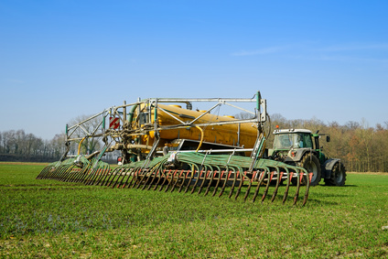

Suelo y fertilización
Abonos orgánicos
Statu quo
Disponibilidad en la zona
Guía sobre suelo y fertilización
Notes:
Organic fertilizer bear a range of benefits compared to mineral fertilizer. Most inorganic fertilizer are designed to provide the three macronutrients nitrogen (N), Phosphorus (P) and potassium (K). While these macronutrients are required in greater quantity for plant growth, secondary nutrients (calcium, sulfur, magnesium) as well as trace nutrients (boron, chlorine, manganese, iron, zinc, copper, molybdenum) are essential, too. Organic fertilizer always contain a number of different macro- and micronutrients (secondary-, tracenutrients) and thus support plant growth on a wider scale.
The long-term use of inorganic fertilizer can lead to soil acidification, which reduces the soils ability to redeliver nutrients to the plant. Usually this is undone by the application of lime, but generally, this process is negative for soil organisms, like earthworms and microorganisms, which are crucial to keep up soil fertility. Populations of beneficial microorganism were found to be higher in soils with a history of organic production practices but also these populations had a greater capacity for growth. Organic fertilizers like manure or compost also improve the humus content of the soil.
Besides what happens on the field, inorganic fertilizer have a negative effect on the environment during their production process. Many are synthesized from oil or are based on other non-renewable resources, which have to be mined.

