Slide 1
What biodiversity aspects product managers should consider?

Slide 2
Why manager responsible for products, quality, supply chains, procurement ?
Manager should consider biodiversity protection as an important aspect of the product quality and:
Select product /production standards with good biodiversity performance
Analyze the sourcing requirements of the own company and improve requirements with relevance for biodiversity
Underline in meetings with suppliers /producers/ farmers that biodiversity protection is a priority for the own company
Motivate the own company to facilitate guidelines and training for the farmers /producers/ suppliers
Initiate pilot initiatives to solve risks /challenges related to biodiversity and the most important commodities
Motivate the own company to incentivize farmers with sound biodiversity performance

Slide 3
Why manager responsible for products, quality, supply chains, procurement ?
Manager should consider biodiversity protection as an important aspect of the product quality and:
Added value for the product - added value for the company
To be prepared in regard to upcoming legislation
Attractive and innovative opportunities for marketing and communication
Access to new consumer groups (those looking for more sustainable products)

Slide 4
Fulfill requirements of the companies' sourcing guidelines
List here your company's procurement requirements relevant to biodiversity

Slide 5
Fulfill requirements of the companies' sourcing guidelines
List here your company's procurement requirements relevant to biodiversity

Slide 6
Biodiversity Management Tools

Slide 7

Why biodiversity management is needed?
Monitoring
Advice and Guidance
Facilitation of Evaluation
Bundle biodiversity activities
Assess biodiversity performance
Giving a roadmap for biodiversity improvement
photo © pixabay

Slide 8

Why biodiversity management is needed?
Some standards and companies are already asking for the development of nature conservation plan/ biodiversity action plan etc…..
In most cases it is not described how these plans should look like? How it should be elaborated? Which elements should be considered?
How is the situation in your company?
Is biodiversity considered in your company´s procurement requirements?
© pixabay

Slide 9
Why a biodiversity management is needed?
How is the situation in „name of the company“? Is Biodiversity considered?
List here the corresponding procurement requirement of your company

Slide 10
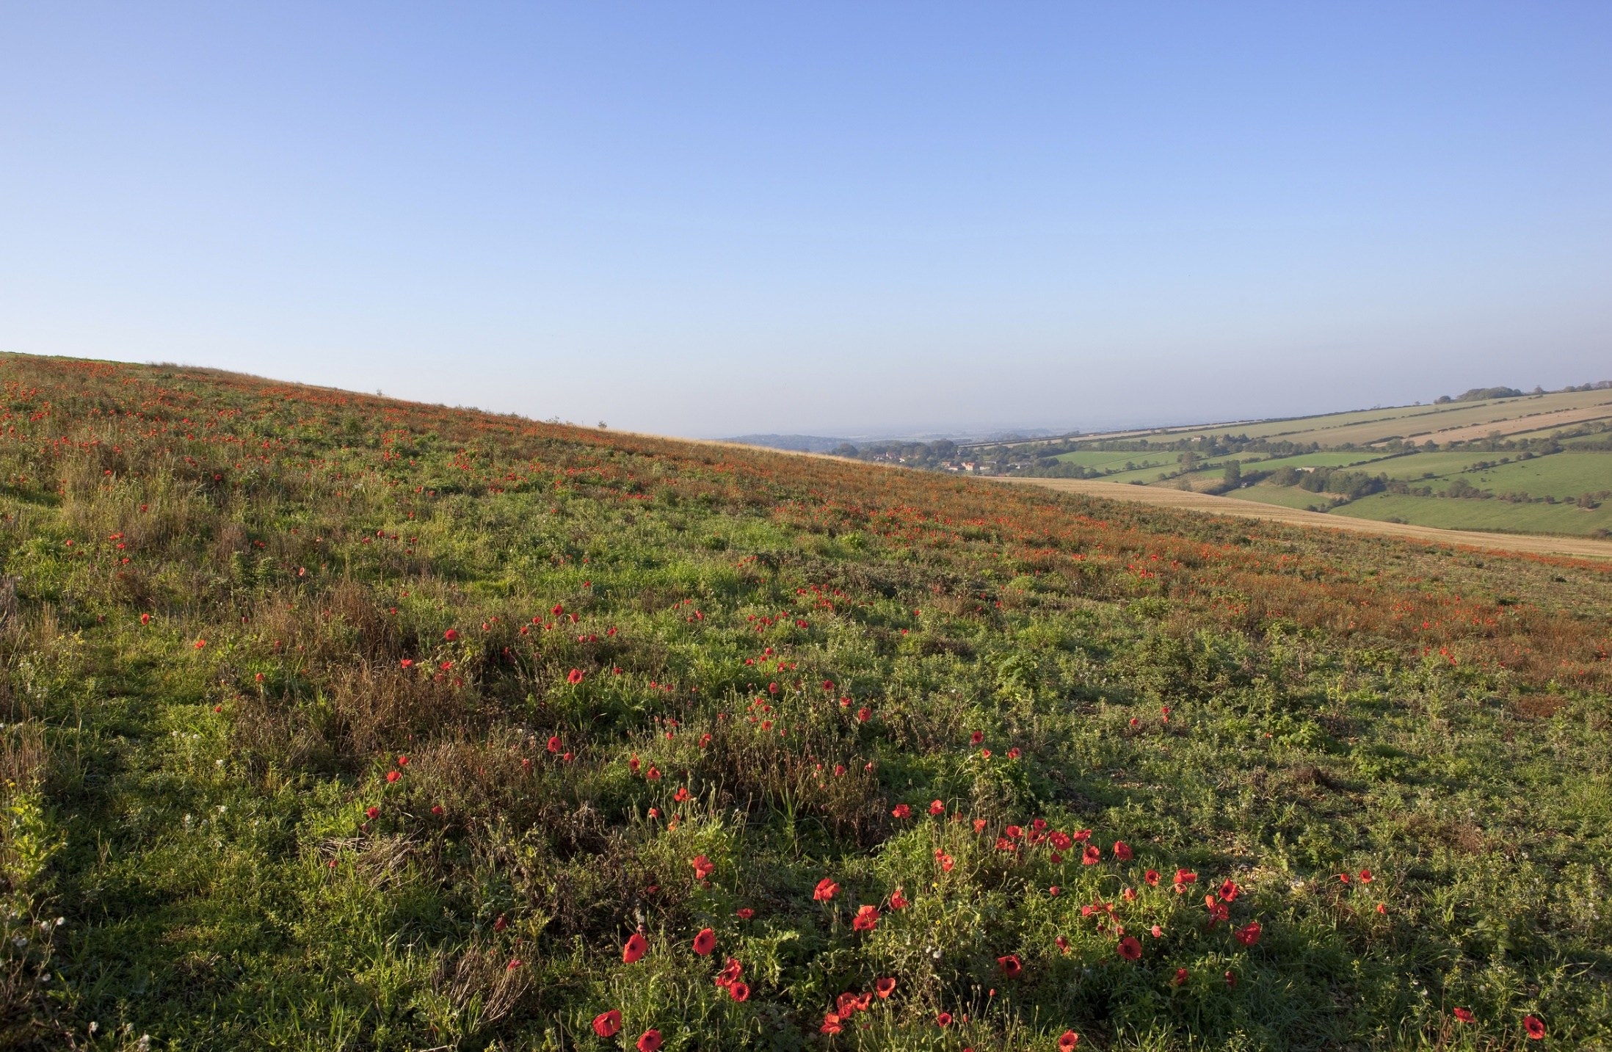
Biodiversity Management Tools
Two ways to go, one destination
The selfmade Biodiversity Action Plan - BAP
The Biodiversity Performance Tool
© pictures: pixabay

Slide 11
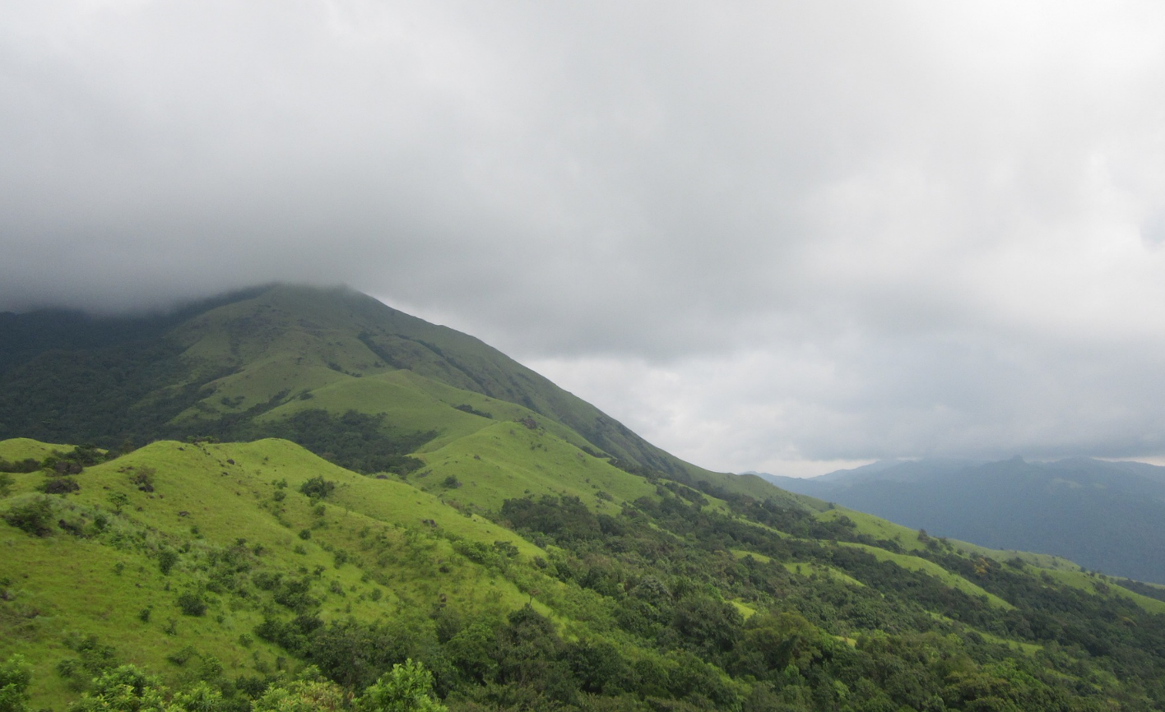
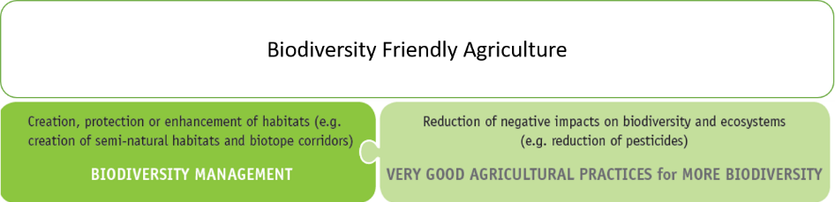
The selfmade BAP
Biodiversity Action Plan
Focus Areas
© pictures: pixabay
Notes:
The BAP should focus on the following two aspects:
The protection of existing biodiversity as well as the creation of potential for increasing biodiversity on the farm and its surroundings in order to increase resilience of productivity of agricultural ecosystems
The continuous reduction of negative impacts on biodiversity produced by agricultural activities (=Very good practices to ensure more biodiversity)

Slide 12

The selfmade BAP
Biodiversity Action Plan
Focus Areas
Principle of cooperation
Principle of continuous improvement
© pictures: pixabay

Slide 13
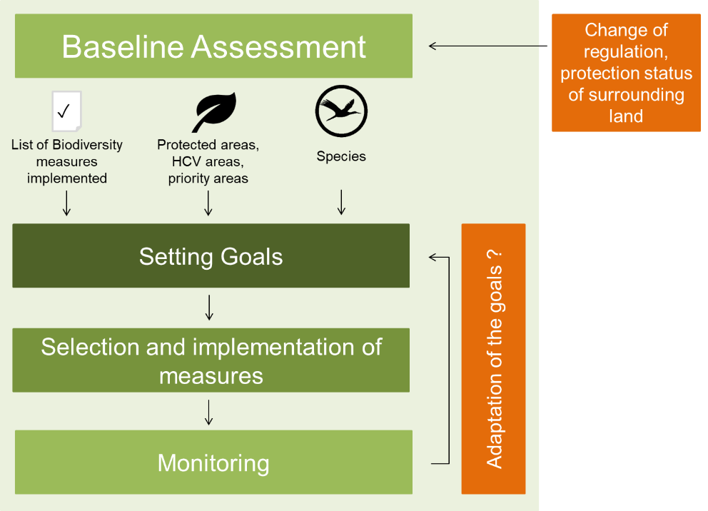
Biodiversity Action Plan
Structure and Method - The four steps
Should be reviewed and update:
  every three years
© pictures: pixabay

Slide 14


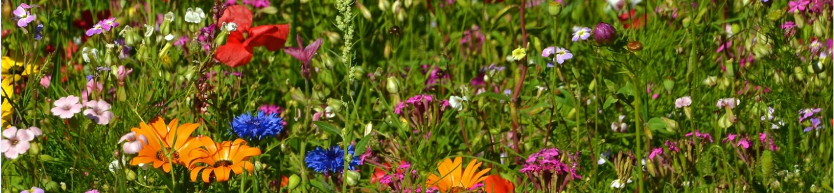
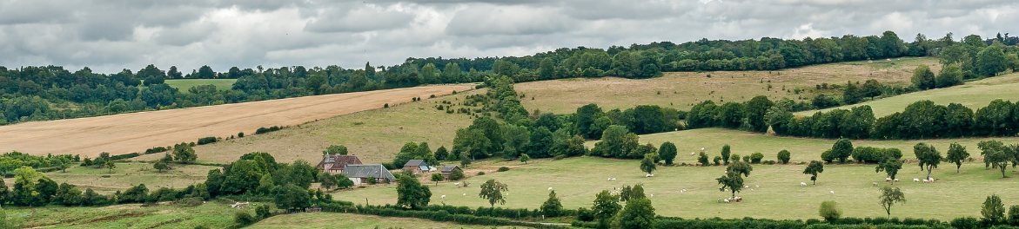

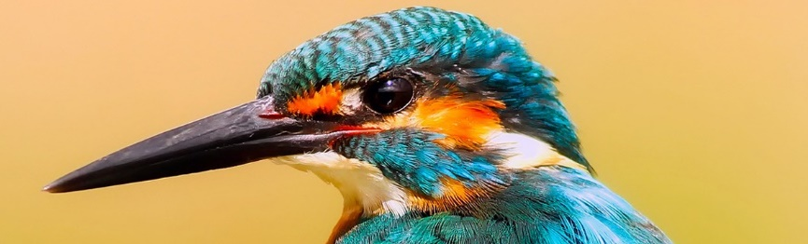

Biodiversity Action Plan
What information is needed?
List of biodiversity measures already implemented
Agricultural +
ecological areas
Species
© pictures: pixabay

Slide 15
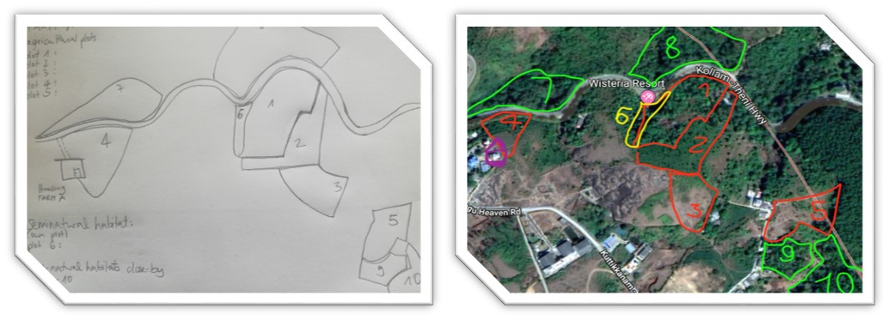
Biodiversity Action Plan - Baseline
What to do with this information?

Slide 16
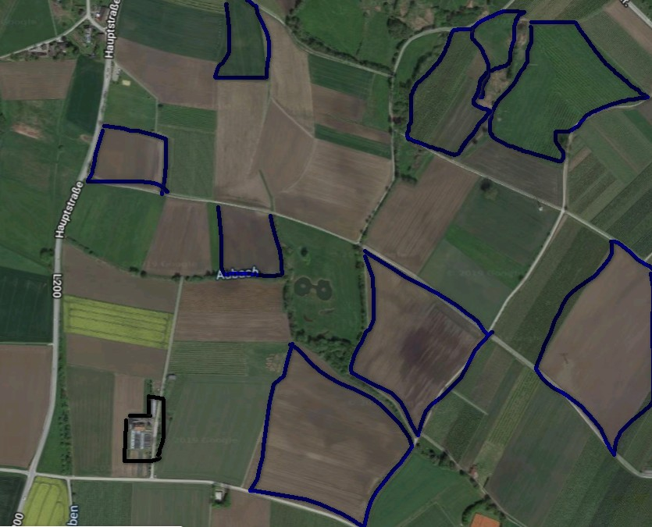
Biodiversity Action Plan - Baseline
What to do with this information?
Step 1: map agricultural land
Step 2: areas with high value for biodiversity
  Natural (primary) ecosystems
  Protected areas
  High Conservation Value Areas “HCVA”
Notes:
Colour legend:
Black = farm house
Blue = agricultural land

Slide 17

Biodiversity Action Plan - Baseline
Natural (primary) ecosystems
……. can be found in a given area in the absence of significant human management impacts.
This includes all naturally occuring
  flowing and still water bodies (streams, rivers, ponds…)
  wetlands
  forests (rainforest, lowland, needle leaf forest)
  other native terresteral ecosystems like woodlands, scrublands …..
What to do with this information?
Step 1: map agricultural land
Step 2: areas with high value for biodiversity
  Natural (primary) ecosystems
  Protected areas
  High Conservation Value Areas “HCVA”
Protected areas
……. are a clearely defined geographical space, recognized, dedicated and managed through legal or other effective means, to achieve the long-term conservation of nature.
A protected area can either be under public or private ownership.
Examples: National parks | Biosphere reserves | Natura 2000 areas ……
HCVAs
……. are natural habitats which are of outstanding significance or critical importance due to their high biological, ecological, social or cultural vaules.

Slide 18
Biodiversity Action Plan - Baseline
What to do with this information?
Step 1: map agricultural land
Step 2: areas with high value for biodiversity
  Natural (primary) ecosystems
  Protected areas
  High Conservation Value Areas “HCVA”
Notes:
Colour legend:
Black = farm house
Blue = agricultural land
Red = protected area

Slide 19
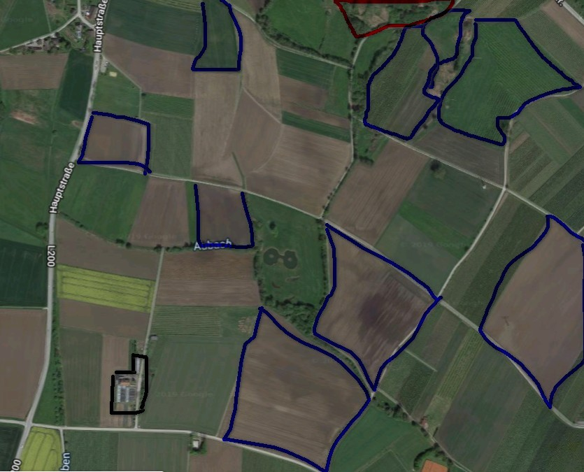
Biodiversity Action Plan - Baseline
What to do with this information?
Step 1: map agricultural land
Step 2: areas with high value for biodiversity
  Natural (primary) ecosystems
  Protected areas
  High Conservation Value Areas “HCVA”

Slide 20
Biodiversity Action Plan - Baseline
What to do with this information?
Step 1: map agricultural land
Step 2: areas with high value for biodiversity
  Natural (primary) ecosystems
  Protected areas
  High Conservation Value Areas “HCVA”
Step 3: semi-natural habitats
Semi-natural habitats
… are influenced by human activities but haven´t lost their structure and are very similar to natural habitats.
… are also artificially created habitats that have been largely left to develop naturally and host typical native plant and animal speices.
Examples: hedges | trees | set-aside areas ….
Notes:
Colour legend:
Black = farm house
Blue = agricultural land
Red = protected area

Slide 21
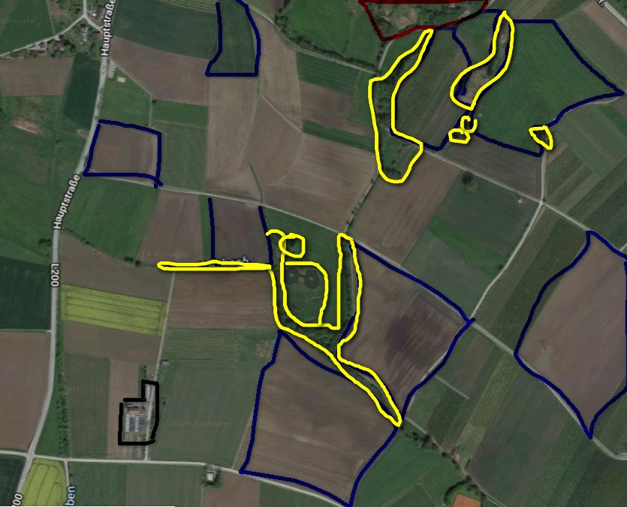
Biodiversity Action Plan - Baseline
What to do with this information?
Step 1: map agricultural land
Step 2: areas with high value for biodiversity
  Natural (primary) ecosystems
  Protected areas
  High Conservation Value Areas “HCVA”
Step 3: semi-natural habitats
Semi-natural habitats
… are influenced by human activities but haven´t lost their structure and are very similar to natural habitats.
… are also artificially created habitats that have been largely left to develop naturally and host typical native plant and animal speices.
Examples: hedges | trees | set-aside areas ….
Notes:
Colour legend:
Black = farm house
Blue = agricultural land
Red = protected area
Yellow = SNH

Slide 22
Biodiversity Action Plan - Baseline
What to do with this information?
Step 1: map agricultural land
Step 2: areas with high value for biodiversity
  Natural (primary) ecosystems
  Protected areas
  High Conservation Value Areas “HCVA”
Step 3: semi-natural habitats
Step 4: protected and endangered species
Protected/endangered species
Species of plants, animals and fungi designated as threatened and endangered by
national laws/classification systems
Listed as endangered or critically endangered by the IUCN Red List
And/or listed in Appendices I, II or III of the Convention on Internaional Trade in Endangered Species of Wild Fauna and Flora (CITES)
Notes:
Colour legend:
Black = farm house
Blue = agricultural land
Red = protected area
Yellow = SNH

Slide 23

Biodiversity Action Plan - Baseline
What to do with this information?
Step 1: map agricultural land
Step 2: areas with high value for biodiversity
  Natural (primary) ecosystems
  Protected areas
  High Conservation Value Areas “HCVA”
Step 3: semi-natural habitats
Step 4: protected and endangered species
Protected/endangered species
Species of plants, animals and fungi designated as threatened and endangered by
national laws/classification systems
Listed as endangered or critically endangered by the IUCN Red List
And/or listed in Appendices I, II or III of the Convention on Internaional Trade in Endangered Species of Wild Fauna and Floar (CITES)
Notes:
Colour legend:
Black = farm house
Blue = agricultural land
Red = protected area
Yellow = SNH
Orange dots = habitat of protected/endangered species

Slide 24
Biodiversity Action Plan - Baseline
What to do with this information?
Step 1: map agricultural land
Step 2: areas with high value for biodiversity
  Natural (primary) ecosystems
  Protected areas
  High Conservation Value Areas “HCVA”
Step 3: semi-natural habitats
Step 4: protected and endangered species
Step 5: measures for more biodiversity
Notes:
Colour legend:
Black = farm house
Blue = agricultural land
Red = protected area
Yellow = SNH
Orange dots = habitat of protected/endangered species

Slide 25
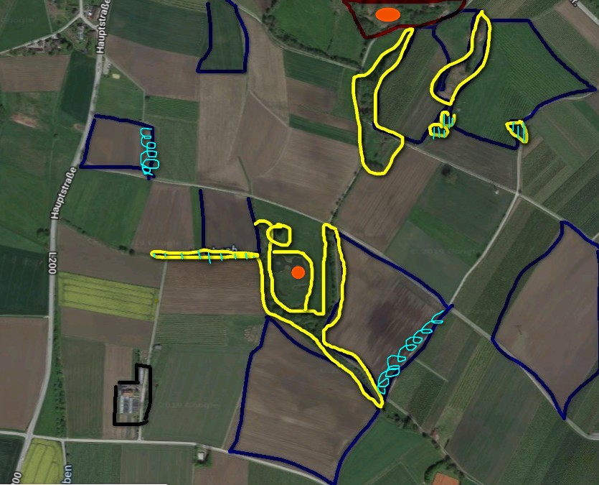
Biodiversity Action Plan - Baseline
What to do with this information?
Step 1: map agricultural land
Step 2: areas with high value for biodiversity
  Natural (primary) ecosystems
  Protected areas
  High Conservation Value Areas “HCVA”
Step 3: semi-natural habitats
Step 4: protected and endangered species
Step 5: measures for more biodiversity
Notes:
Colour legend:
Black = farm house
Blue = agricultural land
Red = protected area
Yellow = SNH
Orange dots = habitat of protected/endangered species
Turquoise = measures for more biodiversity

Slide 26
Biodiversity Action Plan - Baseline
Where to get this information?
Examples for sources of information:
  other farmers
  Standard/company technical advisors
  Local, regional or national authorities like national and state Biodiversity Authority
  Regional botanical surveys or studies
  NGOs for nature conservation
  Manager or staff of the closest nature reserve

Slide 27
Biodiversity Action Plan - Baseline
From your point of view:
What is easy to assess and which elements are more tricky to assess and why?
© pictures: pixabay

Slide 28
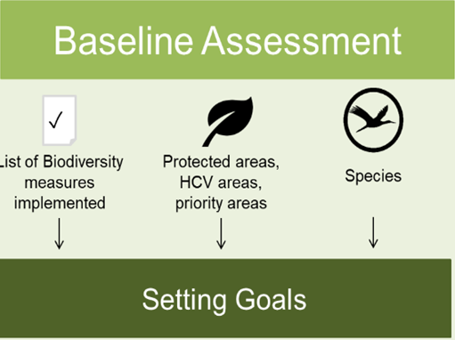
Biodiversity Action Plan
© pictures: pixabay

Slide 29

Biodiversity Action Plan – Setting Goals
Identify priorities
Main opportunities
Main impacts on
Two focuses:
Protection of habitats and ecological structures, protection of species
Reduction of negative impacts on biodiversity produced by agricultural activities
Notes:
A first step in setting goals is to identify priorities!
Both aspects must be considered:
Identify main opportunities for biodiversity, protect existing biodiversity elements and influence others positively
Identify main impacts on biodiversity, related to the agricultural/sourcing activities, which should be avoided and/or reduced.

Slide 30

Biodiversity Action Plan – Setting Goals
Main opportunities
What opportunities does our test farmer have?
Step 1: List the answers
Notes:
What are main opportunities to protect biodiversity and to create potential for biodiversity?
This question can be answered with the help of the developed map and the list of already implemented „biodiversity measures“. The farmer should have a look at both and ask himself questions like:
Which area are present?
Which points/aspects are covered quite well?
What is not considered so far?
Where and what could be done more?

Slide 31
Biodiversity Action Plan – Setting Goals
Main impacts on
What are the main impacts on biodiversity our test farmer could have?
Step 1: List the answers
Notes:
What are the main impacts on biodiversity that should be avoided and/or reduced?
To answer this question it could be helpful to look at the main drivers for the loss of biodiversity:
Degradation/destruction of ecosystems
Overexploitation of natural resources
Expansion of alien invasive species
Contamination
Climate Change

Slide 32
Biodiversity Action Plan – Setting Goals
Main impacts on
Step 2: Check land use changes!
Where will new land be installed?
What impact will it have on biodiversity?
Are land use changes essential?
Notes:
all questions:
Is the natural/semi-natural land that is subject to the transformation of high ecological value?
Are there habitats of protected/endangered species?
Would the “new” agricultural area be next to or in a protected area?
Would the “new” agricultural area be in or next to an ecological corridor?
Would the “new” agricultural area be in a water-scarce area with stressed water sources (rivers, creeks, lakes, groundwater)?

Slide 33
Biodiversity Action Plan – Setting Goals
Identify priorities
Main opportunities
Main impacts on
Setting measurable goals

Slide 34
Biodiversity Action Plan – Setting Goals
Step 3: Setting measurable goals
Example
Current situation | Possible opportunity …. | Goal
No trees present | …. to plant trees? | Increase the number of trees
Step 4: Prioritization
Goal
short term
low
medium
medium term
...
biodiversity measure
timeframe
benefits for biodiversity
long term
high
...
Notes:
further examples:
- Increase of semi-natural habitats (% of the total farm area)
- Increase of ecological corridor areas (size / % of corridors)
Goals should be prioritized

Slide 35
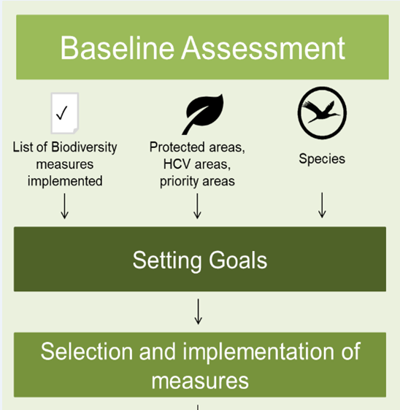
Biodiversity Action Plan
© pictures: pixabay

Slide 36

Biodiversity Action Plan - Measures
Step 1: selecting measures
Like the goals, also the measures can be prioritized.
This can be done by assessing each measure regarding:
how difficult it will be to implement (easy, medium, difficult)
the benefits for biodiversity (low, medium, and high)
and benefits for the resilience of the agricultural system (low, medium, high)

Slide 37
Biodiversity Action Plan - Measures
Goal
easy
low
medium
medium
...
biodiversity measure
complexity of implementation
benefits for biodiversity
high
high
...
benefits for farming
low
medium
high
....
.....
....
....

Slide 38
Biodiversity Action Plan - Measures
Step 2: selecting measures, what´s taken into account:
  reason for measure > biodiversity goal
  resources needed
  responsible person for implementation
  timetable for implementation
  expected positive effect/impact for biodiversity and resilience of the agricultural system
Step 3: List measures in table with information of 2,3,4,and 5

Slide 39
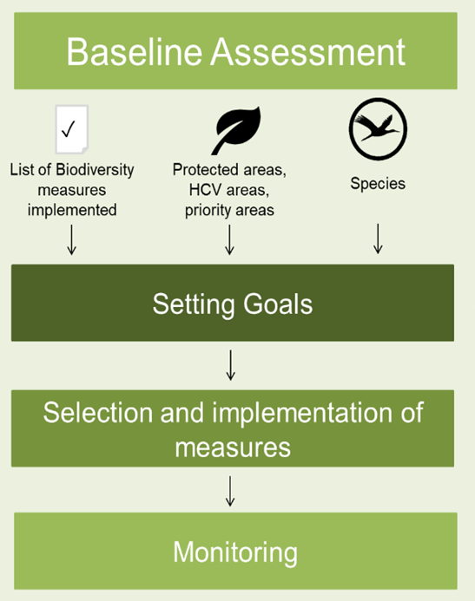
Biodiversity Action Plan
© pictures: pixabay

Slide 40


Biodiversity Action Plan - Monitoring
level 3 monitoring
level 2 monitoring
level 1 monitoring
3: Monitor characteristic species
© GIZ / Charlotte Haeusler
2: Check changes in biodiversity performance due to implemented measures
  e.g. Number of trees planted
1: Check implementation of measures
Guideline Biodiversity Action Plan
Methodical Guidelines Baseline Assessment, Setting Goals and Priorities, Monitoring
Notes:
First level - very simple:
Have the selected measures been implemented timely? Yes/No
Have they been implemented according to these guidelines? Yes/No
Have corrections been agreed in case the measures have not been implemented? Yes/No
This level of monitoring should be carried out every year.
Second level:
Focuses on the improvement of potential and reduction of negative impacts.
Key data and indicators must be selected according to the indicated goals and selected measures
This level of monitoring should be carried out every 2-3 year.
Third level - more complex:
Needs knowledge of the state of biodiversity and the occurrence of species on the farm and in adjacent areas.
Examples:
Endangered/protected species on farm (number of species)
Development of the population of 2 – 3 regional characteristic species (plants and/or animals) as indicators for the health of ecosystems and biodiversity increase
This level of monitoring should be carried out every 3-5 years.

Slide 41
Biodiversity Management Tools
Two ways to go, one destination
The selfmade Biodiversity Action Plan - BAP
The Biodiversity Performance Tool
© pictures: pixabay

Slide 42
Biodiversity Performance Tool
Biodiversity Performance Tool
A tool for agriculture
Principle of cooperation
Principle of continuous improvement
© pictures: pixabay

Slide 43
Biodiversity Performance Tool (BPT)
Screening of existing tools
Sustainability assessment (agronomical, ecological and socio-economical)
Biodiversity assessment
EFA
Farming practices + SNH/EI
EFA Calculator
IP Suisse
Gaïa Biodiversity Yardstick – Conservation Evidence
Cool Farm Tool
SNH/AEI
→ CFT biodiversity module
Farm Sustainability Assessment
Ecodiag
LEAF Sustainable Farming Review
Outil de Casino – Humanité et Biodiversité
Dialecte
Mixed farm
Multicriteria Tree Auximore (DEXi)
Indiciades
SMART - SAFA
Self CO2
Arable farm
Cap’2ER
Ruminant livestock
Indibio – Méthode BIOTEX
Ecopoints
PAEXA
Notes:
Background information: 17 tools have been screened in general, 10 focusing on sutainabilty assessment, 3 on biodiversity assessment and 4 on Ecological infrastructure/semi-natural habitat

Slide 44
Biodiversity Performance Tool (BPT)
Screening of existing tools
Sustainability assessment (agronomical, ecological and socio-economical)
Biodiversity assessment
EFA
Farming practices + SNH/EI
EFA Calculator
IP Suisse
SA
Cool Farm Tool
SA
Gaïa Biodiversity Yardstick – Conservation Evidence
SA
SNH/AEI
→ CFT biodiversity module
Farm Sustainability Assessment
SA
CI
Ecodiag
SA
LEAF Sustainable Farming Review
AP
Outil de Casino – Humanité et Biodiversité
SA
CI
Dialecte
Mixed farm
Multicriteria Tree Auximore (DEXi)
CI
Indiciades
SMART - SAFA
CI
Continuous improvement
Self CO2
SA
Arable farm
SA
Self-assessment
Cap’2ER
AP
Ruminant livestock
AP
Action plan
Indibio – Méthode BIOTEX
Ecopoints
PAEXA
CI
AP
Notes:
Background information: 17 tools have been screened in general, 10 focusing on sutainabilty assessment, 3 on biodiversity assessment and 4 on Ecological infrastructure/semi-natural habitat
General summary: non of the tools screened combined together the three key elements: continous improvement, self assessment, action plan

Slide 45
Biodiversity Performance Tool (BPT)
General information
Adapted to 4 European agro-climatic zones
Perform biodiversity performance assessment at farm level
Able to assess different farm types
  Cereal production
  Livestock: dairy and meat cattle
  Perennial productions: olive trees, vineyards
  Vegetable production
      Assess a farm over time and does not compare different farms.
      Able to reduce impacts on biodiversity and to create potentials by suggesting measures for improvement (Biodiversity Action Plan)
      Data can be saved

Slide 46
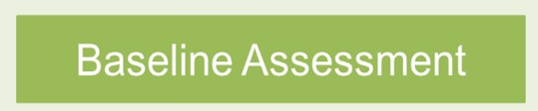
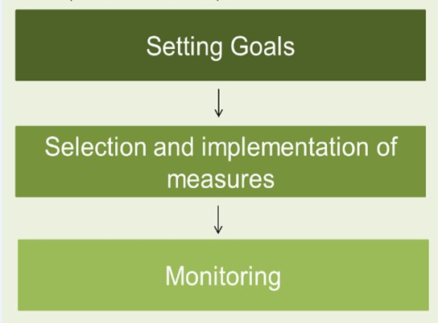
Biodiversity Performance Tool (BPT)
The four steps
Review and update should be adapted to the frequency of the audit
Other frequency could be every three years
© pictures: pixabay

Slide 47
Biodiversity Performance Tool (BPT)
Biodiversity assessment
Farming practices
Cooperation with external partners
Farm environment
(semi-natural habitats)
+
+
e.g. agrobiodiversity, preventing measures, quality of feeding, soil preservation…
e.g. training, monitoring…
e.g. richness, quality…

Slide 48









Biodiversity Performance Tool (BPT)
Biodiversity assessment
Farmer Interview
Farm description (last cultural season)
Farming practices and environment
+
Map analysis
Mapping of the surface area of SNH elements by category at farm level

Slide 49
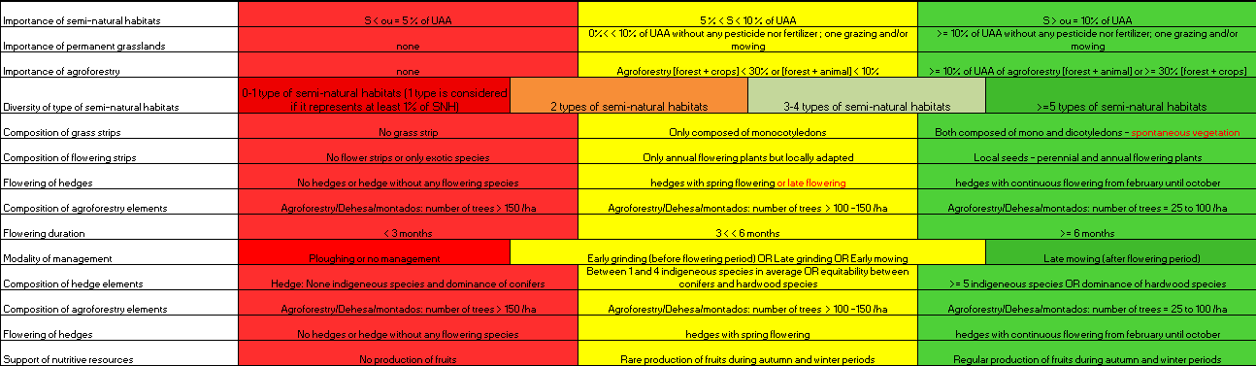
Biodiversity Performance Tool (BPT)
78 Indicators:
  24 indicators: farm environment
  42 indicators: farming practices
  12 indicators: socio-economic context
For each indicator threshold values are identified:

Slide 50
Biodiversity Performance Tool (BPT)
Impact scoring
  Strengths and weaknesses of the farm
+
STRENGTHS
WEAKNESS
List of indicators sorted by weights
SNH Richness
Quantity and diversity of SNH
Quality
Type of SNH
Management
-

Slide 51
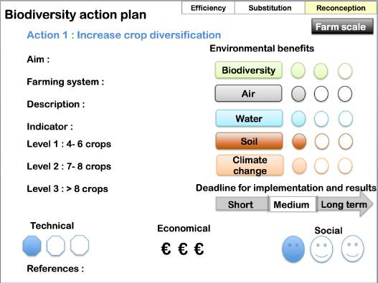
Biodiversity Performance Tool (BPT)
Biodiversity Action Plan
List of measures to improvement biodiversity performance of the farm
For each measure the following
additional information are given (see right side):
It is not excpected to implement all measures at once - continous improvement
Priorizing of the measures should be done together by the farmer and advisor
    Environmental benefits
    Cost
    Time for implementation
User Manual: Biodiversity Performance Tool

Slide 52
Biodiversity Performance Tool (BPT)
1: Check whether measures have been implemented and whether biodiversity performance has changed.
2. Export data to two level Biodiversity Monitoring System
Level 1: System wide monitoring. Data collected for every certified entity through certification applications (e.g. information self-reported by producers), audits and the Biodiversity Performance Tool.
Level 2: In-depth sampled monitoring beyond the scope of the certification audit by data generated on selected farms (different geographical settings, different type of crops). Monitoring of few key indicator species. Every 3 – 5 years.
User Manual: Monitoring System (available from autum 2019)

Slide 53
Thank you very much!
https://www.business-biodiversity.eu/en/life-food-biodiversity
  Knowledge Pool
  Action Facts Sheet
  User Manual
  Guidelines
  Easy Guide
  ……

