Slide 1
HOW BIODIVERSITY IS CURRENTLY CONSIDERED IN STANDARDS AND COMPANY REQUIREMENTS

Slide 2

















Baseline Report: Policy and criteria of
54 Standards and Companies screened

Slide 3
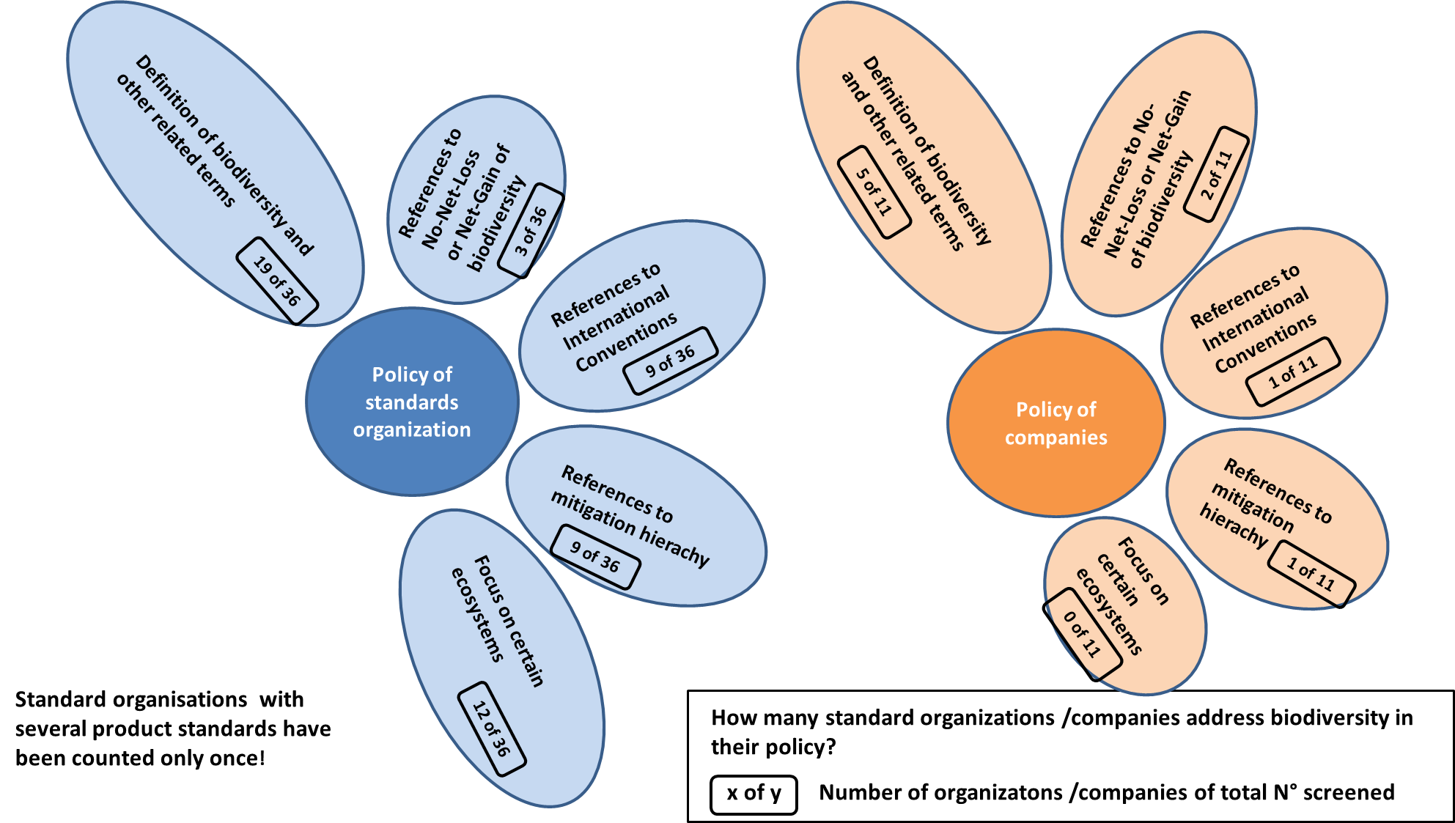
Baseline Report: Screening of 54 standards and sourcing guidelines
Biodiversity in the Policy of standard organizations and companies

Slide 4
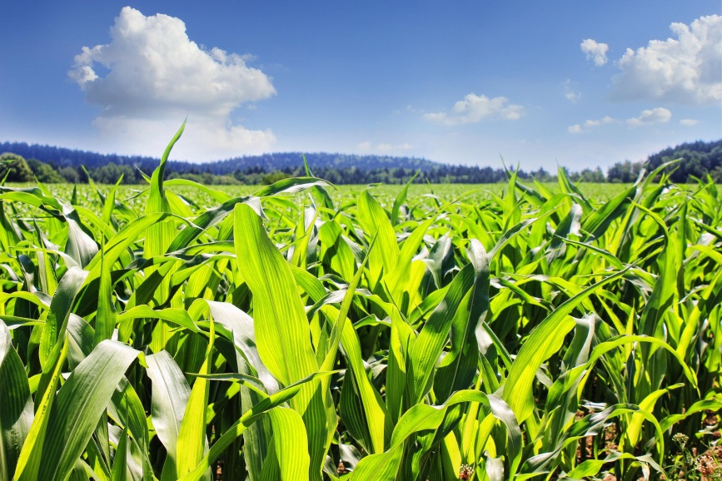
Baseline Report: Screening of 54 standards and sourcing guidelines
Biodiversity in the Criteria of standard organizations and companies
Following driver categories were chosen to structure the screening of criteria related to biodiversity:
  Destruction and Degradation of ecosystems
  Overexploitation of natural resources
  Loss of genetic diversity
  Alien invasive species
  Climate change
  Management
© pictures: pixabay

Slide 5
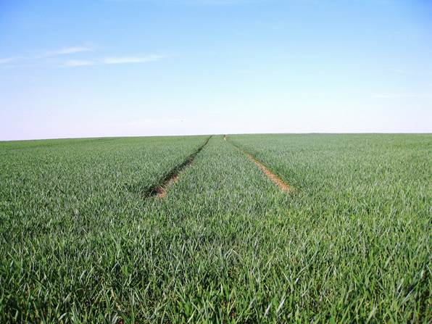
Baseline Report: Results of screening
Destruction and Degradation of Ecosystems
  International standards focus on the protection of water bodies /management of riparian strips and on the protection of primary habitats and protected areas.
  European/national/regional standards focus on grassland preservation, protection of primary and semi-natural habitats and protected areas as well as a minimum proportion of ecological structures /compensation areas.
  Companies focus strongly on the
  protection of water bodies /
  management of riparian strips.
  More than half of the criteria
  screened have been assessed as
  highly effective;
  auditors need a special expertise.
© pictures: pixabay

Slide 6
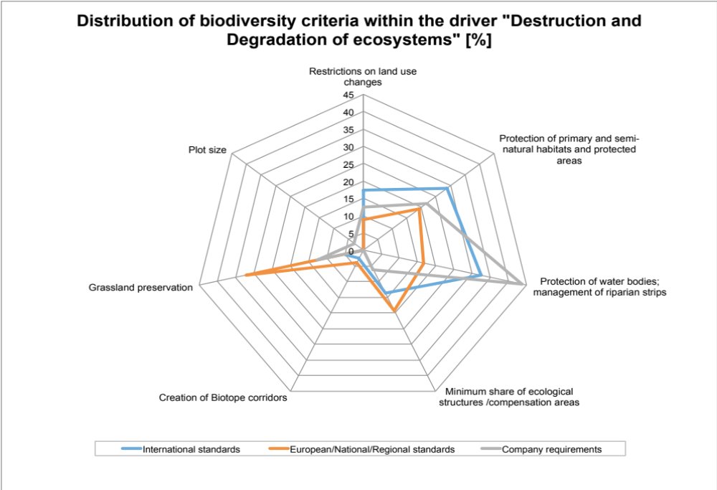
Baseline Report: Results of screening of criteria

Slide 7
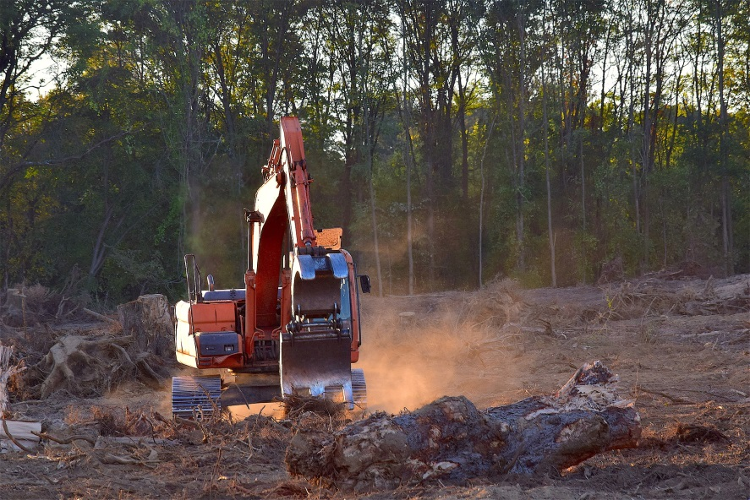
Baseline Report: Conclusions
Destruction and Degradation of Ecosystems
Standards should include criteria focusing on the avoidance of negative impacts on semi-natural ecosystems and protected areas.
The creation of biotope corridors on the farm as well as in the surroundings is not sufficiently considered.
None of the screened standards and companies request measures that go beyond the farm and require the coordination of several stakeholders.
Regarding ecological structures,
criteria of standards and companies
should go beyond legal requirements.
Not only the size, but also the quality
needs to be considered and therefore
it would be very effective to improve
the quality of ecological focus areas.
© pictures: pixabay

Slide 8

Baseline Report: Results of screening of criteria
Overexploitation of natural resources
  International standards focus mainly on restrictions regarding crop protection, other harmful substances or technologies; Handling of crop protection products, harmful substances or technologies; Use of nitrogen and phosphorus, soil fertility.
  For European, national and regional standards two aspects dominate: Use of nitrogen and phosphorus, soil fertility; and Restrictions regarding crop protection, other harmful substances or technologies. Handling of harmful substances is a less important aspect.
  Companies focus strongly on restrictions
  regarding crop protection, other harmful
  substances and technologies and the use
  of nitrogen and phosphorus, soil fertility.
  Around half of the criteria are considered
  to have an average effectiveness and to
  be verifiable.
© pictures: pixabay

Slide 9
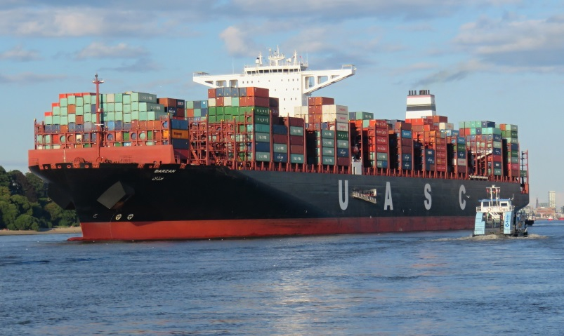
Baseline Report: Conclusions
Overexploitation of natural resources
  The application of “good agricultural practice” as is reflected in most criteria addressing this driver, is not enough to reduce negative impacts on biodiversity.
  Clearly there is a need for the implementation of “VERY good agricultural practice” regarding nutrients, soil fertility, crop protection, lifestock and grazing intensity, irrigation and water resources.
“Invasive alien species” and “Protection of species”
  Management of invasive alien species is rarely considered by standards and not considered by companies.
  All standards and companies include criteria
  for the management of ecological infra-
  structure and specific measures for the
  protection of species. But only very few
  include criteria for harvesting of wild plants.
  75 % of the criteria are rated as highly
  effective; 50 % require particular expertise
  from the auditor for verification
  (botanical and animal skills).
© pictures: pixabay

Slide 10

Baseline Report: Conclusions
“Loss of genetic diversity”
  GMO-free raw materials are a key factor for the preservation of biodiversity in the food industry. Seedfast (non-hybrid) crops are better adapted to natural conditions, making them less susceptible to pests and diseases and they often require fewer pesticides.
  The food industry and respective public authorities should
  support the development towards genetic diversification
  and traditional varieties by changing /adapting specifi-
  cation requirements that also recognize the qualities of
  traditional varieties.
Management
  Standards and companies should make clear improvements on the aspects of monitoring, cooperation with collective local /regional approach, cooperation with external experts and requirements for Biodiversity Action Plans.
  Standards should require the description of the current situation of biodiversity on the farm (baseline).
© pictures: pixabay

Slide 11
Overall conclusions regarding the current situation
Biodiversity is more and better considered than 5 years ago
Today all standards and companies requirements include criteria regarding protection of habitats
Some standards and companies requirements request biodiversity or nature conservation management plans. But baselines are not requested and minimum quality of plans is not defined.
Quality of measures implemented is key in order to increase potential for biodiversity
Only very few standards /companies request agricultural practices beyond “integrated agricultural practices”.
Good agricultural practice is not enough to stop loss of biodiversity! VERY good agricultural practise is required!
Currently non of the standards and companies can proof, biodiversity performance of their certified farms /suppliers. Sound biodiversity monitoring is needed!

Slide 12
Improvement of biodiversity protection in food production – Actors and roles
Farmers
Producer groups
Suppliers
Legislation
Subventions
Market regulations
Regional development programmes
Consumer protection
European Union
National governments
Regional governments
Food retailers
Food producing companies
Consumer
Guarantee for certain product qualities, production methods
Control of legal compliance
Orientation for consumers
Food retailers
Food producing companies
Voluntary Standards
International, national,
regional
Consumer

Slide 13
Improvement of biodiversity protection in food production – Options for action
Include biodiversity into policy and strategies
Improve criteria/requirements with relevance for biodiversity
Training of farmers and advisors
Support regional biodiversity projects
Implement monitoring system
Inform and sensitize food sector and the consumers regarding value of biodiversity
Request more strict legislation and/or implementation of legislation
Voluntary Standards
International, national, regional
Food retailers +
Food producing companies

Slide 14
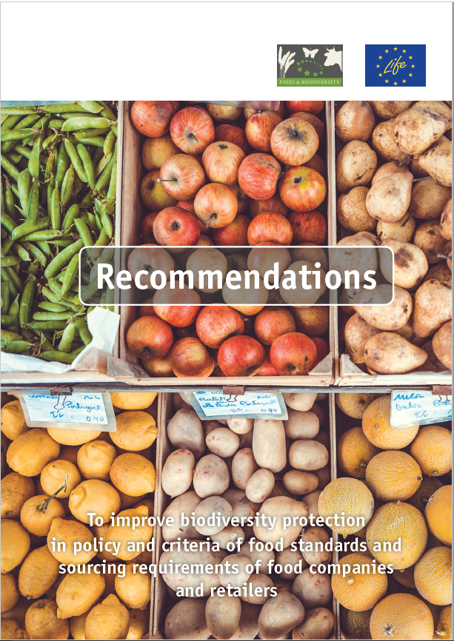
Recommendations for effective biodiversity criteria and sourcing requirements
Procedure of elaboration
Results and conclusions from Baseline Report
(54 Standards und Sourcing Guidelines screened)
Studies, model projects, agri-environmental programmes
Workshops with standards, companies, certifiers, scientific institutions, NGOs
Comments from many organisations
Available in English, German, French, Spanish, Portuguese
www.business-biodiversity.eu

Slide 15
Recommendations for effective biodiversity criteria and sourcing requirements
Structure
Biodiversity
mangement
More potential for biodiversity
Recommendations for standard and company policy
VERY good agricultural Practise
Reduction of negative impacts
Recommendations for processing companies and retailers
Support agro-biodiversity; sensitize consumers

Slide 16
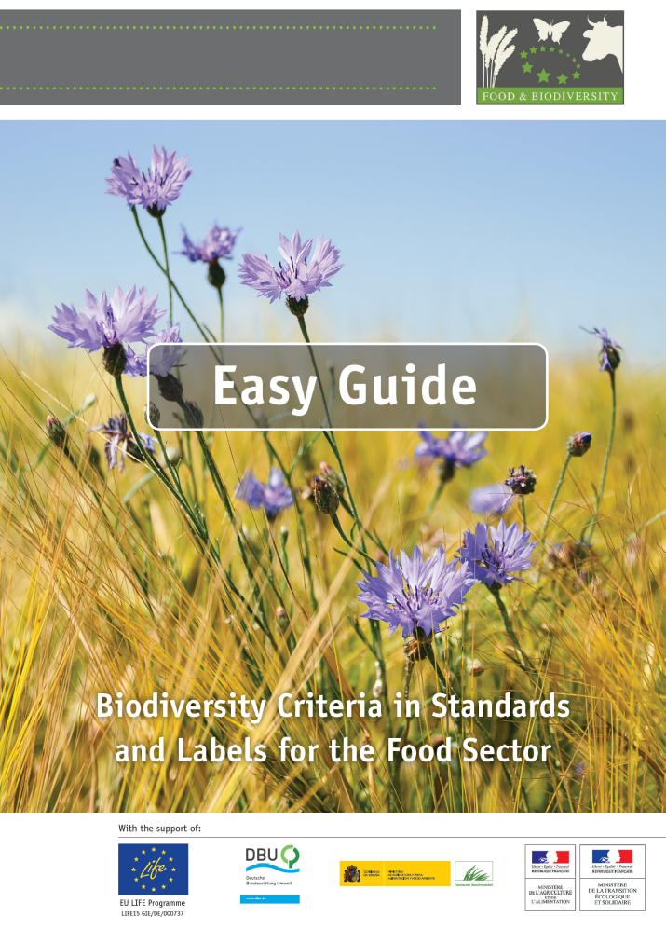
Easy Guide on Biodiversity
Is particularly designed for quality and procurement managers of companies that are responsible for purchasing food products.
The guide provides insights into the status quo of biodiversity criteria and measures in policies of standards and company requirements as well as an overview of formulations for effective biodiversity criteria.
The guide helps managers to assess the current situation and significance of biodiversity in relation to standards or procurement guidelines.

Slide 17







Thanks .…..
……. for the contribution of our partner standard organizations and companies

Slide 18
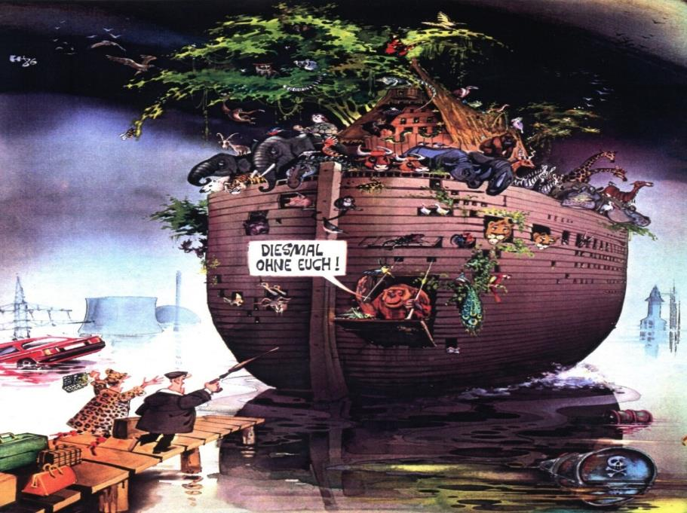
Thank you for your attention!

