Slide 1
HOW BIODIVERSITY IS CURRENTLY CONSIDERED IN STANDARDS AND COMPANY REQUIREMENTS

Slide 2

















Baseline Report: Policy and criteria of
54 Standards and Companies screened

Slide 3
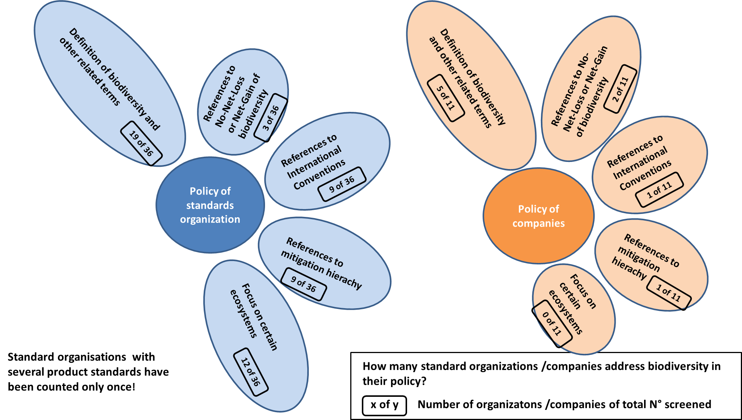
Baseline Report: Screening of 54 standards and sourcing guidelines
Biodiversity in the Policy of standard organizations and companies

Slide 4
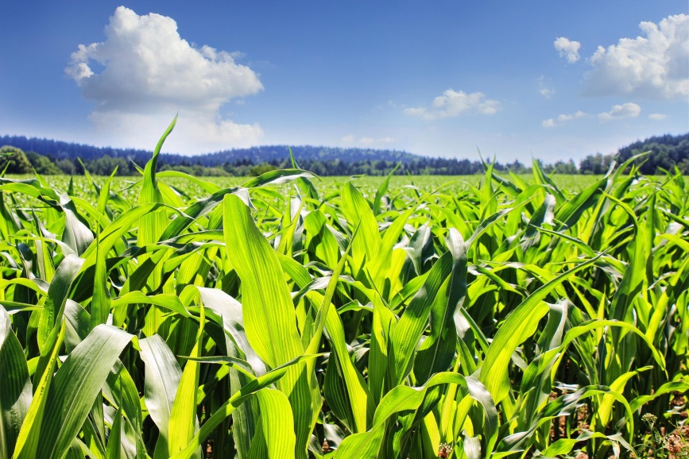
Baseline Report: Screening of 54 standards and sourcing guidelines
Biodiversity in the Criteria of standard organizations and companies
The following driver categories were chosen to structure the screening of criteria related biodiversity loss:
  Destruction and Degradation of ecosystems
  Overexploitation of natural resources
  Loss of genetic diversity
  Alien invasive species
  Climate change
  Management
© pictures: pixabay

Slide 5
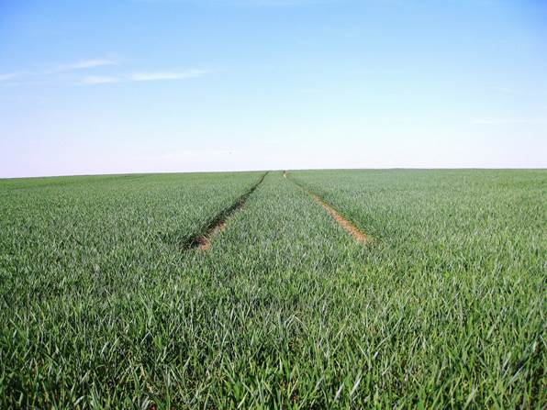
Baseline Report: Results of screening of criteria
Destruction and Degradation of Ecosystems
  International standards focus on the protection of water bodies /management of riparian strips and on the protection of primary and semi-natural habitats and protected areas.
  European/national/regional standards focus on grassland preservation, protection of primary and semi-natural habitats and protected areas as well as a minimum proportion of ecological structures /compensation areas.
  Companies focus strongly on the
  protection of water bodies /
  management of riparian strips.
  More than half of the criteria
  screened have been assessed as
  highly effective;
  auditors need a special expertise.
© pictures: pixabay

Slide 6
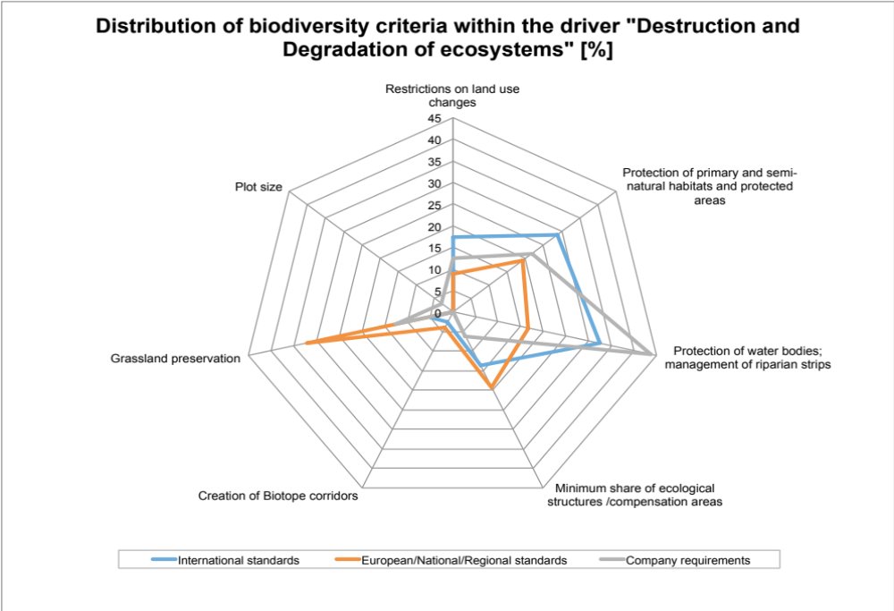
Baseline Report: Results of screening of criteria

Slide 7
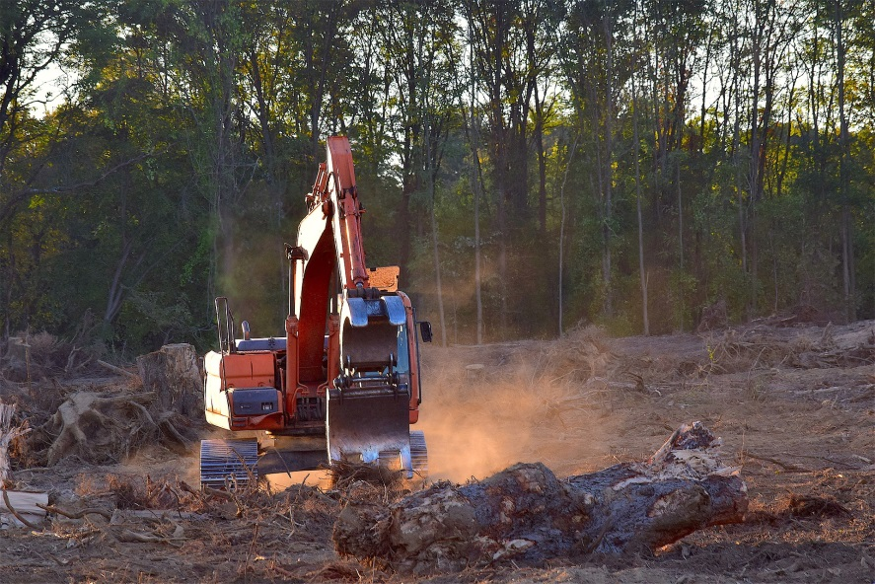
Baseline Report: Conclusions
Destruction and Degradation of Ecosystems
Standards should include criteria focusing on the avoidance of negative impacts on semi-natural ecosystems and protected areas.
The creation of biotope corridors on the farm as well as in the surroundings is not sufficiently considered.
None of the screened standards and companies request measures that go beyond the farm and require the coordination of several stakeholders.
Regarding ecological structures,
criteria of standards and companies
should go beyond legal requirements.
Not only the size, but also the quality
needs to be considered and therefore
it would be very effective to improve
the quality of ecological focus areas.
© pictures: pixabay

Slide 8

Baseline Report: Results of screening of criteria
Overexploitation of natural resources
  International standards focus mainly on restrictions regarding crop protection, other harmful substances or technologies; Handling of crop protection products, harmful substances or technologies; Use of nitrogen and phosphorus, soil fertility.
  For European, national and regional standards two aspects dominate: Use of nitrogen and phosphorus, soil fertility; and Restrictions regarding crop protection, other harmful substances or technologies. Handling of harmful substances is a less important aspect.
  Companies focus strongly on restrictions
  regarding crop protection, other harmful
  substances and technologies and the use
  of nitrogen and phosphorus, soil fertility.
  Around half of the criteria are considered
  to have an average effectiveness and to
  be verifiable.
© pictures: pixabay

Slide 9

Baseline Report: Conclusions
Overexploitation of natural resources
  The application of “good agricultural practice” as is reflected in most criteria addressing this driver, is not enough to reduce negative impacts on biodiversity.
  Clearly there is a need for the implementation of “VERY good agricultural practice” regarding nutrients, soil fertility, crop protection, lifestock and grazing intensity, irrigation and water resources.
“Invasive alien species” and “Protection of species”
  Management of invasive alien species is rarely considered by standards and not considered by companies.
  All standards and companies include criteria
  for the management of ecological infra-
  structure and specific measures for the
  protection of species. But only very few
  include criteria for harvesting of wild plants.
  75 % of the criteria are rated as highly
  effective; 50 % require particular expertise
  from the auditor for verification
  (botanical and animal skills).
© pictures: pixabay

Slide 10

Baseline Report: Conclusions
“Loss of genetic diversity”
  GMO-free raw materials are a key factor for the preservation of biodiversity in the food industry. Seedfast (non-hybrid) crops are better adapted to natural conditions, making them less susceptible to pests and diseases and they often require fewer pesticides.
  The food industry and respective public authorities should
  support the development towards genetic diversification
  and traditional varieties by changing /adapting specifi-
  cation requirements that also recognize the qualities of
  traditional varieties.
Management
  Standards and companies should make clear improvements on the aspects of monitoring, cooperation with collective local /regional approach, cooperation with external experts and requirements for Biodiversity Action Plans.
  Standards should require the description of the current situation of biodiversity on the farm (baseline).
© pictures: pixabay

Slide 11
Overall conclusions regarding the current situation
Biodiversity is more and better considered than 5 years ago
Today all standards and companies requirements include criteria regarding protection of habitats
Some standards and companies requirements request biodiversity or nature conservation management plans. But baselines are not requested and minimum quality of plans is not defined.
Quality of measures implemented is key in order to increase potential for biodiversity
Only very few standards /companies request agricultural practices beyond “integrated agricultural practices”.
Good agricultural practice is not enough to stop loss of biodiversity! VERY good agricultural practise is required!
Currently non of the standards and companies can proof, biodiversity performance of their certified farms /suppliers. Sound biodiversity monitoring is needed!

Slide 12
Improvement of biodiversity protection in food production – Actors and roles
Farmers
Producer groups
Suppliers
Legislation
Subventions
Market regulations
Regional development programmes
Consumer protection
European Union
National governments
Regional governments
Food retailers
Food producing companies
Consumer
Guarantee for certain product qualities, production methods
Control of legal compliance
Orientation for consumers
Food retailers
Food producing companies
Voluntary Standards
International, national,
regional
Consumer

Slide 13
Improvement of biodiversity protection in food production – Options for action
Legislation: Increase biodiversity protection
Subventions: Eliminate subventions for harmful production methods
Market regulations: No trading with countries destroying ecosystems; Tax incentives for biodiversity products ……
Regional development programmes: Support biodiversity friendly practises; support reseach, implement monitoring systems …….
Consumer protection: Prohibit use of harmful pesticides; information campaigns on value of biodiversity ……..
European Union
National governments
Regional governments
Voluntary Standards
International, national,
regional
Include biodiversity into policy and strategies
Improve criteria/requirements with relevance for biodiversity
Training of farmers and advisors
Support regional biodiversity projects
Implement monitoring system
Inform and sensitize food sector and consumers regarding value of biodiversity
Request more strict legislation; implementation of legislation
Food retailers
Food producing companies

Slide 14
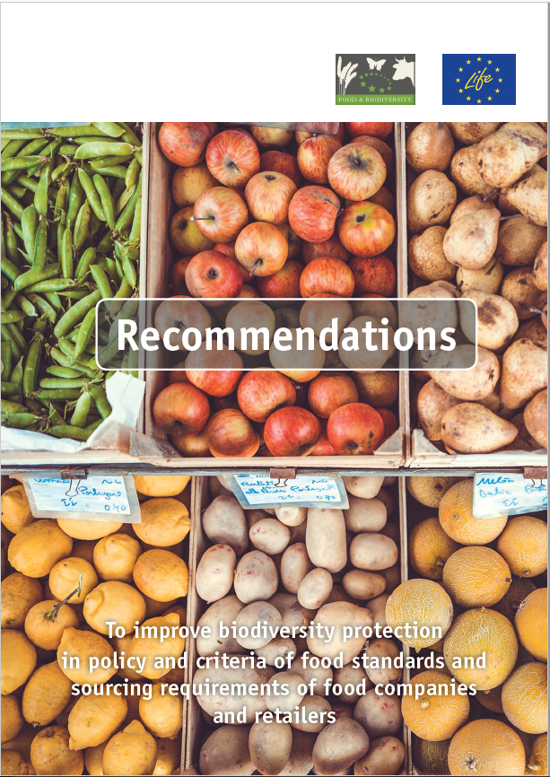
Recommendations for effective biodiversity criteria
Procedure of elaboration
Results and conclusions from Baseline Report
(54 Standards und Sourcing Guidelines screened)
Studies, model projects, agri-environmental programmes
Workshops with standards, companies, certifiers, scientific institutions, NGOs
Comments from many organisations
Available in English, German, French, Spanish, Portuguese
www.business-biodiversity.eu

Slide 15
Recommendations for effective biodiversity criteria
Structure
Biodiversity
mangement
More potential for biodiversity
Recommendations for standard and company policy
VERY good agricultural Practise
Reduction of negative impacts
Recommendations for processing companies and retailers
Support agro-biodiversity; sensitize consumers

Slide 16
Recommendations for effective biodiversity criteria
Biodiversity Management
Biodiversity Action Plan
Baseline assessment
Measures to create potential
Measures to reduce negative impacts
  Minimum share of semi natural habitats
  Creation of habitat corridors
  Preservation of grassland
  Management of semi-natural habitats
  Protection of species
Protection of primary (natural) ecosystems, semi-natural habitats and protected areas
Protection of water bodies; management of riparian strips
Prevent Introduction and Spread of Invasive Alien Species
Wild harvesting
Biodiversity Risk Analysis for Pre-Products (e.g. seeds, seedlings)

Slide 17
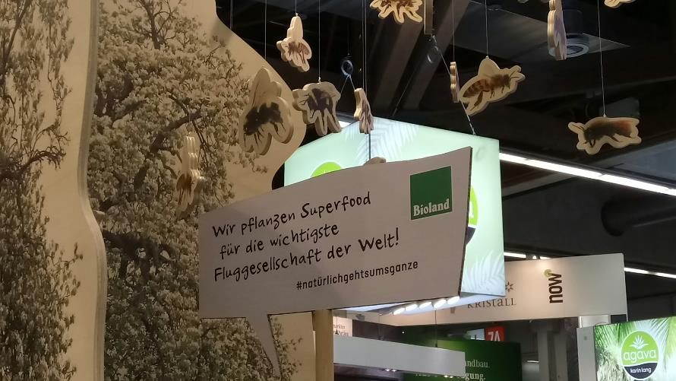
Recommendations for effective biodiversity criteria
VERY Good
Agricultural Practise
is needed !!
© pictures: Bodensee-Stiftung

Slide 18
Recommendations for effective biodiversity criteria
VERY Good Agricultural Practise
Soil and Fertilization
Standards/companies
require nutrient balances and provide proven methods
regulate crop-specific nutrient limits
provide guidelines for crop rotation (excluding permanent crops)
define requirements for an improvement of soil quality
establish requirements for the recognition and prevention of soil damage, i.e. erosion and compaction
Improvement of fertilizer management
Pest Management
The general principle and long-term objective: biological pest management + cultivation of crops that are adapted to the respective location.
The basis is the consequent implementation of all principles of the integrated pest management
The target is to reduce the negative impacts of pesticides on biodiversity as much as possible.
The strategy: Continuous improvement in terms of pesticide use (reduction in quantity and toxicity). The application of pesticides that are particularly harmful to biodiversity is excluded or strictly restricted.
Pesticide users are regularly trained and motivated in order to achieve the reduction target.

Slide 19
Recommendations for effective biodiversity criteria
VERY Good Agricultural Practise
Livestock
Criteria regarding the origin of feed stuff to prevent the destruction of ecosystems in other countries
Criteria that prevent overgrazing and destruction of agro-forestry ecosystems
Criteria to reduce the amount of imported feedstuff
Optimize water use for irrigation
Link between water source and water use (ecosystem and ecosystem service) is critical
Standard provides orientation values for water consumption and efficient irrigation systems
Standard defines threshold values for certain crops considering the climatic and local conditions
.

Slide 20
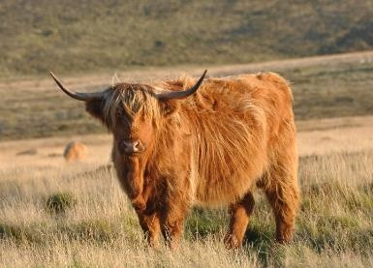
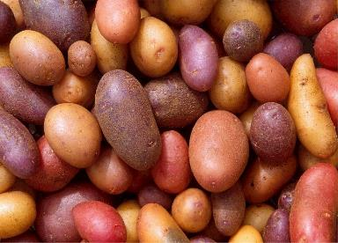
Recommendations for effective biodiversity criteria
Traditional crops and breeds….
The standard organization/company
contribute to create better market access for traditional varieties and breeds.
Farmers/suppliers who cultivate these will be rewarded = incentives
support initiatives for the further development of traditional varieties with the objective to fulfil current user expectations.
reward certified farms/suppliers that supplement agricultural production with educational, cultural, social and tourist activities which are aiming at promoting knowledge of agro-biodiversity
…….
© pictures: pixabay

Slide 21
A standard with sound biodiversity performance? Should consider the following aspects!
Biodiversity Action Plan with
  Baseline information (e.g. habitats, protected species)
  Identification of biodiversity issues in the region of sourcing/farming
  Measures to protect /restore semi natural habitats and promote ecological corridors
  Specific action to protect endangered species
Regular monitoring to assess improvement regarding development of biodiversity
Land Management
No production in primary ecosystems
Natural and semi-natural habitats on the farm must be identified and well managed
Areas of high value for biodiversity (e.g. protected areas, HCV areas, primary/diverse ecosystems etc.) must be protected
Promotion of semi natural habitats and their connectivity (protection, restoration, creation)
Promotion of collaboration between farmers with respect to nature and biodiversity conservation in the region

Slide 22
A standard with sound biodiversity performance? Should consider the following aspects! -2-
Invasive alien species
Invasive alien species on the farm are identified and reported to the responsible nature protection authority or technical institutes.
In case of imported products and before products are transported from the farm, the farm operator shall carry out an inspection to ensure that no invasive alien species entering or leaving the premises.
Collection of wild plants /hunting
No hunting, fishing, gathering of protected/endangered species
Wild collection has to be sustainable. Aspects to ensure sustainability (e.g. regeneration rates) must be defined

Slide 23
A standard with sound biodiversity performance? Should consider the following aspects! -3-
Soil management
Impact of water and wind erosion must be minimized and measures to counteract these events are required
Soil analysis (including organic matter content) must be conducted regularly
Soil should be covered as long as possible at least during times prone for nutrient leaching (rainy seasons)
Crop rotation patterns need to be addressed (e.g. on the total area of the farm a minimum of three different main crops (different crop families) are cultivated annually; at least a four years crops rotation is followed)
Grazing intensities must be defined and kept at a sustainable level (livestock unit/ha grassland)
Livestock production units must be self-sufficient in at least 50 % of the animal forage feed (calculated annually) and this feed must come mainly from direct grazing
GMO
The use of GMOs should be prohibited

Slide 24
A standard with sound biodiversity performance? Should consider the following aspects! -4-
Water management
Farmers must document the amount of water they withdraw. They prove that they are fully informed about the situation of aquatic ecosystems in their respective watershed
Overexploitation of water sources is strictly prohibited. Farmers must participate in a water management plan for the watershed
Irrigation patterns and methods must be evaluated and adapted to the regional situation
Degradation of water bodies is prohibited. Buffer zones of a certain size (e.g. 10 meters in width), covered with native vegetation must be established. Fertilization and the use of plant protection products on such elements is prohibited
Fertilizer and pesticide use
The use of organic fertilizers instead of mineral fertilizers is preferred
Substitute pre-emergence herbicides by mechanical weeding in early stages
Control disease/pest thresholds actively on each field and use fungicides/insecticides only after all preventive measures have been implemented and thresholds were verifiably met
The promotion of beneficial organisms is a key measure advised by the standards and a focal point of the farm operation’s preventative pest controls
The standard has a Negative List of Pesticides. Non-selective herbicides cannot be used

Slide 25







Thanks .…..
……. for the contribution of our partner standard organizations and companies

Slide 26
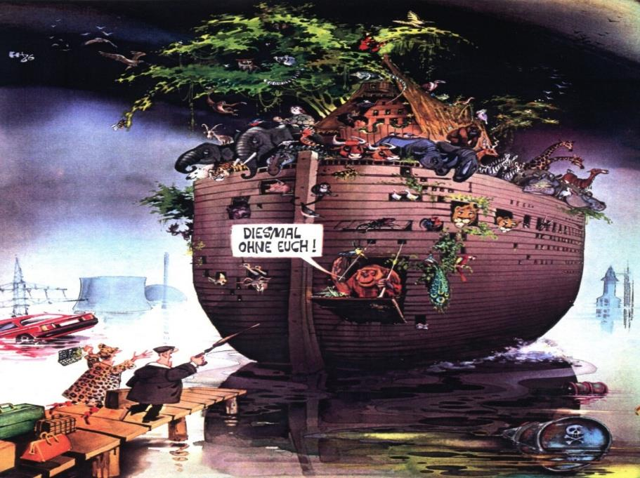
Thank you for your attention!

