Slide 1
Biodiversity, agriculture and food sector

Slide 2

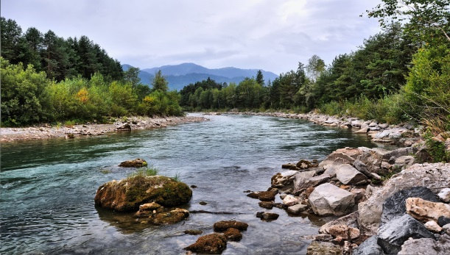
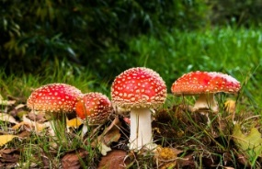
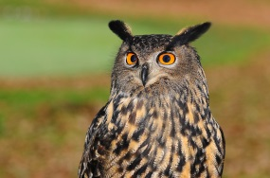
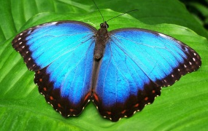
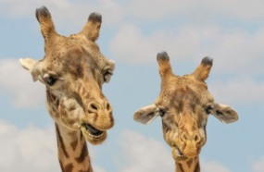
Biodiversity, agriculture and food sector
Loss of biodiversity – one of the biggest challenges of our time!
We don´t know how many organisms are living on our planet and how many we lose every year. Today only about 1,8 million plants and animals are described. But we know that species loss driven by human activities is occurring 1,000 times faster than it would under natural circumstances. The dramatic loss of biodiversity is not just happening in the so called hotspots of biodiversity, but also in Europe.
Genetic diversity
Diversity of ecosystems
Diversity of species
…and interrelation between species = Biodiversity - basis for life!
© pictures: pixabay

Slide 3
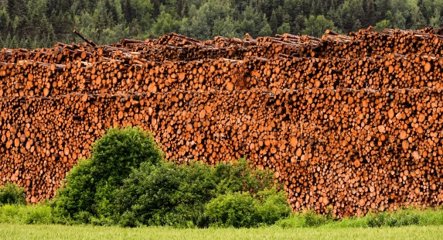
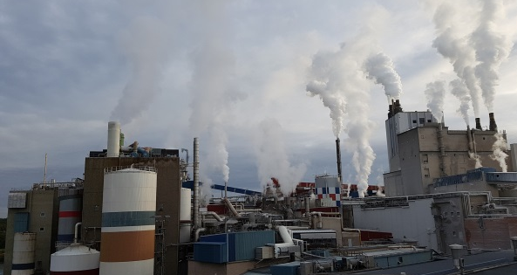


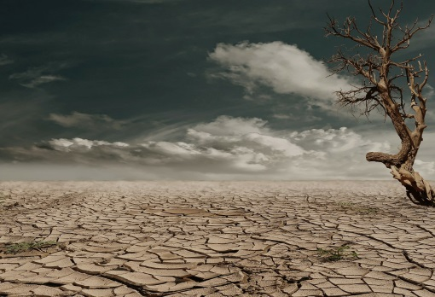
Biodiversity, agriculture and food sector
Main drivers for loss of biodiversity
Destruction of ecosystems
Contamination
Invasive species
Intensive agriculture is one of the main drivers of destruction of ecosystems, overexploitation of natural resources and contamination!
Ammonia and methane emissions have direct negative effects on human health and ecosystems. Methane is a climate forcer with global warming potential (GWP) about 28 times higher than CO₂ (IPPC)
© pictures: pixabay
Overexploitation of natural resources
Climate Change

Slide 4
Biodiversity, agriculture and food sector
Agriculture and biodiversity
Agriculture depends on Biodiversity
Biodiversity depends on Agriculture
In Europe, about 84% of 264 agricultural crops are pollinated by animals, particularly bees.
Approximately 50% of European species depend on agricultural habitats.
However
Since the 70ties, agriculture has been heavily intensified.
Globally, 50% of all habitats have been converted to farmland.
Utilized agricultural area in the EU covers 40% of the total land area.
Thus, globally, food systems are responsible for 60% of global terrestrial biodiversity loss.

Slide 5
Biodiversity, agriculture and food sector
Agriculture and biodiversity
Humankind
Biodiversity
enabled
enabled
Crop/lifestock variety
Population growth
enabled
Small scale farming
Intensification of land-use
causes
causes
Destruction of ecosystems
shapes
Overexploitation
Pollution
Landscape
destroys

Slide 6

Biodiversity, agriculture and food sector
Agriculture and biodiversity
Humankind
Biodiversity
enabled
enabled
Crop/lifestock variety
Population growth
enabled
Small scale farming
Intensification of land-use
causes
causes
Sustainable
agriculture
Destruction of ecosystems
shapes
Overexploitation
Pollution
Landscape
destroys
Frequently Asked Questions

Slide 7
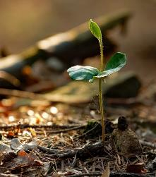
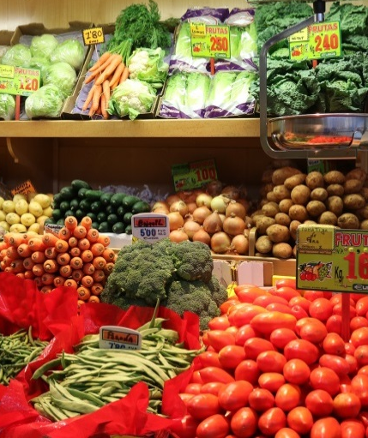
Biodiversity, agriculture and food sector
Good arguments for improving biodiversity performance
Soil biodiversity = basis for successful agriculture
Intact ecosystems and related species = providing ecosystem services, key element for resilience against impacts of climate change. Example:
Aquatic ecosystems = providing water and micro climate
Genetic diversity = key element for resilience against impacts of climate change
Traditional varieties and breeds (agro-biodiversity) = key to food sovereignty and local development
© pictures: pixabay

Slide 8
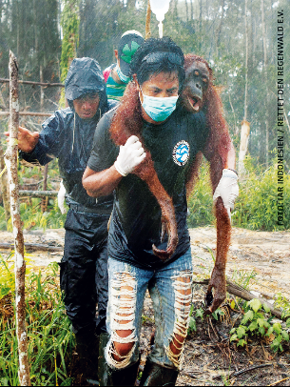
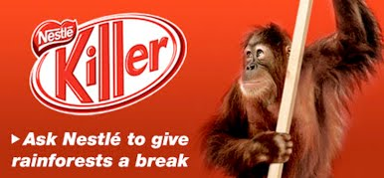
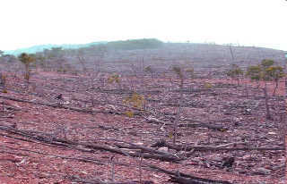

Biodiversity, agriculture and food sector
Good arguments for improving biodiversity performance
Increased sensitivity of consumers
Change of consumer behavious
Increased risk to be involved in scandals related to biodiversity destruction
Increasing requirements from food companies and retailers
More strict legislation and regulations (e.g. EU Pesticides Directive, EU Pollinators Initiative ….)

Slide 9

Biodiversity, agriculture and food sector
79%
Increasing sensitivity of consumers
79%
UEBT Biodiversity Barometer 2017
„Companies have a moral obligation to assure they have a positive impact“
Biodiversity awareness continues to grow!
73%
„It makes me feel good when I buy a product that respects people and biodiversity“
„…positive impact can be created for people and biodiversity all along the supply chain.“
Active contribution to biodiversity conservation convinces people most that a brand respects people and biodiversity
„Increased attention is paid to harvest techniques, working conditions, and mitigation of environmental impacts.“

Slide 10
Biodiversity, agriculture and food sector
Increasing sensitivity of consumers
Attitudes towards Biodiversity:
“Respondents are most likely to say that they have heard of the term “biodiversity” and know what it means in Austria, Germany (both 80%) […]” (EU-Eurobaromenter Biodiversity 2013)
“Over three quarters of Europeans very much agree that it is important to halt biodiversity loss because it is a moral obligation” (EU-Eurobaromenter Biodiversity 2013)

Slide 11
Biodiversity, agriculture and food sector
Increasing sensitivity of consumers
= increasing demand for products certified by sustainability standards
UTZ
Certified coffee volume almost doubled from 2011 to 2016 (476.903 MT to 870.102 MT)
Certified cocoa volume almost fivefold from 2011 to 2016 (212.690 MT to 1.188.166 MT) (Annual report, 2017)
Fairtrade
Revenue of Fairtrade foodstuff from Europe increased more than 50% from 2016 to 2017
Highest increase is recorded for tropical fruits with an increase of 22% (77.406 T to 94.256 T)
Coffee, which has the highest sales of all Fairtrade products (34,3%), increased 8% (20.014 T to 21.529 T) (Forum Fairer Handel, 2018)
Aquaculture Stewardship Council (ASC)
founded in 2010, reached a production volume of about 1.1 MT in 2016 (ASC Strategic overview 2017-2021)

Slide 12
Biodiversity, agriculture and food sector
Increasing sensitivity of consumers
= increasing demands for products certified by organic standards
The world of organic agriculture - Booming organic sector = 57,8 million hectares / 90 Billion US Dollars (2016). Top markets in billion Euro: USA (38,9), Germany (9,5) France (6,7). FIBL, 2018
EU Organic Farming
Organic Production is on the increase:
2002: 5.6 million ha,
2012: 10.0 million ha
2016: 11.9 million ha
    increase from 2012 – 2016: 18.7 %
(EU Commission: The EU organic Farming (R)evolution; Eurostad, Data from 10/2017)

Slide 13

Biodiversity, agriculture and food sector
Increasing sensitivity of consumers
= increasing requirements of food companies and retailers
“In its guideline for sustainable management, REWE Group is committed to the conservation and protection of natural ecosystems and supports the goals of the UN Convention on Biological Diversity.”
"REWE Group's goal is [...] to develop and market more sustainable products. The protection of biological diversity is an essential component of the ecological quality of products.

Slide 14


Biodiversity, agriculture and food sector
Increasing sensitivity of consumers
= increasing requirements of food companies and retailers
„The business case for protecting biodiversity is quite simple. Without biodiversity, there is no business “
"For ALB-GOLD, the conservation of biodiversity is one of the central challenges of our society."
„We want to inspire farmers to start their own Biodiversity Action Plans“

Slide 15
Biodiversity, agriculture and food sector
Exchange of experience
How do you experience biodiversity in your
daily work?

