Slide 1
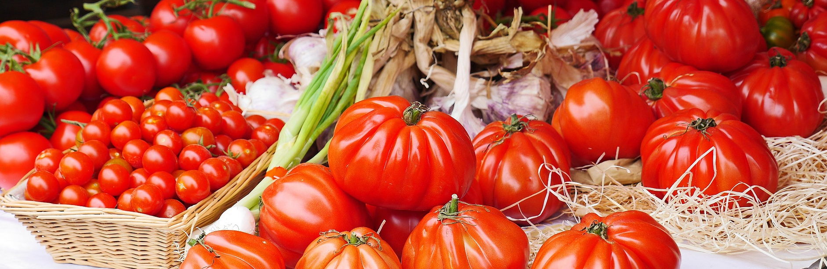
Very Best Agricultural Practices
Agro - Biodiversity
© pictures: pixabay

Slide 2
1. What is agro-biodiversity
“The variety and variability of animals, plants and micro-organisms that are used directly or indirectly for food and agriculture, including crops, livestock, forestry and fisheries. It comprises the diversity of genetic resources (varieties, breeds) and species used for food, fodder, fibre, fuel and pharmaceuticals. It also includes the diversity of non-harvested species that support production (soil micro-organisms, predators, pollinators), and those in the wider environment that support agro-ecosystems (agricultural, pastoral, forest and aquatic) as well as the diversity of the agro-ecosystems.” (FAO, 1999a).
Witin this training guide the focus is on plant and animal genetic resources (varieties and breeds) and species used for food.

Slide 3
2. Why it is relevant
Cultural heritage
10.000 years of human intervention → 7.000 crop species and 7.600 animal breeds
Nutritional safety
Livelihood for 1.2 billion people (smallholders)
Economic relevance
Food, employment, income: 170.000 products, 600.000 employees and 179,6 billion € annual sales only in Germany (2017)
Ecological services
Genetic diversity of crop species and animal breeds is an insurance for our future nutrition → changing environmental conditions, new pests, shortage of resources e.g. for synthetic fertilizer

Slide 4
2. Why it is relevant (continued)
Example current situation plant genetic resources
300.000-500.000
plant species globally
30.000 edible
7.000 used and cultivated
30 species deliver 95% of plant based food

Slide 5
3. Elements of Very Good practices
Two ways of preserving and promoting agro-biodiversity
Ex-situ conservation
Preservation of seed material outside of its natural range in a gene bank.
Facts
More than 1750 gene banks worldwide
7.4 million accessions; therefrom 6.6 million held by national governments
One of the largest gene banks is the Svalbard Global Seed Vault (SGSV) located on the Spitzbergen archipelago (Norway), comprising more than 800.000 accessions

Slide 6
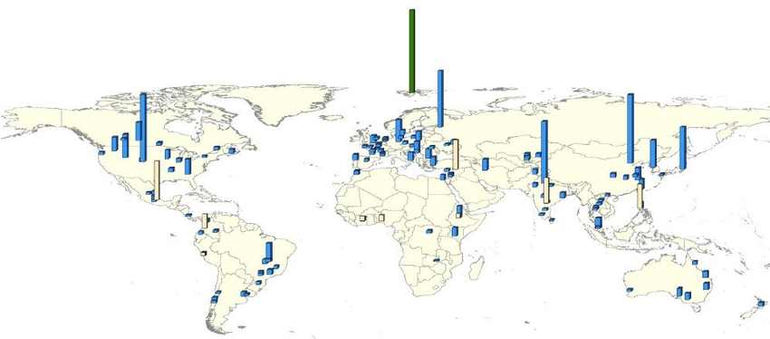
3. Elements of Very Good practices
Ex-situ conservation
Geographic distribution of genebanks with holdings of >10,000 accessions; national and regional genebanks in blue, CGIAR centres genebanks in beige, SGSV in green (Source: FAO, 2010)

Slide 7
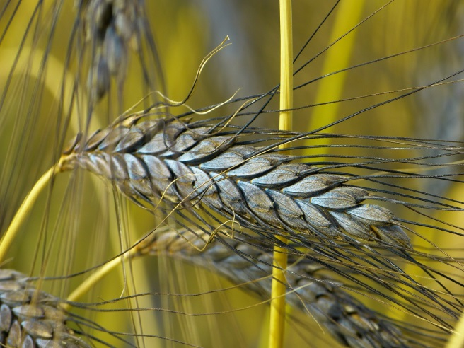
3. Elements of Very Good practices
2. On-farm conservation
A special form of in-situ conservation where genetic material is preserved through cultivation in its natural habitat range and that is thereby exposed to natural conditions.
Advantages compared to Ex-situ conservation:
Exposure of genetic resources to field conditions enables constant development of a strong relation to location and cultivation technique, adaptation to regional conditions and a changing environment
Positive example: Rediscovery of the white Swiss Emmer
http://www.emmer-einkorn.ch
© pictures: pixabay

Slide 8
3. Elements of Very Good practices
Examples of advocates of on-farm agro-biodiversity
Pro Specie Rara
  Protection of endangered farm animal breeds and crop plants from extinction
Slow Food Foundation for Biodiversity
  ‚Ark of Taste‘ catalogue of traditional products
  Presidia label to sustain quality production at risk of extinction, protect unique regions and ecosystems, recover traditional processing methods, safeguard native breeds and local plant varieties
CAPSELLA Project
  ICT solutions tailored to the needs of food, field and seed related actors engaging in agro-biodiversity
SAVE Foundation
  ‘Safeguard for Agricultural Varieties in Europe’
Breeder associations
Individuals
  Private seed bank of Manfred Hahm-Hartmann with >1000 varieties of tomato

Slide 9
4. What are the opportunities
Auditors
Auditors lack an explicit assignment in the frame of this training
  verify and report compliance of criteria of a certified entity
  time restriction for any additional action
Idea
Auditors can distinguish between conventional species and native, endangered species on the farm, if:
  a respective criterion that aims at detecting the variety of cultivated species/breeds is to be verified anyway during the audit process
Potential benefit
  trigger development of a criterion on traditional species/breeds
  reveal the number of unreported cases where traditional species/breeds occur on certified farms → Overview on farms promoting agro-biodiversity

Slide 10

Thank you very much!
https://www.business-biodiversity.eu/en/life-food-biodiversity
  Knowledge Pool
  Action Facts Sheet
  User Manual
  Guidelines
  Easy Guide
  ……

