Slide 1
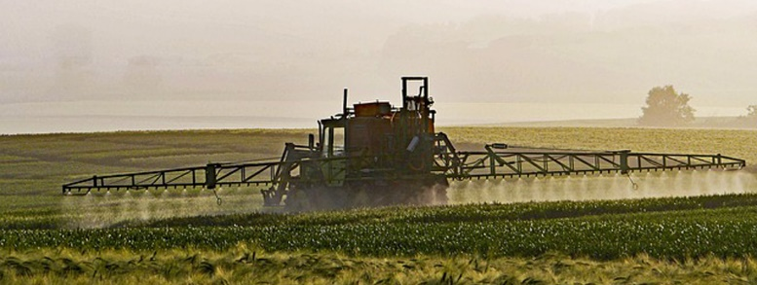
Plant Protection
© pictures: pixabay

Slide 2
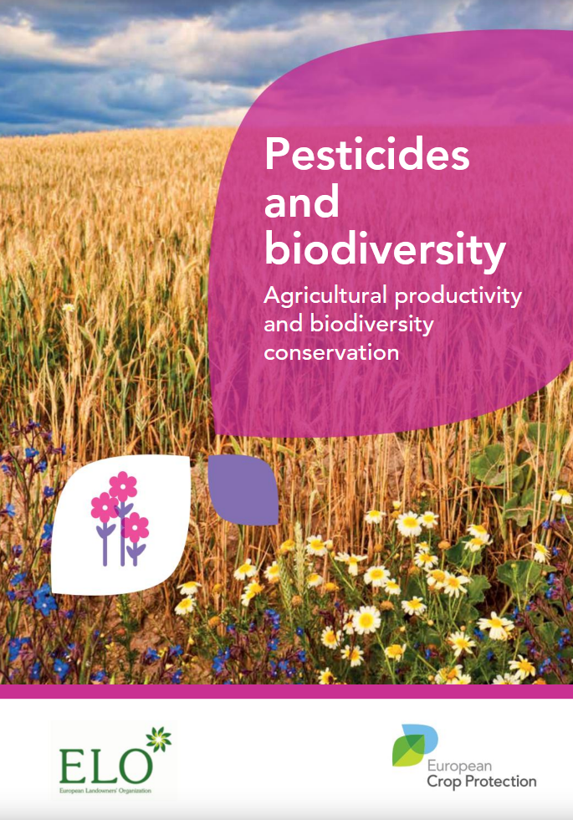
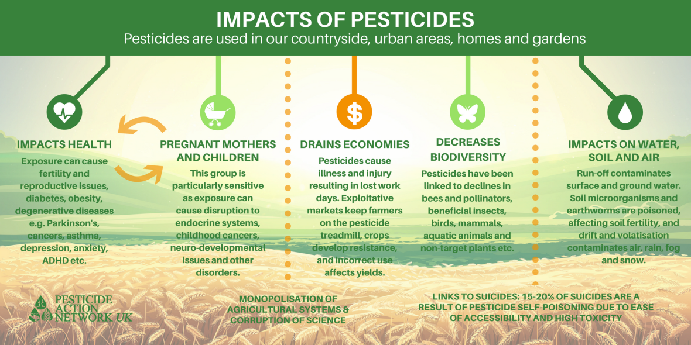
Plant protection
SOURCE: http://www.pan-uk.org/site/wp-content/uploads/Impacts-of-pesticides-infographic.png
Notes:
https://www.theguardian.com/us-news/2018/apr/30/fda-weedkiller-glyphosate-in-food-internal-emails
US government scientists have detected a weedkiller linked to cancer in an array of commonly consumed foods, emails obtained through a freedom of information request show.
The Food and Drug Administration (FDA) has been testing food samples for residues of glyphosate, the active ingredient in hundreds of widely used herbicide products, for two years, but has not yet released any official results.
But the internal documents obtained by the Guardian show the FDA has had trouble finding any food that does not carry traces of the pesticide. […]

Slide 3
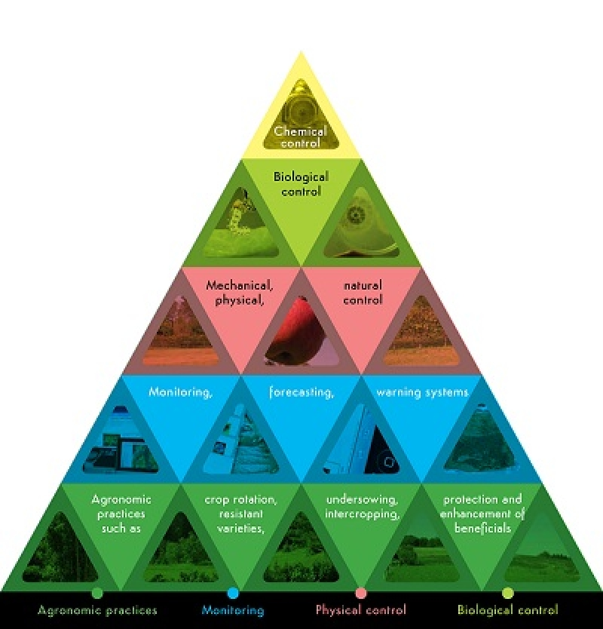
Plan protection
IPM – Integrated Pest Management
IPM Status Quo
8 principles
General avoidance of psm
Demanded by pesticide directive but not enforced properly
IPM Recommendation
! Consequent implementation of all principles of the integrated pest management (IPM³)
Source: www.low-impact-farming.info
Notes:
In Europe, the application of have pesticides as to comply with the integrated pest management concept. Monitoring of the pest levels, crop rotation, mechanical soil preparation, good water and nutrient management, seeding rates and depths, and biological pest control must proceed the inevitable use of pesticides. Crop rotation e.g. focuses on the reduction of crop infections by reducing build-ups of insect pests, weeds, nematodes or other soil-borne diseases. Pesticides should only be applied when pests and diseases exceed economic thresholds. The amount of active matter applied needs to be adjusted to the degree of infection. Preventive (i.e. pre-emergent) and calendar spraying, i.e. the application of pesticides without reported signs of diseases or risk assessment, is not allowed according to applicable EU legislation.
[…]
Integrated Pest Management (IPM)
General Overview
A cornerstone of the Directive is the promotion of IPM, for which general principles are laid down in Annex III to the Directive. Along with the promotion of organic farming, IPM is one of the tools for low-pesticide-input pest management, and IPM must be implemented by all professional users.
IPM involves an integrated approach to the prevention and/or suppression of organisms harmful to plants through the use of all available information, tools and methods
IPM aims to keep the use of pesticides and other forms of intervention only to levels that are economically and ecologically justified and which reduce or minimise risk to human health and the environment.
Sustainable biological, physical and other non-chemical methods must be preferred to chemical methods if they provide satisfactory pest control.
Definition
Integrated pest management means careful consideration of all available plant protection methods and subsequent integration of appropriate measures that discourage the development of populations of harmful organisms and keep the use of plant protection products and other forms of intervention to levels that are economically and ecologically justified and reduce or minimise risks to human health and the environment. 'Integrated pest management' emphasises the growth of a healthy crop with the least possible disruption to agro-ecosystems and encourages natural pest control mechanisms.
Principles
The prevention and/or suppression of harmful organisms should be achieved or supported among other options especially by:
crop rotation,
use of adequate cultivation techniques (e.g. stale seedbed technique, sowing dates and densities, under-sowing, conservation tillage, pruning and direct sowing),
use, where appropriate, of resistant/tolerant cultivars and standard/certified seed and planting material,
use of balanced fertilisation, liming and irrigation/drainage practices,
preventing the spreading of harmful organisms by hygiene measures (e.g. by regular cleansing of machinery and equipment),
protection and enhancement of important beneficial organisms, e.g. by adequate plant protection measures or the utilisation of ecological infrastructures inside and outside production sites.
Harmful organisms must be monitored by adequate methods and tools, where available. Such adequate tools should include observations in the field as well as scientifically sound warning, forecasting and early diagnosis systems, where feasible, as well as the use of advice from professionally qualified advisors.
Based on the results of the monitoring the professional user has to decide whether and when to apply plant protection measures. Robust and scientifically sound threshold values are essential components for decision making. For harmful organisms threshold levels defined for the region, specific areas, crops and particular climatic conditions must be taken into account before treatments, where feasible.
Sustainable biological, physical and other non-chemical methods must be preferred to chemical methods if they provide satisfactory pest control.
The pesticides applied shall be as specific as possible for the target and shall have the least side effects on human health, non-target organisms and the environment.
The professional user should keep the use of pesticides and other forms of intervention to levels that are necessary, e.g. by reduced doses, reduced application frequency or partial applications, considering that the level of risk in vegetation is acceptable and they do not increase the risk for development of resistance in populations of harmful organisms.
Where the risk of resistance against a plant protection measure is known and where the level of harmful organisms requires repeated application of pesticides to the crops, available anti-resistance strategies should be applied to maintain the effectiveness of the products. This may include the use of multiple pesticides with different modes of action.
Based on the records on the use of pesticides and on the monitoring of harmful organisms the professional user should check the success of the applied plant protection measures
(source: ec.europa.eu/food/plant/pesticides/sustainable_use_pesticides)
EU Pesticides Directive
„Directive 2009/128/EC “Pesticides Directive” aims to achieve a sustainable use of pesticides in the EU by reducing the risks and impacts of pesticide use on human health and the environment and promoting the use of Integrated Pest Management (IPM) and of alternative approaches or techniques, such as non-chemical alternatives to pesticides. Member States have drawn up National Action Plans to implement the range of actions set out in the Directive. The main actions relate to training of users, advisors and distributors of pesticides, inspection of pesticide application equipment, the prohibition of aerial spraying, limitation of pesticide use in sensitive areas, and information and awareness raising about pesticide risks. Member States must also promote Integrated Pest Management, for which you find general principles in Annex III to the Directive.
Main Actions
Member States were required to adopt National Action Plans (NAPs) to implement the Directive for the first time by November 2012. These plans should contain quantitative objectives, targets, measurements and timetables to reduce the risks and impacts of pesticide use. You should review these plans should at least every five years. The Directive identifies specific measures that Member States are required to include in their plans for proper implementation. The main actions relate to
training of users, advisors and distributors
inspection of pesticide application equipment
the prohibition of aerial spraying
limitation of pesticide use in sensitive areas
information and awareness raising about pesticide risks
systems for gathering information on pesticide acute poisoning incidents, as well as chronic poisoning developments, where available”
(source: ec.europa.eu/food/plant/pesticides/sustainable_use_pesticides)
Status quo of implementation in Europe
The commission report published in October 2017 (ec.europa.eu/food/audits-analysis/overview_reports/details.cfm?rep_id=114) indicates a hesitant and delayed implementation of the pesticides directive in the member states. After all, Member States adopted National Action Plans (NAPs), with significant delays in many cases, and with recognizable differences in completeness and coverage. Only five Member State NAPs set measurable targets, which was in the spirit of the directive. Hence, four of these relate to risk reduction and only one to use reduction. IPM is a cornerstone of the Directive, but Member States do not check compliance with the principles of IPM at individual grower level systematically. Furthermore, Member States have not yet set clear criteria in order to ensure that the general principles of IPM are implemented by all professional users. Observing organisations, such as the Pesticides Action Network assume, that the Commission will not accept this diversity and will insist on the proper implementation of the pesticides directive, infringement procedures are to be expected here.

Slide 4

Plant protection
Critical substances
Recommendations
The standard organisation /company defines a negative list (list of all pesticides that are NOT allowed) and a strategy with clear time-bound targets aimed at the continuous reduction of substances considered harmful to humans and the environment.
Certified farms do not use any pesticides from the current negative list. The standard organisation /company has defined clear sanctions in case of violations.
Notes:
Handling of very critical substances for biodiversity:
• The standard organisation /company defines a negative list (list
of all pesticides that are NOT allowed) and a strategy with clear
time-bound targets aimed at the continuous reduction of substances
considered harmful to humans and the environment.
• Certified farms do not use any pesticides from the current negative
list. The standard organisation /company has defined clear
sanctions in case of violations.
• Certified farms and farm operators only use substances not
included in the current negative list. The standard organisation
/company defined appropriate penalties in case infringements
should occur.
• The standard organisation /company excludes pesticides proven
to have damaging effects on bees, pollinating insects, beneficial
organisms, amphibians or fish.
• None of the herbicides are really “selective”. The use of very
harmful substances (e.g. Glyphosat, Diquat, Paraquat, Glufosinate
ammonium, Indaziflam and the salt equivalent versions) is not
allowed. If these substances are still used, the standard organisation
/company clearly defines where and when application is
permitted (e.g. not in flowering crops, not for siccation).
BOSTI_Empfehlungen_English_DRUCK.indd 30 23.01.2018 15:31:28
31
Recommendations for very good practices to ensure more biodiversity
• The use of pre-emergence herbicides is not allowed and can be
substituted, e.g. by mechanical weeding in early stages.
• The use of herbicides is not permitted in the interrow of permanent
crops (e.g. vineyards, fruits, hop).
• The application of fertilizers and pesticides in riparian buffer zones
is generally prohibited. The standard organisation /company
provides cultivar and application specific rules for pesticide use
adjacent to water bodies and gives precise information about the
minimum distance (minimum 10 meters) and quality of riparian
buffer zones (height, width, vegetation density). The height has
to be defined depending on the height of the cultivated crop and
the application method.
• Only max. 80% of very large cultivation areas (the standard
Organisation /company has to define the critical size, suggestion
for arable farming in Europe: >20ha) are treated with pesticides
per annum. 20% of the area is free of pesticide application and
can be managed with alternative techniques (mechanical and/or
biological pest control). This has been shown to lead to a considerable
increase in biodiversity. The 20% surface ratio can rotate
annually.

Slide 5
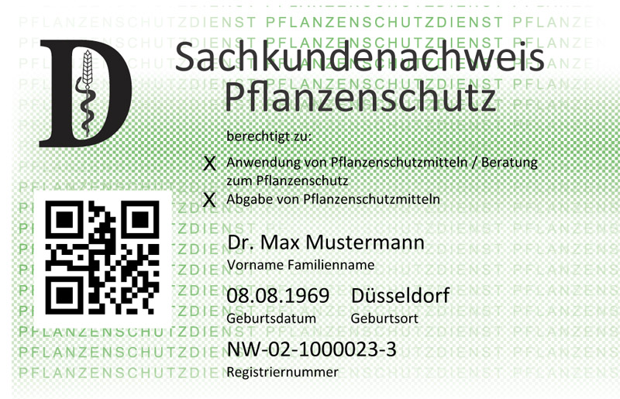

Plant protection
PSM Training
Recommendations
! Appropriate use of pesticides
Only authorized and regularly trained staff can use the machinery and apply the pesticides.
Source: LWK NRW, https://www.landwirtschaftskammer.de/landwirtschaft/pflanzenschutz/sachkunde/sachkundenachweis.htm
Guideline Pesticide Management
Notes:
Bild (https://www.landwirtschaftskammer.de/landwirtschaft/pflanzenschutz/sachkunde/sachkundenachweis.htm(

