Slide 1
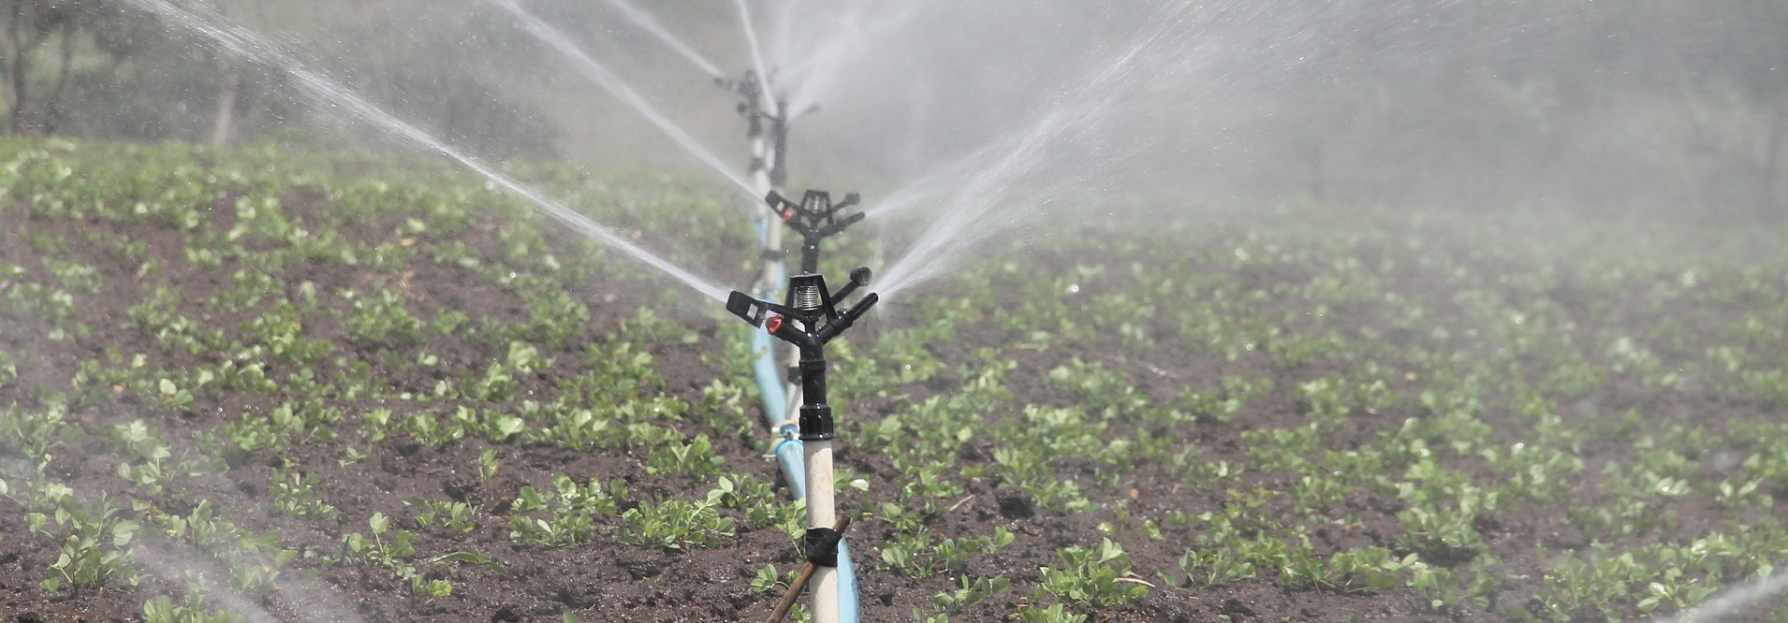
Very Best Agricultural Practices
Water / Irrigation
Photo credit © pixabay

Slide 2
1. Why water is relevant
Main services of water on farming sector
Risks and weaknesses
Scarce resource (availability is already in question for the coming years)
Vulnerable resource(risk of pollution and salinization)
Irregular distribution
Health and hygiene on farm level
Proper animal nutrition
Key role in irrigation
Efficient water management is an imperative issue in temperate regions
reduce water consumption
increase the efficiency of the systems
re-use and recycle water

Slide 3
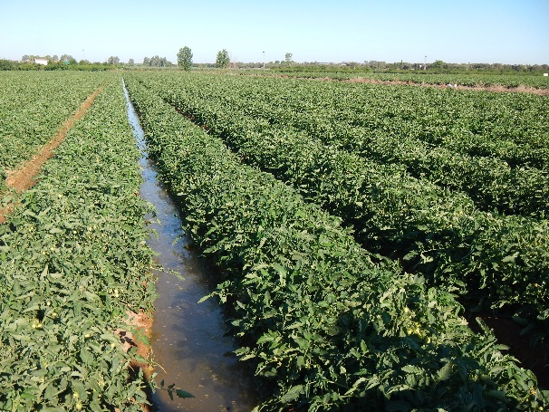
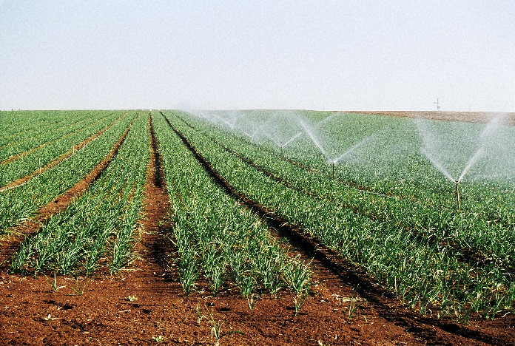
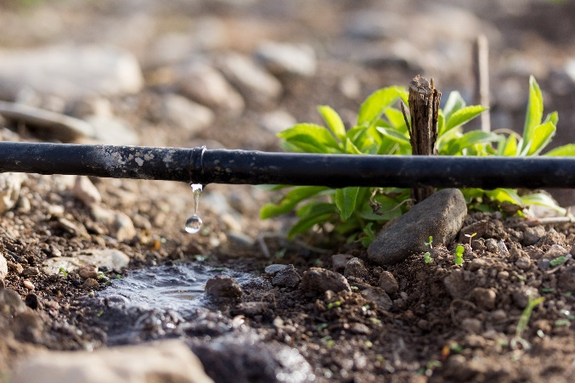
2. Water on the farming sector
Main irrigation management systems in EU
Surface irrigation (´flood irrigation`)
Sprinkler irrigation
Drip irrigation
less efficient
high efficiency
water and energy efficient
energy saving
accurate water distribution
minimal capital investment and energy costs
easily automated
uniformity in water distribution
fewer problems with weeds and fungus
higher costs than in surface irrigation
expensive and difficult to maintain

Slide 4
3. Elements of Very Good practices
There are many ways to improve efficiency in water management in the farming sector
1. Irrigation recording sheet
2. Irrigation systems of maximum efficiency
2.1. Drip irrigation
2.2. Buried and semi-buried drip irrigation
3. Decision support tools for irrigation
3.1. Tools for climate-soil-plant control
3.2. Teledetection and GIS tools
3.3. Fertilization control tools
4. Changing crop type
5. Recycling and harvesting (animal breeding farms)
6. Buffer strips establishment
7. Catch crops and cover crops
8. Ponds and water retention areas
9. Water points
Very Good Agricultural Practices for More Water Use Efficiency
Very Good Agricultural Practices for Water Bodies Protection
Very Good Agricultural Practices for Enhancement of Biodiversity

Slide 5
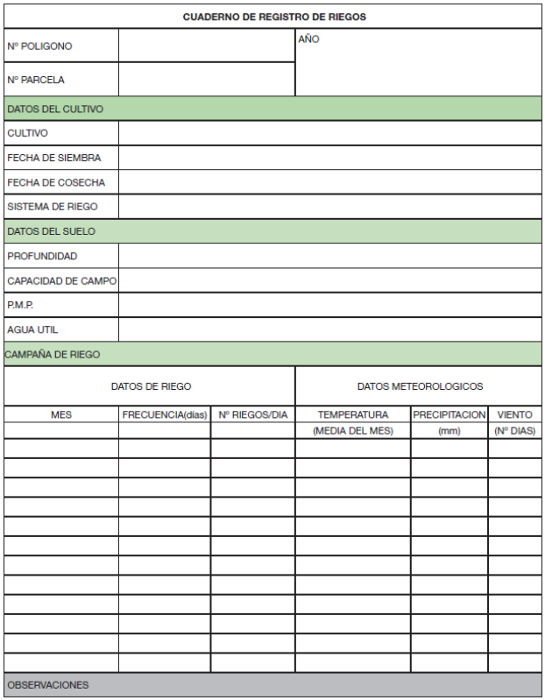
Elements of Very Good practices
1. Irrigation recording sheet
Monitoring of water consumption
Recommended for medium and high water consumers
Easy to apply practice
Some data can be recorded in the sheet
Source: “Manual de buenas practicas de riego” (WWF, 2009)
A line for each irrigation episode including:
time devoted to each irrigation
flow rate
water volume used during the crop cycle (total volume and total volume/ha)
Rainfall, temperature and wind data
Situation in European agriculture
Challenges to implement the measure
its application in Europe is not well extended yet
No technological or economic constraints are foreseen

Slide 6
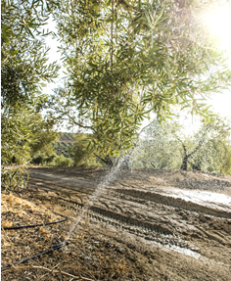
3. Elements of Very Good practices
2. Irrigation systems of maximum efficiency: DRIP IRRIGATION
Shall be used when irrigation water consumption exceeds 2,500 m3/ha/year
Bad example of irrigation of olive trees.
The installation should be reviewed and the water lost due to poor maintenance should be measured.
BENEFITS
reduced impact of weeds due to less soil surface with moisture
© Deyan Georgiev, www.fotolia.com
more efficient application of fertilizers
less herbicides needed
works at low pressure (less energy costs)
Situation in European agriculture
Challenges to implement the measure
33% of the irrigated areas of the EU-28 was drip irrigated in 2010. In some Mediterranean countries the use of drip irrigation reaches 50% (Spain) or even 75% in Cyprus
Additional costs for the farmers (e.g. annual fuel consumption for pumping and annual cost of tubing, regular emitters inspection)

Slide 7
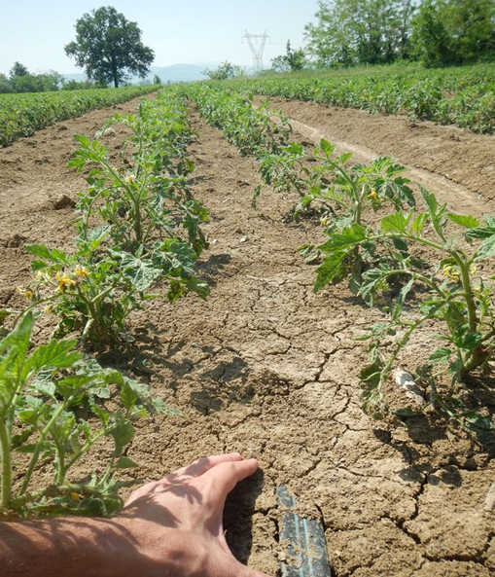
3. Elements of Very Good practices
2. Irrigation systems of maximum efficiency: BURIED AND SEMI-BURIED DRIP IRRIGATION
The tubing is buried (at least 15 cm) or semi-buried (about 5 cm)
BENEFITS
- water use is optimized:
  is released closer to the root system
  evaporation is reduced, and as a result
- risk of tubing damage by birds and mammals is reduced
- risk of tubing damage due to strong winds
- less fungal diseases inthe plant neck
Situation in European agriculture
Challenges to implement the measure
Not widely extended in Europe
Advanced knowledge of the irrigation needs and limitations required
Fauna damages or strong winds as driving forces to implementing this practice
Burying 15 cm: Additional costs due to installation cost and the use of thicker tubing. Risk of tubing blocked; limited access for reparation
Burying 5 cm: Lower risks, all the benefits maintained

Slide 8
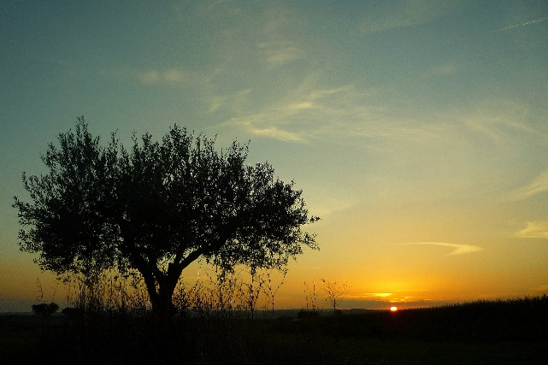
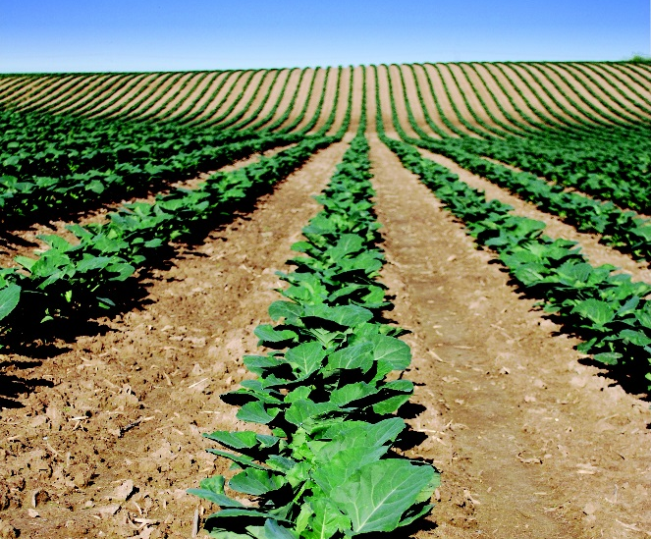
3. Elements of Very Good practices
3. Decision support tools for irrigation
These tools are technologies to help farmers to make a decision regarding the crop irrigation
They give high accuracy of the knowledge of the water needs of the crop
GOOD EXAMPLES
of the use of the data obtained from decision support tools
Practice of deficit irrigation: increase the water use efficiency of a crop by eliminating irrigations that have little impact on yield.
Irrigation is applied mostly during the drought-sensitive growth stages of a crop (usually the vegetative stages and the late ripening period)
© Pixabay
Changing the time for irrigation: some crops make better use of water at night
Measuring their water consumption at different times during the very same day.

Slide 9
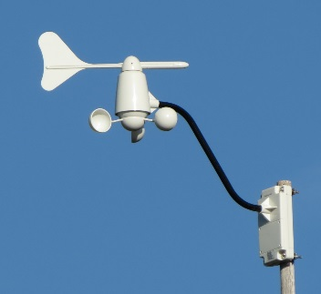
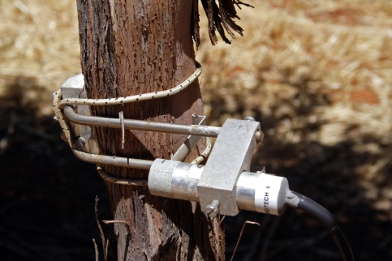
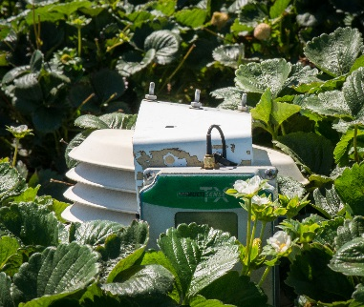
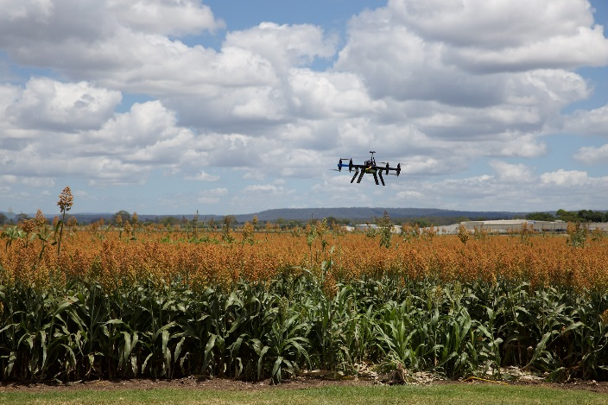
3. Elements of Very Good practices
3. Decision support tools for irrigation
Use of tools for climate-soil-plant control (sensor)
Dendrometers:
measure plant growth and water use, recording small contractions and expansions in plant tissue
Soil sensors
© CSIRO
- Tensiometers
- Capacitance probes
- Neutron probes
- Electric resistance blocks
- Wetting front detectors
- Modified atmometers
© Greg Goebel
Climate sensors
(weather stations)
Plant sensors
Use of teledetection and GIS tools
Remote Sensing (RS) satellites, airplanes/drones with multiesprectral camera: identifies areas with water stress, detects nutrient deficiences early identification of pests.
Global Positioning System (GPS)
Geographic Information Systems (GIS)

Slide 10
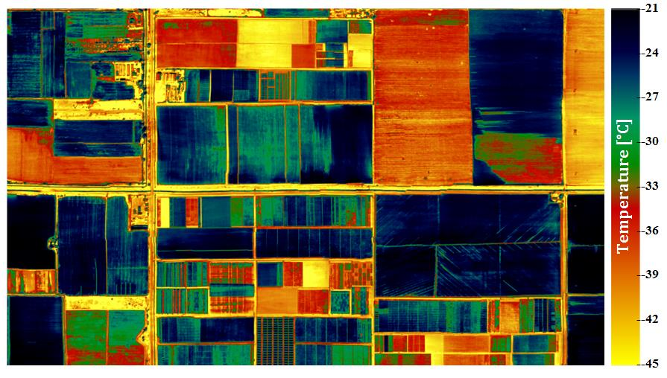
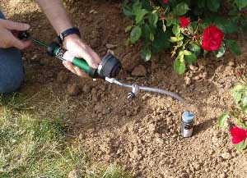
3. Elements of Very Good practices
3. Decision support tools for irrigation:
USE OF FERTILIZATION CONTROL TOOLS
Over-fertilization can lead to problems of pollution in water through high concentration of nutrients
Multispectral imaging camera drones
Suction probes, used to collect undisturbed and authentic soil water samples to analyze the solutes and evaluate whether a new fertilizer application is needed and what its content must be
Situation in European agriculture
Challenges to implement the measures
Tools for irrigation are relatively new or its use is not well extended in Europe yet
Cost of the equipment
Collective use of these technologies is a way to reduce costs
Complex interpretation of the results
Technology can be hired, and advice services are often included

Slide 11
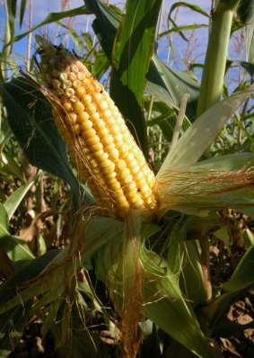
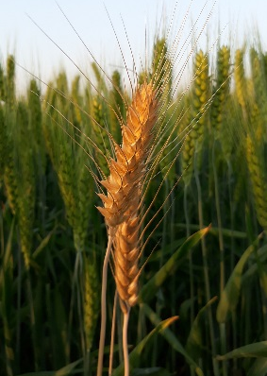
3. Elements of Very Good practices
4. Changing crop type and/or implementing improved crop rotation system
BENEFITS
Variables affecting this decision
- Less water-consuming when combining crops or varieties with different peak necessities away from the driest periods during the summer.
- Maximize water efficiency
Market considerations
Availability of water throughout the year
Specific climate of the region
Soil
SUNFLOWER
LENTIL
WHEAT
ALFALFA
CROP TYPE CHANGE
ROTATION SYSTEM

Slide 12
3. Elements of Very Good practices
4. Changing crop type and/or implementing improved crop rotation system
BENEFITS
Variables affecting this decision
- Less water-consuming when combining crops or varieties with different peak necessities away from the driest periods during the summer.
- Maximize water efficiency
Market considerations
Availability of water throughout the year
Specific climate of the region
Soil
Situation in European agriculture
Challenges to implement the measures
Experimentation with new varieties must be further enhanced in Europe
Creativity, comprehensive study and experimentation needed
Need to develop new studies in pilot farms to find solutions for better yields, better soil and water condition and more biodiversity
Requires time to get to find the best alternatives

Slide 13
3. Elements of Very Good practices
5. Recycling and harvesting in animal breeding farms
Some facts
Water consumed by animals and in some farm operations (e.g. in the milking parlour) needs high quality and often comes from the water supply network.
This water is expensive and has a higher footprint than the one harvested or recycled.
Other farm operations (e.g. barn cleaning) do not need high quality water, so recycled water can be used in them.
Main objectives for livestock farms
1. Understand the water inputs and outputs.
2. Reduce to the minimum the use of clean water by recycling water or harvesting it.
3. Increase the efficiency in farm operations.

Slide 14
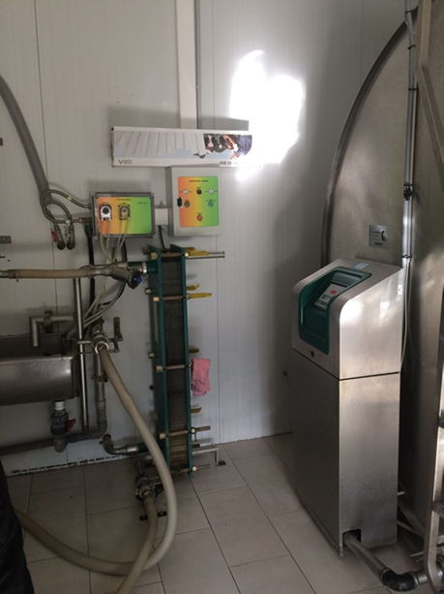
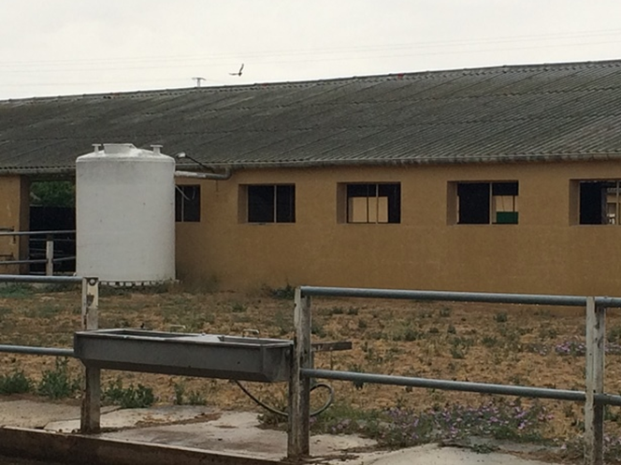
3. Elements of Very Good practices
5. Recycling and harvesting in animal breeding farms
Examples of very good practices
Rainwater harvesting
Recycling water from plate heat exchangers
- Very simple practice
- Passive collecting of rainwater with a system of gutters and a tank
- Plate heat exchangers need 4 liters of fresh water/liter of milk for reducing milk temperature before entering the tank
- A pig farm in a dry region, getting 300 mm of water a year, with a 200 m2 roof, will be collecting 60,000 litres/ year
- Re-using that water for cleaning and/or animal feeding purposes in a 80 milking cows farm, between 6,400 and 12,800 liters of water a day will be saved
Situation in European agriculture
Challenges to implement the measures
Implementation of these practices is still insufficient in many farms around Europe.
Livestock farms are very diverse all over Europe and the challenges are difficult to foresee.
Advisers shall support farmers in auditing water consumption at farm level and suggest tailored solutions
local opportunities may arise depending on farm system, type and management of animals.
Need to develop training to spread these practices.

Slide 15
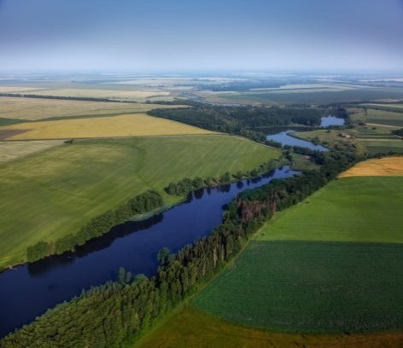
3. Elements of Very Good practices
6. Buffer strips (Riparian strips)
Riparian strips are vegetated areas along water courses and/or water bodies which help to control air, soil and water quality. For its implementation, native species are used.
BENEFITS
Riparian strips can have different configurations. Structural complexity combining grasses, shrubs and trees, will deliver more benefits for biodiversity
Act as sediment traps
Prevent excessive nutrient, pesticide and heavy metals concentrations in water
Prevent erosion and landslides
Restore ecological connectivity
Enhance biodiversity (providing food and
shelter for many living organisms)
Situation in European agriculture
Challenges to implement the measures
Currently mandatory under the Common Agricultural Policy.
Requires involvement of different actors such as river managers, farmers, etc.
Success depends on characteristics such as buffer zone width, gradient of the slope, soil type and variety and density of the vegetation.
Why it is not being properly implemented:
Lack of incentives programs, lack of a common definition for buffer strip, poorly defined goals, lack of maintenance, opposition from landowners.
May suppose a slight reduction in the field surface.

Slide 16
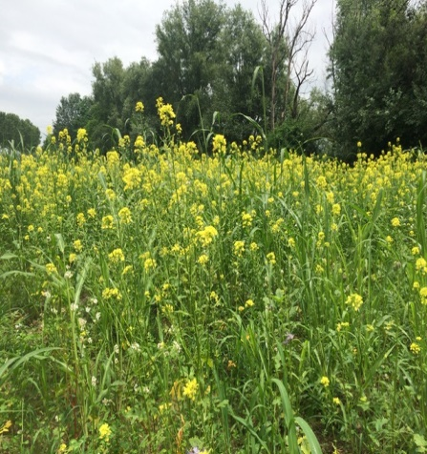
3. Elements of Very Good practices
7. Catch crops and cover crops
Catch and cover crops are crops growing in the period between two main crops or between the rows of a main crop in the same time-frame, acting on and protecting bare soil.
BENEFITS
Catch and cover crops reduce the use of fertilizers, pesticides and herbicides, prevent water pollution and clouding. Effectiveness depends on the time of establishment, the time of termination, the growth rate and the root depth and density.
Water and wind erosion reduction
Soil organic matter increment
Immobilization and storage of nutrients
Biological nitrogen fixation
Increase biodiversity
Weeds and pests supression
Soil compaction reduction
Situation in European agriculture
Challenges to implement the measures
In some countries the implementation of cover and catch crops is mandatory due to the Nitrates Directive.
However, it is a measure far from being widely implemented despite de benefits described.
Lack of knowledge for finding a suitable option.
Costs of seed bed preparation, seed, planting, termination.
Soil moisture content depleted before seeding the main crops.
Rodents and rabbits find their habitat in cover and catch crops.

Slide 17
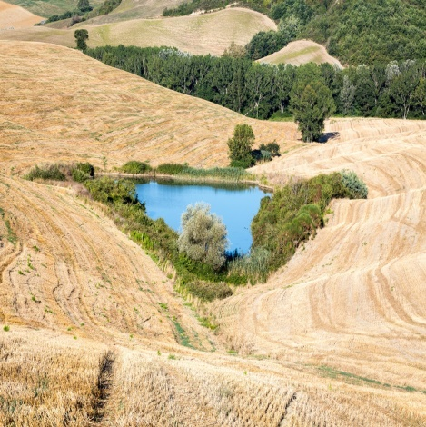
3. Elements of Very Good practices
8. Ponds and water retention areas
Water retention areas can be implemented as ponds or small dams. They can be built using pond liner or directly excavating and compacting the soil (if enough clay content is present)
Ponds and dams can be built by hand or using a mechanical digger (compaction of walls and basin are very important), diverting drainage water in them instead of leading the water out of the farm and, placing them where the runoff water channels converge.
BENEFITS
Supplement irrigation in zones with limited access to water
Possibility of using gravity force as energy input for irrigation
Increase biodiversity by attracting insects and useful creatures like snakes, amphibians and birds (very beneficial for pest control)
Situation in European agriculture
Challenges to implement the measures
Water retention areas naturally occur in wet regions. These areas can be used for crop growing; drainage systems are normally installed to divert that water.
In dry places the implementation of this measure is even more unusual.
Expert guidance is needed to avoid problems such as landslides and floods.
If the area is large, approval from the water regulatory authority is needed.

Slide 18
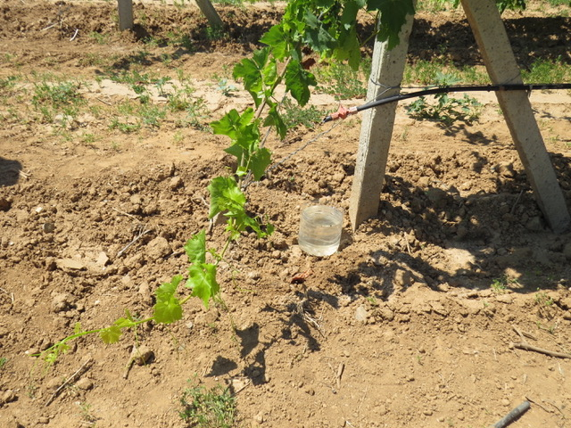

3. Elements of Very Good practices
8. Water points
Water must not be wasted. Identifying points in the farm where that occurs and implementing a creative solution will enhance biodiversity.
BENEFITS
Biodiversity enhancement
Creating a comfortable habitat for wildlife (very useful for pest control)
Water points can be created by small solutions like a plate under a water tap (indirectly filled when used) or, small plates under certain drip irrigation emitters or at the end of the line.
Guideline Water Management

