Slide 1
Biodiversity: Status quo
Biodiversity loss data; influence of agriculture

Slide 2

Introduction - definition
Biodiversity
Means the variability among living organisms from all sources including inter alia, terrestrial, marine and other aquatic ecosystems and the ecological complexes of which they are part; this includes diversity within species, between species and of ecosystems.“
(Convention on Biological Diversity, Article 2)

Slide 3
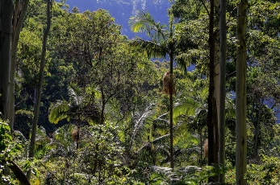
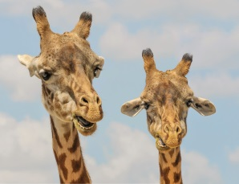
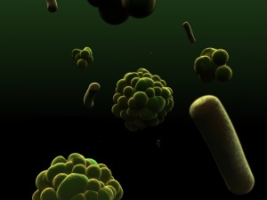
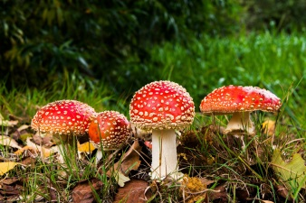
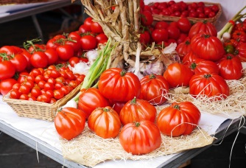
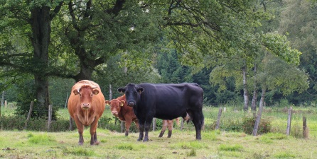
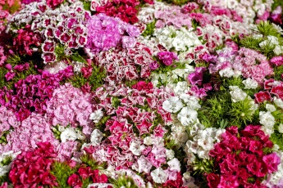
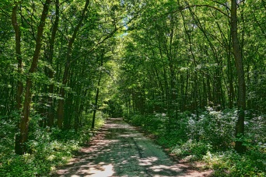
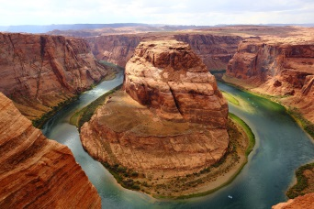
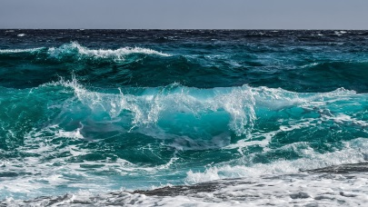
Biodiversity
Diversity between species (plant, animal, microorganism, fungi)
Diversity within species (genes, e.g. different species of tomato, cattle, carnation)
Diversity of ecosystems (forest, rivers, ozeans, ….)
© pictures: pixabay

Slide 4

Biodiversity – global situation
... some data
In the United States, biodiversity has declined by 31% since the 15th century.
71% of fish species have become extinct in Europe/Central Asia
87% of wetlands have been lost since the beginning of the modern era
More than 25,000 species are on the list of threatened or endangered animal and plant species around the globe
Eight out of 18 ecosystem services have substantially decreased since 1960:
    Amongst others: pollination, drinking water purification, and protection against erosion and flooding
But there are also some ecosystem services that have been intensified:
    Amongst others: production of agricultural goods, animal husbandry, and the harvesting of timber from forests
Ecosystem services
Benefits people receive from ecosystems. These include:
provisioning services (food, water);
regulating services (regulation of floods, drought,...);
supporting services (soil formation);
cultural services (recreational);
and other non-material benefits (health and well being)
(Millennium Ecosystem Assessment)
Source: Homepage Helmholtz Centre -. Summary about the ipbes assessment reports
Notes:
It should be highlighted that this loss is anthropologically caused and has little to do with natural variations.

Slide 5
Biodiversity – global situation
... some calculations
Estimated total number of species on Earth: 6.5 million species *
86% of all species on land and 91% of those in the seas have yet to be discovered, described and catalogued *
Actual species extincion rate: 50 – 300 species per day
total species number in 130.000 years = 0
          With the current extinction rate only a marginal number of species and it´s role in providing ecosystem services can be described and discovered.
* Source: Camilo, M. et al. How many species are there on earth and in the ocean?, PLoS Biology, 9 (8), 2011.
Notes:
It should be highlighted that this loss is anthropologically caused and has little to do with natural variations.

Slide 6
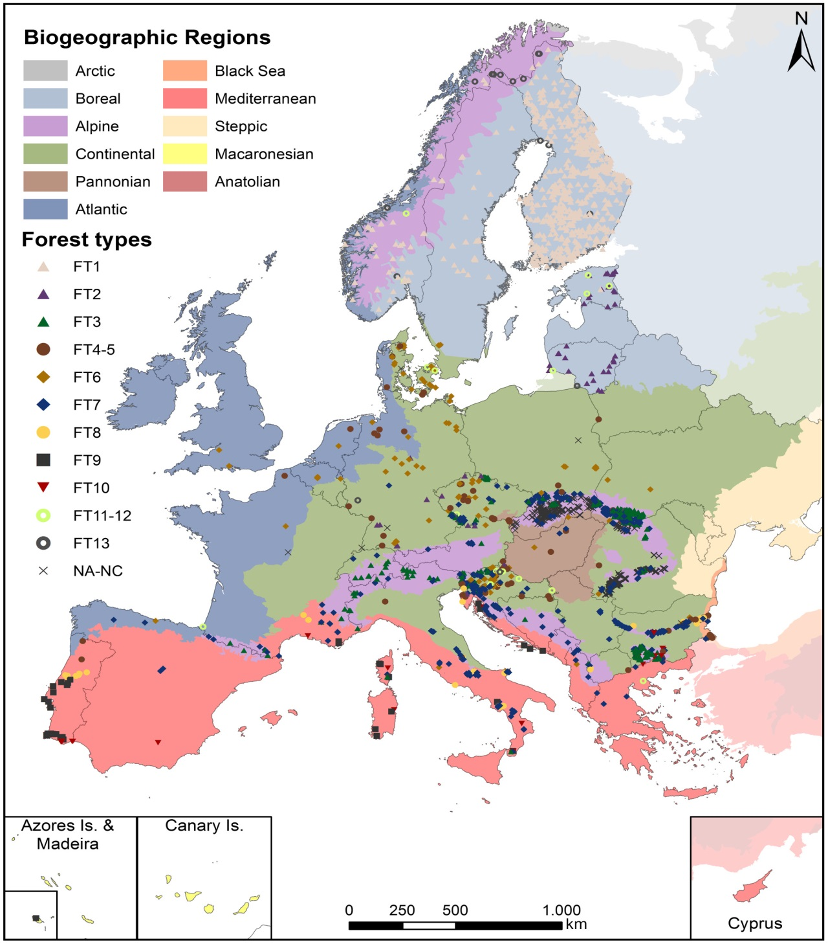
Biodiversity – global situation
Natural (primary) ecosystems
……. can be found in a given area in the absence of significant human management impacts.
This includes all naturally occuring
  flowing and still water bodies (streams, rivers, ponds …)
  wetlands
  forests (rainforest, lowland, needle leaf forest …)
  other native terresteral ecosystems like woodlands, scrublands …..
Source: Sabatini, F. et al. Where are Europe´s last primary forests?, Diversity and Distribution. 24, 1426-1439 (2018).
Notes:
Background information:
Distribution of primary forest patches retrieved for Europe by forest type. The map of biogeographical regions in the background follows BfN (2003). Forest types follow EEA (2006): FT1—boreal forest, FT2—hemiboreal and nemoral coniferous‐mixed forest, FT3—alpine coniferous, FT4‐5—mesophytic deciduous and acidophilus forest, FT6—beech forest, FT7—mountainous beech forest, FT8—thermophilus deciduous forest, FT9—broadleaved evergreen forest, FT10—coniferous Mediterranean forest, FT11‐12—mire and swamp forests and floodplain forest, FT13—nonriverine alder, birch or aspen, NA‐NC—no data/unclassified [Colour figure can be viewed at wileyonlinelibrary.com]

Slide 7
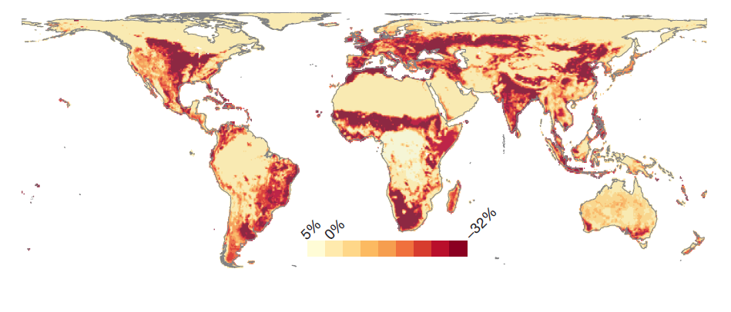
Biodiversity – global situation
Net change in local biodiversity richness caused by land use and related pressures by 2000
Source: Newbold, T. et al. Global effects of land use on local terrestrial biodivesity, Nature. 520, 45-69 (2015).
Notes:
Information: A new study published today in the journal Nature gives a global view of this damage since the 1500s. It shows that by 2005, worldwide land use change had caused a drop of 14 per cent in the average number of species found in local ecosystems. Most of this loss came in the last 100 years.
First global analysis
The study is the first global analysis of human impacts on local biodiversity. It is a major collaboration between the Natural History Museum, United Nations Environment Programme World Conservation Monitoring Centre (UNEP-WCMC), and British universities.
Scientists submitted data from more than 70 countries and considered 26,593 species, adding more than 1.1 million records to the PREDICTS (Projecting Responses of Ecological Diversity In Changing Terrestrial Systems) survey database.
The team's figure of a 14 per cent drop in species in local ecosystems is a global average. So local biodiversity in some areas is still quite intact, but others - including Western Europe - have had losses of 20-30 per cent.
Tipping point
This is important because 20 per cent is widely considered the tipping point beyond which an ecosystems' ability to provide the natural services like flood protection or control of pest outbreaks are compromised.
'For example as biodiversity declines, outbreaks of crop pests become more likely,' said Andy Purvis, the study's lead scientist and Museum biodiversity expert. 'We can spray crops and spend money to reduce that risk but that is basically compensating for something that biodiversity used to provide before'. (https://phys.org/news/2015-04-major-biodiversity-losses-reversed.html#jCp)

Slide 8
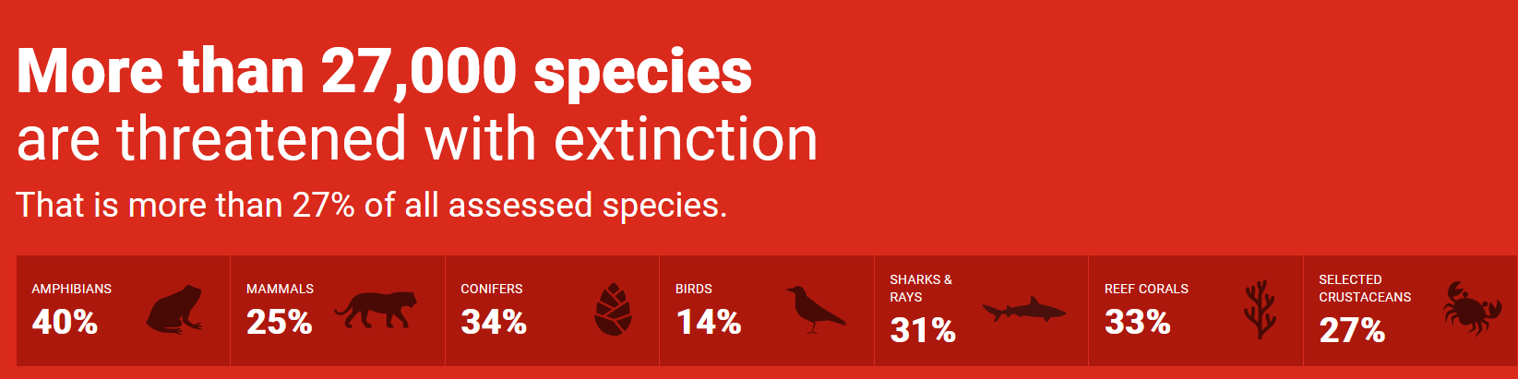
Biodiversity – global situation
Species extinction
IUCN Red List (IUCN = International Union for Conservation of Nature)
Established in 1964, IUCN Red List of Threatened Species has evolved to become the world´s most comprehensive information source on the global conservation status of animal, fungi and plant species.
It provides information about range, population size, habitat and ecology, use and/or trade, threats and necessary conservation actions
Source: Homepage ICUN Red List, 2019
Notes:
Background information:
To date, IUCN assessed 98,500 species for the IUCN Red List (date: 02.04.2019)

Slide 9
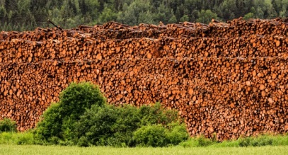

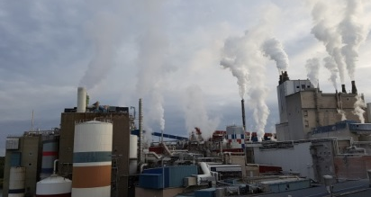
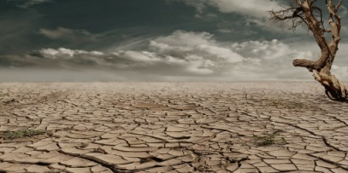

Main drivers for the loss of biodiversity
Destruction and degradation of ecosystems
Land use change: conversion of pristine forest ecosystems to agricultural systems
burning of natural vegetation
Overexploitation of natural resources
overstraining of soils
overfishing of fish species
depletion of fresh water resources
Contamination
of water, air and soil with pollutants (GHGs, chemicals, garbage etc..)
number and range of species will decline greatly as temperatures continue to rise
Climate change
Invasive, alien species
See next slide
© pictures: pixabay

Slide 10

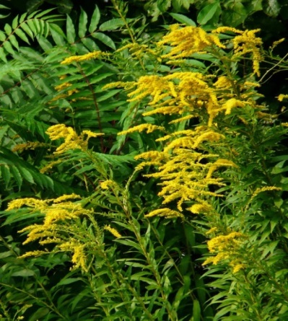
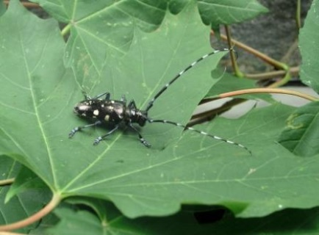
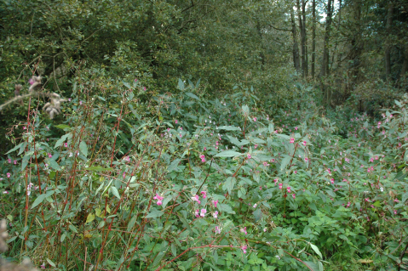
Definition
© pictures: pixabay; Bayerische Landesanstalt für Landwirtschaft; Mike Sutton-Croft
Invasive, alien species
Are non-native species causing damage to the environment and potentially cause species extinction, modify ecosystem processes and act as disease vectors. The problems caused by alien invasive species have potentially large economic consequences.
Alien species
Native in North America; Invasive in Germany
Native to China and Korea;
Invasive in USA, Austria
Native to Himalayas countries;
Invasive in temperate Europe and northern North America
Canadian and Late Goldenrod (Solidago canadensis/gigantea L.)
Asian longhorn beetle
(Anoplophora glabripennis)
Himalayan balsam
(Impatiens glandulifera)

Slide 11
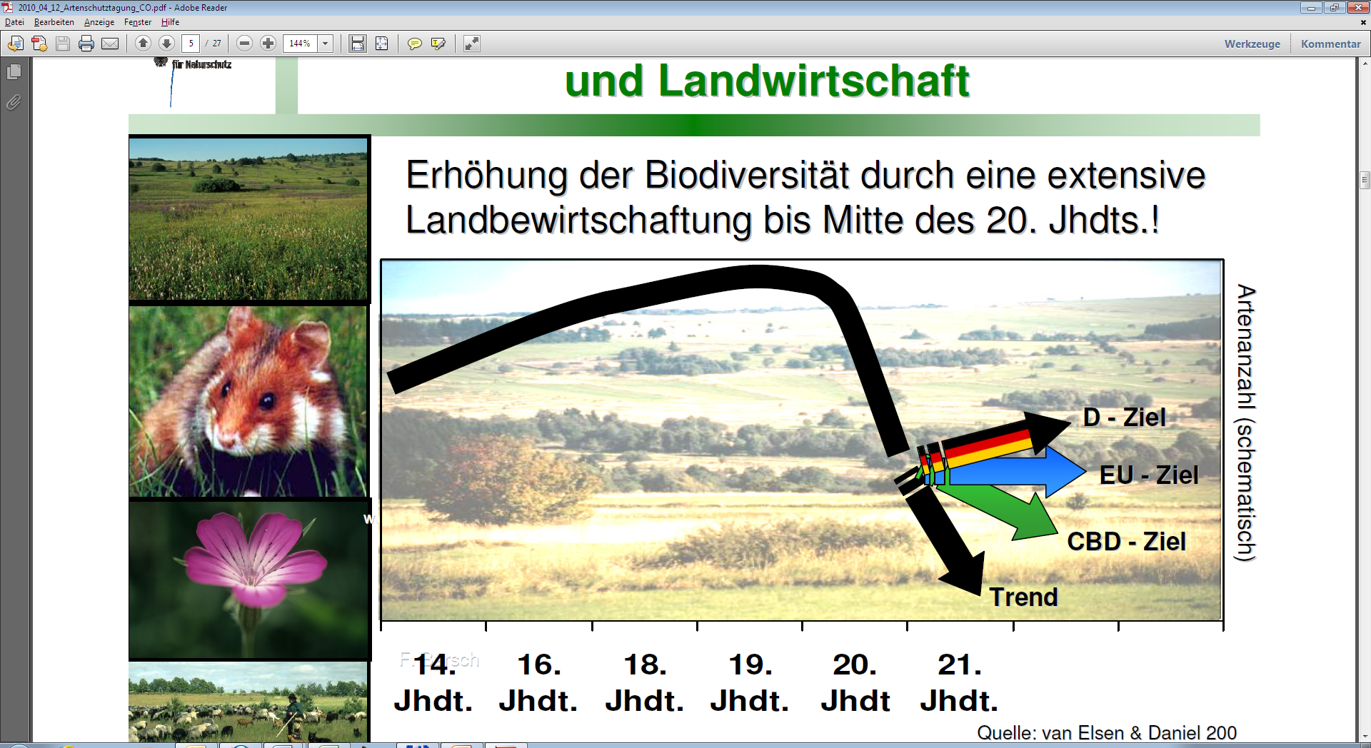
Biodiversity & Agriculture
Increasing biodiversity through extensive land management until the middle of the 20th century
Number of species (schematically)
Source: van Elsen & Daniel, 2000

Slide 12
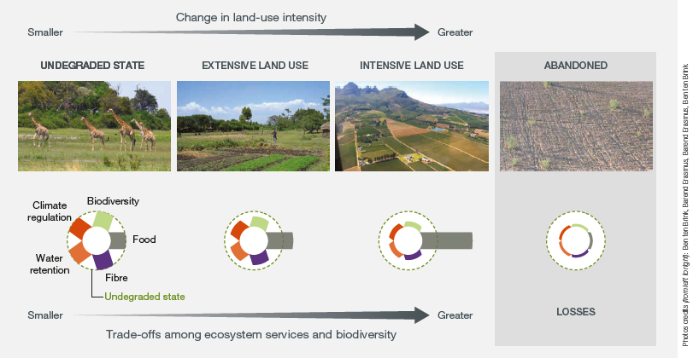
Biodiversity & Agriculture
…..some examples
Land degradation
Source: ipbes – The assessment report on Land degradation and restoration – full report. (2018)
Notes:
Background information: Human transformation of natural ecosystems and trade-offs among ecosystem services and biodiversity
This figure shows the trade-offs among exocsystem services and biodiersity with land use intensification, using food production as an example. In this specific example as food production increases, there is a decreas in other ecosystem services and biodiverstiy (illustrated by reduced bars) as compared to the undegraded state. In extreme cases, land has been degraded to the point of abandonment (right panel), thus providing less of all ecosystems services. This pattern generally applies to all ecosystems and land-use types. Source: Adapted from Van der Esch et al. (2017)

Slide 13
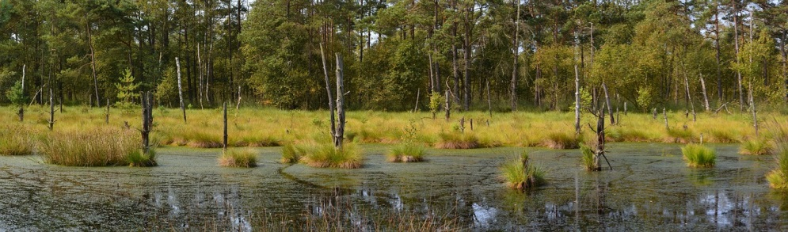
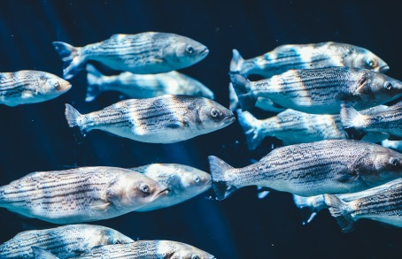
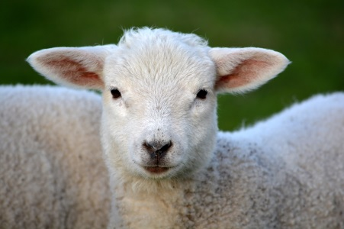
Biodiversity & Agriculture
... some data
Globally, agrifood systems are responsible for.....
60% of the loss of terrestiral biodviersity,
approximately 24 % of global greenhouse gas emissions,
33 % of degraded soils,
The depletion of 61% of commercial fish stock species
The overexploitation of 20% of the world´s aquifers.
© pictures: pixabay

Slide 14


Biodiversity: status quo
Questions?
Frequently asked questions
Knowledge pool
© pictures: pixabay

