Slide 1
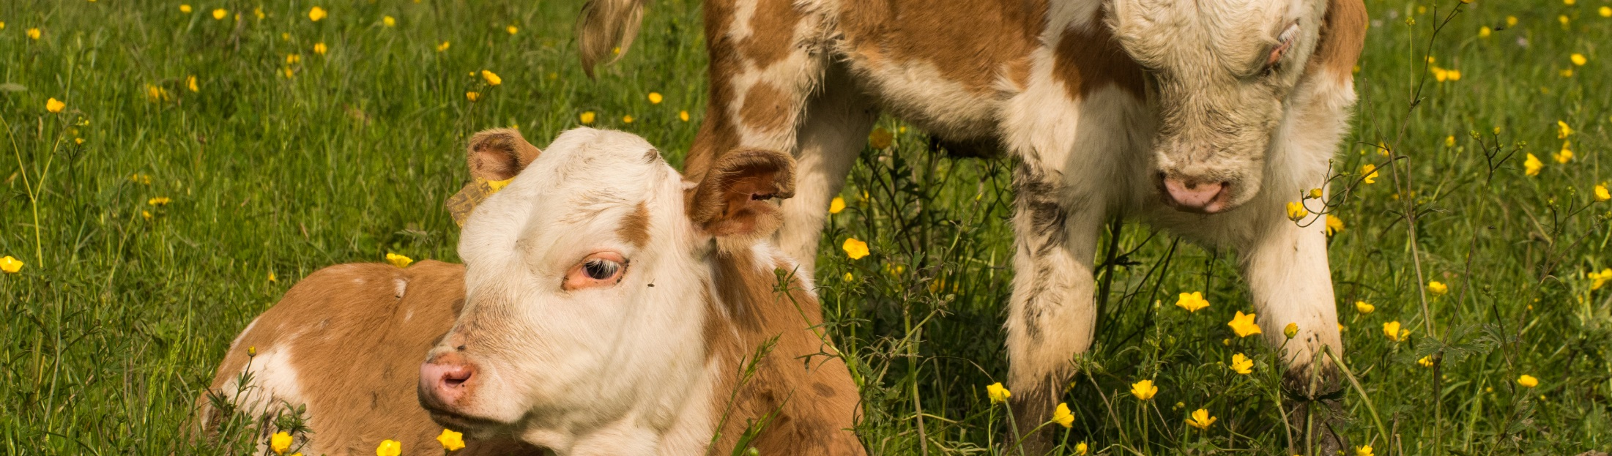
Very Best Agricultural Practices
Livestock Production
© Sven Schulz, Bodensee-Stiftung

Slide 2
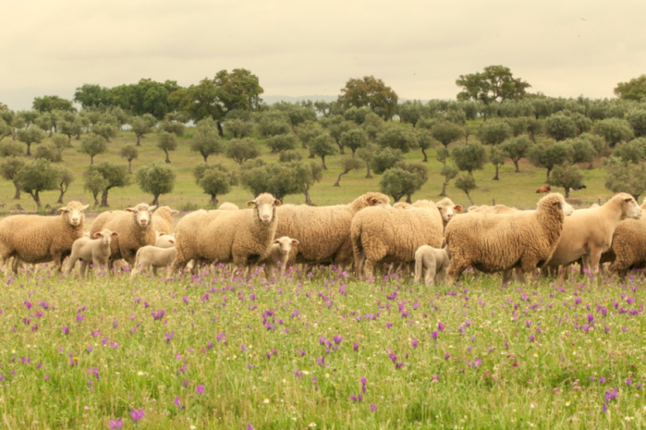
1. The concept of Livestock
The term ‘livestock’ refers to all animal species and breeds which are kept or reared in captivity mainly for agricultural purposes - Food and Agriculture Organization of the United Nations (FAO 2017).
This includes many species and breeds of mammals, birds and insects such as bees and silkworms.
Figure 1 – Sheep (Ovis aries) is among the most popular species reared worldwide as livestock. The global standing population for sheep and goats (Capra aegagrus hircus) is estimated at 1.87 billion individuals (Robinson et al. 2014). Photo: © Terraprima.
Notes:
The main task of livestock production is to provide a secure protein supply for a fast-growing world population in order to contribute to food security. Consumption patterns in industrialized and emerging economies have led to an intensification of animal husbandry and a more globalized food market, resulting in tremendous changes in the use of agricultural land, grassland and pastures, highly intensive production systems and worldwide trade of animal food and animal products.

Slide 3
2. Livestock systems and production
‘Livestock system’ (FAO 2017) - practices involved in the process of raising livestock on a specific holding, and its general characteristics.
Grazing systems – characterized by ruminants (e.g. cattle, sheep and goats) grazing mainly on grass species and other herbaceous plants, often on communal or open-access areas and often in a mobile fashion. Grazing systems can be:
  Nomadic or totally pastoral;
  Semi-nomadic, semi-pastoral or transhumant;
  Sedentary pastoral;
Mixed systems – characterized by activities that connect livestock-rearing and the production of agricultural crops
Industrial systems – characterized by intensive livestock-raising methods in which at least 90% of the dry matter of the animal feed is produced outside of the holding or farm considered.

Slide 4
2. Livestock systems and production
At the Global Scale
Higher demand for livestock products is expected for the next decades. As a consequence, pressure over land resources is expected to increase (McMichael et al. 2007).
The livestock production sector is the world’s largest user of land resources (Monfreda et al. 2008, Ramankutty et al. 2008, Teillard et al. 2016, FAO 2018b):
30% of the Earth’s ice-free terrestrial surface;
≈ 80% of total agricultural land;
Requires ≈ 8% of global water use.
Dietary shifts in emerging countries
Risk of negative impacts on biodiversity
Notes:
Livestock supports the livelihoods and food security of almost 1.3 billion people worldwide and represents about 40% of the global value of agricultural output.
The consumption of meat in Asian countries, such as China and Indonesia, has already increased significantly and dairy consumption is expected to increase in India (FAO 2018a).
In 1978, meat consumption in China corresponded to 1/3 of that in the United States of America (USA). However, currently the former is more than the double of the latter (Larsen 2012).

Slide 5
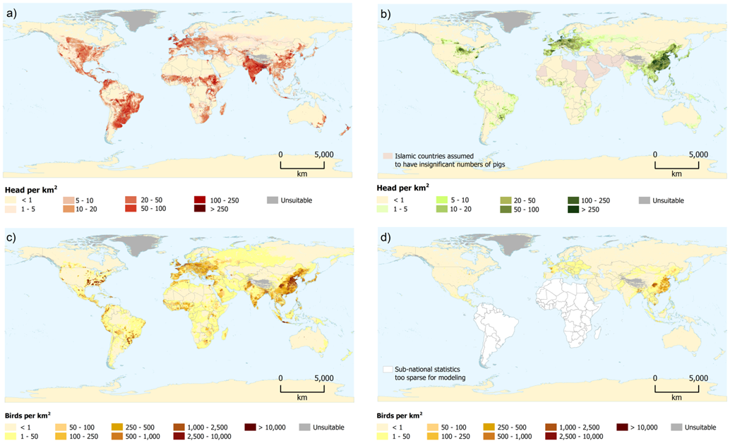
2. Livestock systems and production
At the Global Scale
Figure 2 – Global distributions of a) cattle; b) pigs; c) chickens; and d) distribution of ducks, excluding South America and Africa (Robinson et al. 2014).
Notes:
The global livestock standing populations are estimated to include about 1.43 billion cattle, 1.87 billion sheep and goats, 0.98 billion pigs and 19.60 billion chickens (Robinson et al. 2014) (Figure 2).

Slide 6
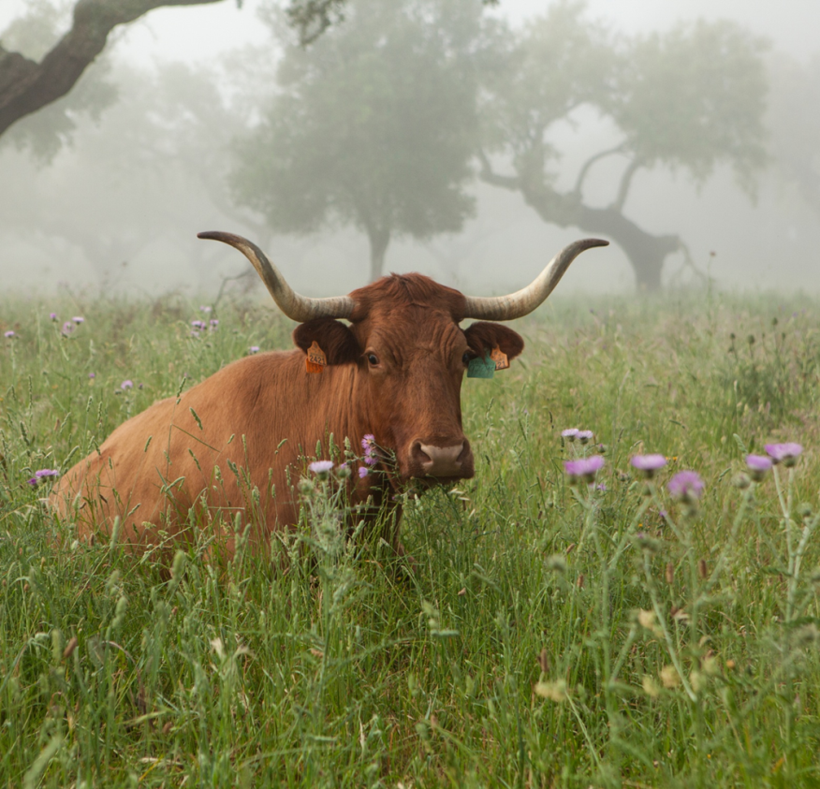
2. Livestock systems and production
In the European Union
The EU livestock sector is the largest in the world (Eurostat 2018):
Meat, milk, and eggs → ≈ 39% of the EU’s agricultural industry output;
In 2015, ≈ 10 million people employed in agriculture in the EU-28;
Pastures and meadows occupy nearly 22% of Europe’s agricultural area;
©Terraprima

Slide 7
3. Environmental Impacts of Livestock Production
  3.1. Livestock and Climate Change
Significant emissions of greenhouse gases (GHG), generating worldwide about 7.1 Gt of CO₂ (Gerber et al. 2013):
methane (CH₄) (≈44%);
nitrous oxide (N₂O) (≈29%);
carbon dioxide (CO₂) (≈27%).
The EU estimations (JRC 2010):
≈ 9.1% of GHG results from this sector (if impact of sourcing animal feed included);
12.8% of total GHG emissions (if land use and land use change emissions included).
Notes:
7.1 gt of CO2 - representing about 14.5 % of all anthropogenic GHG emissions (Gerber et al. 2013).

Slide 8
3. Environmental Impacts of Livestock Production
  3.2. Livestock and Biodiversity
  Lack of common ‘currency’ for biodiversity complicates the assessment of impacts on biodiversity (FAO 2016).
Livestock production depends on biodiversity and at the same time play an important role in shaping biodiversity (two-way street):
Increase in landscape and species diversity, at the local scale.
Decline of many wild species in Europe
Notes:
Biodiversity is complex and multivariate by nature. The assessment of biodiversity is complicated by the lack of a common ‘currency’ for biodiversity, and by it being extremely context-dependent. Due to societal value judgements, there is great variation in the conservation value of different species and habitats, which complicates decision-making about conservation objectives and priorities

Slide 9
3. Environmental Impacts of Livestock Production
  3.2. Livestock and Biodiversity
  The assessment of biodiversity is extremely context dependent, with great variation in the conservation of different species and habitats.
  Expansion of agriculture, pastures, orchards and cultivated landscapes led to new landscape features, linking the conservation of biodiversity and habitats to agro-ecosystems.
    ≈ 176 million ha of arable and grassland areas used for agriculture (EC 2017);
    ≈ 50% of European species are associated with agricultural habitats (EEA 2003).

Slide 10
3. Environmental Impacts of Livestock Production
  3.2. Livestock and Biodiversity
  Livestock production can have positive and negative impacts on biodiversity, through five main drivers of change (Teillard et al. 2016) (Figure 3):
  Habitat change;
  Pollution;
  Climate change;
  Over-exploitation;
  Invasive species.
Main negative impacts:
Destruction of habitats;
Degradation of soils;
Acidification and eutrophication of soils and water bodies.
Notes:
Notwithstanding the role that livestock has played and still plays in shaping part of Europe's biodiversity in relation to agroecosystems, particularly through grazing, the main impacts highlighted in literature and scientific reports, and frequently by non-governmental organisations (ENGOs), are negative. These include:
The destruction of habitats through the conversion of native primary forest into pastures or feed crop production areas, mostly in South America and particularly in the Amazon rainforest and the Brazilian Pantanal regions (Lambin et al. 2003, Wassenaar et al. 2007, Nepstad et al. 2009, Teillard et al. 2016);
The degradation of soils due to excessive livestock densities and/or intensification practices;
The acidification and eutrophication of soils and water bodies, due to diffuse pollution driven by nutrient run-offs and caused by inadequate animal waste disposal and/or excessive fertilizer use.

Slide 11
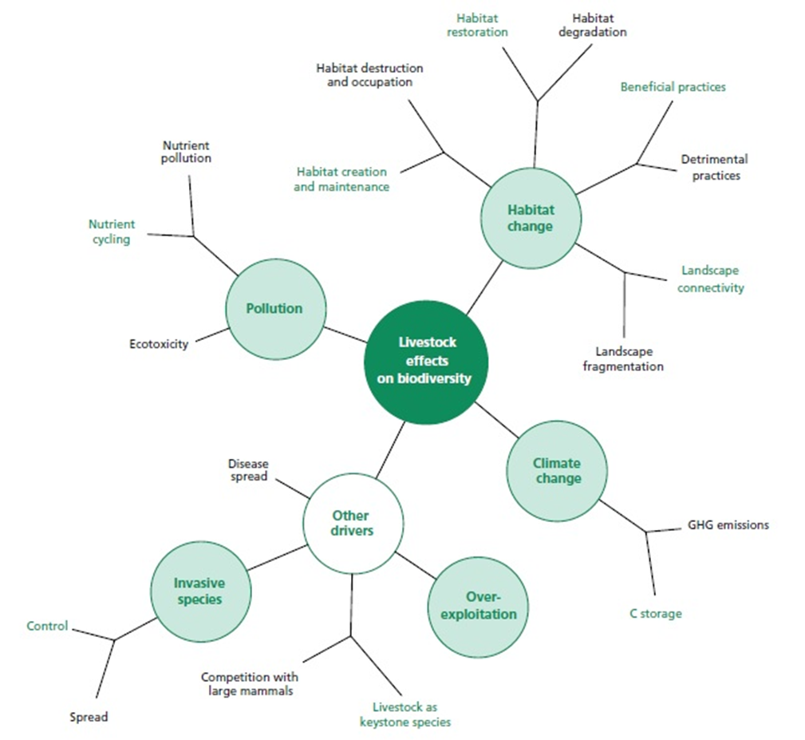
3. Environmental Impacts of Livestock Production
  3.2. Livestock and Biodiversity
Figure 3 – Categories of influences that livestock have on biodiversity. The five main drivers of biodiversity loss recognized by the Millennium Ecosystem Assessment (MEA 2005) appear in green circles. However, for most of these drivers, livestock can either put pressure (black) or provide benefits (green) to biodiversity (Teillard et al. 2016).
Notes:
Notwithstanding the role that livestock has played and still plays in shaping part of Europe's biodiversity in relation to agroecosystems, particularly through grazing, the main impacts highlighted in literature and scientific reports, and frequently by non-governmental organisations (ENGOs), are negative.

Slide 12

3. Environmental Impacts of Livestock Production
  3.2. Livestock and Biodiversity
Agriculture practices significantly involved with the driver ‘Pollution’:
Nutrient management;
Fertilization;
Pest control and plant protection;
Harvesting and mowing.
Acidification and eutrophication
of soils and water bodies.
Negative impact (Carpenter et al. 1998, EEA 2018)
Eutrophication
According to the definition considered by the European Environment Agency, a process of pollution that occurs when a lake or stream becomes over-rich in plant nutrient; as a consequence it becomes overgrown in algae and other aquatic plants. The plants die and decompose. In decomposing the plants rob the water of oxygen and the lake, river or stream becomes lifeless. Nitrate fertilizers which drain from the fields, nutrients from animal wastes and human sewage are the primary causes of eutrophication (EEA 2018).
© pictures: pixabay
Notes:
As far as the negative impacts of livestock production on biodiversity are concerned, some agricultural practices are particularly relevant for the way they are connected to the drivers.
Acidification and eutrophication of soils and water bodies, due to diffuse pollution driven by nutrient run-offs and caused by inadequate animal waste disposal and/or excessive fertilizer use. Nutrient run-offs due to excessive fertilization cause relevant diffuse pollution and impact aquatic ecosystems particularly through acidification and eutrophication, i.e., the oxygen depletion that takes place in a water body after an excessive growth of plants and algae as a consequence of higher nutrient and mineral availability (Carpenter et al. 1998, EEA 2018).

Slide 13
3. Environmental Impacts of Livestock Production
  3.2. Livestock and Biodiversity
Practices significantly involved with the driver ‘Habitat change’:
Livestock management;
Grazing system.
Overgrazing (high livestock densities):
Soil compaction, erosion and degradation
(desertification in arid regions)
Excessive nutrient run-offs;
Consequent diffuse pollution;
Direct loss of biodiversity (intensification of grasslands)
Low grazing (low livestock densities):
Higher risk of shrub invasion;
Higher risk of fire and landscape homogenization;
Decline in soil fertility.
Negative impacts (Asner et al. 2004, Eurostat 2018, Thórhallsdóttir et al. 2013)

Slide 14
4. Total Livestock Density (TLD) and Grazing Livestock
Density (GLD)
Livestock production is dependent on agricultural land availability.
Total Livestock Density (TLD) and Grazing Livestock Density (GLD)
The ‘livestock unit’ → LSU or LU, reference unit that facilitates the aggregation of livestock from various species and age as per convention, via the use of specific coefficients established initially on the basis of the nutritional or feed requirement of each type of animal.
1 LSU → grazing equivalent of 1 adult dairy cow producing 3 000 kg of milk annually, without additional concentrated foodstuffs (Eurostat 2018).
Total livestock density (TLD) (LU/ha of UAA) – ratio of total livestock to the total utilized agricultural area (UAA).
Total livestock
Total grazing livestock
Grazing livestock density (GLD) (LU/ha of fodder area) – ratio of total grazing herbivores to the total fodder area.
Notes:
The ratio of total livestock (including animals kept indoors) to the total utilised agricultural area (UAA) represents the total livestock density (TLD) (LU/ha of UAA). However, while omnivores (like pigs) and granivores (like poultry) are usually fed specific feedstuffs and do not necessarily require significant agricultural land, herbivores (e.g., cattle, sheep, goats and horses) may be raised indoors, and be fed with harvested fodder, or outdoors – grazing directly on pastures and grasslands. For the latter, the ratio of total herbivores to the total fodder area, i.e., the grazing livestock density (GLD) (LU/ha of fodder area) can be considered.

Slide 15
4. Total Livestock Density (TLD) and Grazing Livestock
Density (GLD)
  GLD maximum of 1.4 LU/ha - established in 1989 (CAP):
  Limit the compensation benefits paid to farms in less favored areas (LFA);
  Define extensive livestock farming (since 1992);
  Limit the eligibility to receive support for extensification measures (Piva et al. 1999).
National Rural Development Programmes of Member States with more ambitious limits to obtain support for HNV farming, within and outside Natura 2000 areas.
E.g.:
France (Boccaccio et al. 2009):
Min. GLD - 0.1 to 0.35 LU/ha
Max. GLD - 1.6 to 2 LU/ha
New Forest (UK) wood-pasture systems (Mountford and Peterken 2003, Plieninger et al. 2015):
Max. GLD - 0.3 (cattle), 0.15 (ponies) and 0.45 (deer) LU/ha/year
Southern Portugal montado systems (Godinho et al. 2016):
Optimum carrying capacity - 0.18 to 0.60 LU/ha
Belgium (Van Uytvanck 2009, Plieninger et al. 2015):
Max. GLD - 0.35 to 0.5 LU/ha/year (in former pastures and arable fields)

Slide 16
5. Very good agricultural practices (VGAP) for more biodiversity (examples)
  Good agricultural practices:
  Create safe and wholesome food for consumers;
  Prevent and reduce the negative impacts of livestock production on biodiversity;
  Help revert the less favorable conditions found in many agricultural lands.
VGAPs for Grassland Management
Increase soil biological activity to improve self-regulation of soil ecosystems and decomposition of organic material.
Mulch-seeding and direct-seeding is preferred;
Low mobilization of the upper soil layer (0 to 30 cm).
VGAPs for Nutrient Management and Fertilization
Application of organic fertilizers/organic matter aiming to reduce the nutrient run-off into water bodies.
Manure should not be applied on:
  water-saturated or flooded soils;
  deeply frozen soils;
  soils covered with snow.

Slide 17
5. Very good agricultural practices (VGAP) for more biodiversity (examples)
  VGAPs for Pest control and Plant Protection
Integrated pest management aims to prevent the use of pesticides by applying cultivation aspects that reduce pests and diseases in crops.
Reduce the presence of weeds using mechanical measures;
Avoid tillage and preserve the existing soil organic matter;
Promote beneficial organisms (important for grasslands);
Prevent spreading of harmful organisms:
  the removal of affected plants or plant parts;
  the regular cleansing of machinery and equipment;
  balanced soil fertility or water management.
Creation of buffer zones along the edges of water bodies (min: 10 m with);
Prohibit the use of pesticides dangerous to bees, pollinating insects, beneficial organisms, amphibians or fish.
Notes:
Furthermore, very harmful substances and their salt equivalent versions should not be allowed (e.g., glyphosate, diquat, paraquat, glufosinate-ammonium, indaziflam).

Slide 18
5. Very good agricultural practices (VGAP) for more biodiversity (examples)
  VGAPs for Harvesting and Mowing of livestock feed production
  A series of measures help to reduce the impact of mowing on biodiversity:
  Strategically delaying the mowing season;
  Establishing a minimum mowing height of at least 7 cm;
  Reducing the mowing frequency.
  Biodiversity friendly mowing regime:
    Mowing when insects and other arthropods are less active;
    Mowing different areas in different moments;
    Adopting an adequate mowing pattern.
  VGAPs for Livestock management and grazing
  Adequate management plans and grazing strategies should aim to reduce the impact on the grassland and biodiversity.
  Apply basic grazing systems:
    Continuous;
    Rotational;
    Ultra-high density, mob grazing and flash-grazing.
  Respect the maximum of 1.4 LU/ha of fodder surface;
  Aim for more ambitious limits in the case of HNV farmland, such as wood-pasture systems.
Notes:
a) Continuous (the pasture is not divided in sub-pastures or paddocks and the livestock is allowed to graze all the pasture area at any given time);
b) Rotational (the pasture is divided into sub-pastures or paddocks, using appropriate mobile and wildlife-friendly fences, and the cattle is allowed to graze each paddock for an adequate time period before being moved);
c) Ultra-high density, mob grazing and flash-grazing (usually in the morning, high livestock densities are allowed in a pasture for invasive species control but may also later be moved according to a rotation system).
Farms with higher stocking densities must work towards a reduction of density values in order to match this limit within a given period. Farms with lower stocking densities should hold these lower densities. Overall, livestock density values should be subject to a continuous reduction over time until the optimum level is reached.

Slide 19

Final remarks
The main task of livestock production is to provide a secure protein supply for a fast-growing world population, contributing to food security.
Consumption patterns in industrialized and emerging economies have led to an intensification of animal husbandry and a more globalized food market, resulting in tremendous changes in the use of agricultural land, grassland and pastures, with highly intensive production systems and worldwide trade of animal products.
Guideline Livestock Production

