Slide 1
Possibilities of improvement
Measures that can be taken

Slide 2
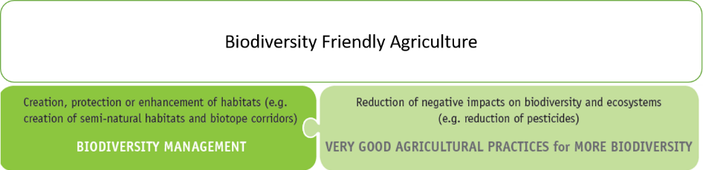
Part 3

Slide 3
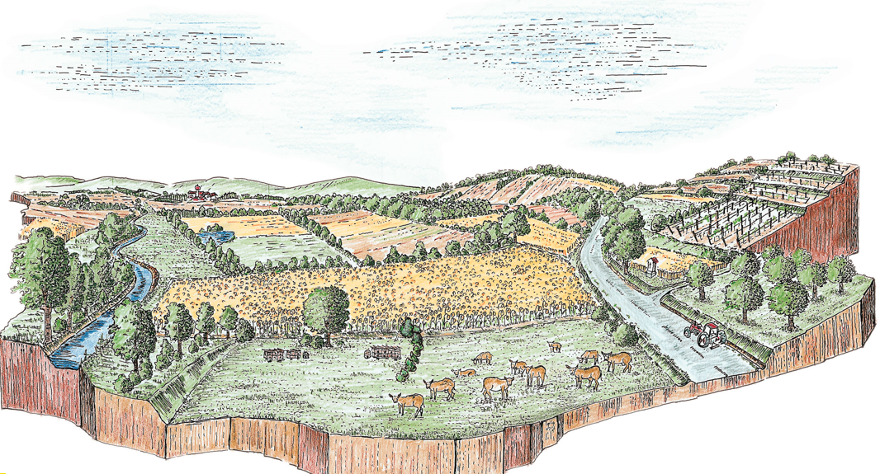
Biodiversity management
…….. providing potential - What can be done?
© pictures: pixabay

Slide 4
Biodiversity management
…….. providing potential - What can be done?
Protection of natural (primary) ecosystems, semi-natural habitats and protected areas
Protection of water bodies; management of riparian strips
Minimum share of semi-natural habitats
Management of semi habitats
Creation of habitat corridors
Grassland preservation
Specific measures for the protection of species
Prevent Introduction and Spread of Invasive Alien Species
Wild harvesting
© pictures: pixabay

Slide 5
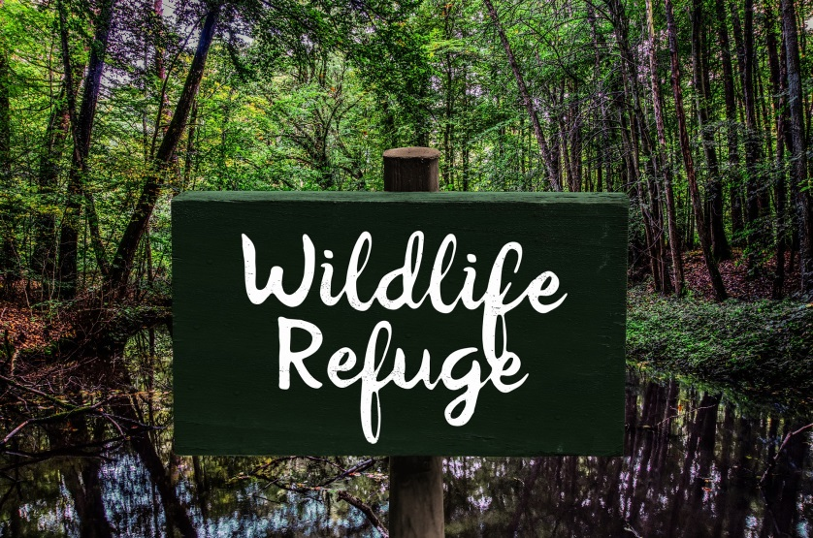

Biodiversity management …..
a. Protection of natural (primary) ecosystems, semi-natural habitats and protected areas
Possible actions:
Natural ecosystems must not be converted or used as agricultural land
Semi-natural habitats are only used sustainably, which means to keep and support natural processes and to prevent damages
Negative impacts on neighboring natural (primary) ecosystems and protected areas are prevented. Negative impacts can arise from fertilizing, spraying of pesticides, use of heavy machinery…
No drainage of marshes; no extraction of peats (climate protection, carbon sink)
Why?
© pictures: pixabay
Guideline on the Protection of Primary Ecosystems and Semi-natural habitats
Notes:
Why?:
Primary (natural) ecosystems, semi-natural habitats and protected areas have a high diversity of animals and plants and are therefore particularly valuable. A disturbance of the balance between organisms in an ecosystem/habitat but also the interactions of the organisms and the environment can result in significant and irreversible damage. For example, eliminating parts of a forest can alter its biodiversity and thus influencing the oxygen level in the air, dries the climate, enhances erosion, reduces the number of predators and increases other populations – often pests or invasive species - that cause major economic and social problems.
Additional possible actions:
If drainage is inevitable, natural soil drainage is preferred over installed water drainage canals.
If peatland is agriculturally used, proof must be given that these activities are compatible with biodiversity protection. If biodiversity friendly farming is not possible, it should be checked whether there are possibilities for subsidies in order to exclude these areas from cultivation.
Water drainage canals are removed wherever possible and the restoration of former wetland sites is supported.

Slide 6
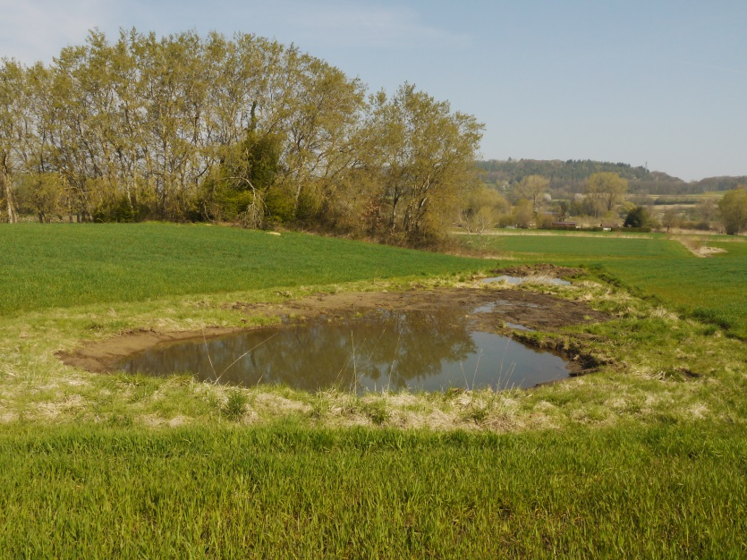
Biodiversity management …..
b. Protection of water bodies; management of riparian strips
What? Why?
Possible actions:
Larger cattle herds are not allowed free access to natural water bodies. In order to prevent contamination of water with excrements and protect public health.
A buffer zone of primarily native vegetation is kept along seasonal and permanent water bodies. The buffer zone should be of minimum 10 m width and kept free of fertilizers and pesticides.
Materials and substances inappropriate for the environment and biodiversity such as oil, CPPs, CPP packaging or containers, medicines, animal manure are not disposed in rivers, streams or other surface or ground waters.
© pictures: Bodensee-Stiftung
Guideline on the Protection of Primary Ecosystems and Semi-natural habitats
Action Facts Sheets on water protection……
Notes:
Why?
Water is basis of all living organisms. Therefore, water bodies such as lakes and rivers are habitats for many animals and plants and must be protected from pollution. Leaving or creating a broad riparian strip, with vegetation that is not or at least extensively managed, is a very important contribution here.

Slide 7
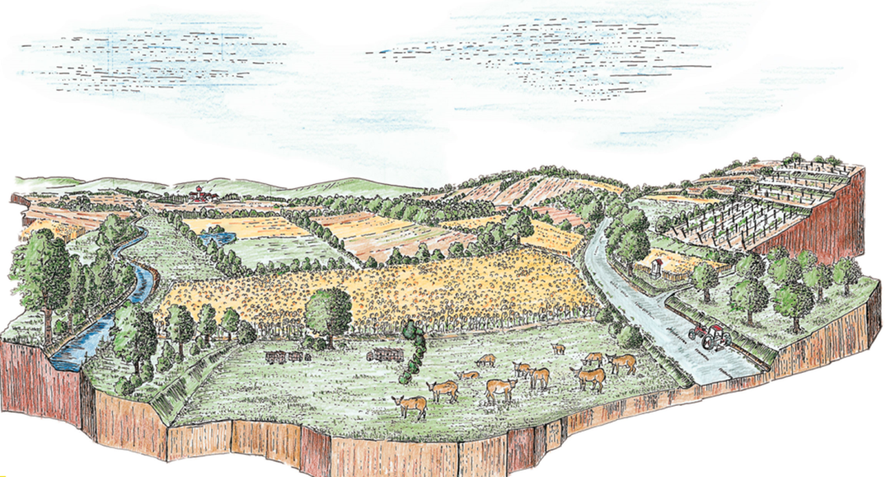
Biodiversity management …..
c. Minimum share of semi-natural habitats
Possible actions:
A minimum of 10 % of semi-natural habitats at farm level should be present. They are preferably located adjacent and inside (large) agricultural.
A minimum of 15 % of canopy cover of the farm (or group of member farms) in the case of growing shade tolerant crops should be reached.
Why?
© pictures: pixabay
Notes:
Why?
Semi-natural habitats are important elements to promote biodiversity on farm operations. They provide refuge and food for animals and plants. Sufficient size, each area independently and in summary, and a well-designed implementation of semi-natural habitats can compensate for habitat losses caused by agricultural activities.
Additional possible actions:
Identify areas on the farm that are in a beneficial position for semi natural habitats or less productive (stony areas, steep slopes, wet areas etc.) or already covered by natural vegetation and use them as or create semi-natural habitat on them (e.g. planting trees, hedges and other refuges for wildlife).
Existing semi-natural habitats /ecological structures are conserved.
For newly developed agricultural areas:
If areas will be converted into farm land an independent environmental impact assessment prior to the conversion should be carried out
If areas were recently converted into farmland, the loss of biodiversity/habitats must be compensated/restored

Slide 8
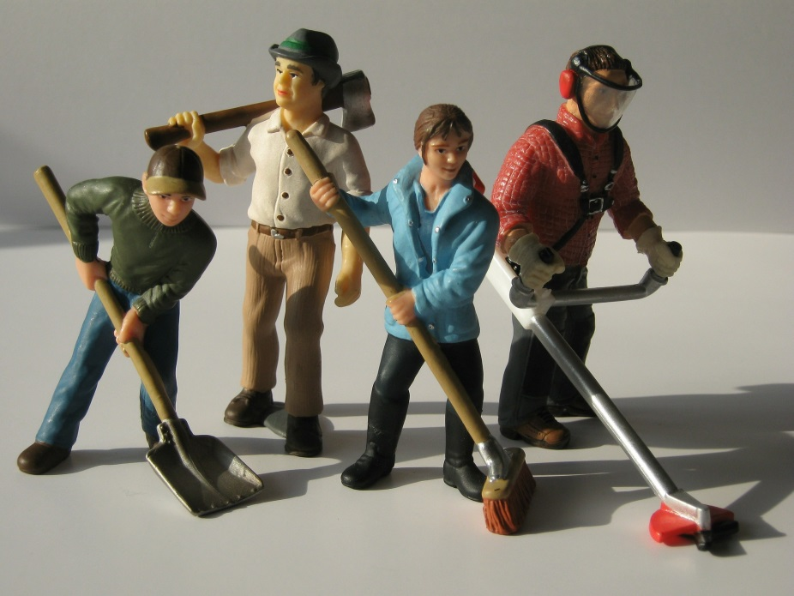
Biodiversity management …..
d. Management of semi-natural habitats
Why?
Possible actions:
Neither fertilizer nor plant protection products are used on any ecological structure
Maintenance of hedges: e.g. trimming of hedgerows max. every 3 years; respecting breeding seasons.
No burning
Late mowing of flower strips
Export of mowed material
© pictures: pixabay
Guideline on the Protection of Primary Ecosystems and Semi-natural habitats
Action Facts Sheets on Biodiversity Management
Notes:
Why?
Diverse vegetation, natural or planted such as hedges flower strips etc. provide habitat, shelter and food for a variety of animals and plants. In addition to the size, semi-natural habitats must also have a certain quality in order to be optimally used by the animals and plants as described above. Quality is expressed, among other things, in the diversity of landscape elements, plant selection and suitable maintenance.

Slide 9
Biodiversity management …..
e. Creation of habitat corridors
Why?
Possible actions:
Create, maintain and enhance a network of natural vegetation along live fences, hedges, ditches, riparian strips, roadside and field margins across the landscape. Please note: buffer zones are also representing habitat corridors.
If the farm operation borders with a protected area, areas specified for biodiversity on the farm must be connected to the protected area
Areas specified for biodiversity at the farm operation are connected to one another via habitat corridors
Biotop 1
Biotop 2
biotop corridor
Biotop 1
Biotop 2
step stones
Action Facts Sheets on Biodiversity Management
Notes:
What?
……. is an area of habitat connecting wildlife populations separated by human activities or structures (e.g. roads, logging, production sides on farms etc.)
…… are allowing an exchange of individuals between populations, which may help prevent the negative effects on inbreeding and reduced genetic diversity that often occur within isolated populations.
Why?
Habitat corridors connect habitats separated by human activities or structures, allowing an exchange of individuals between populations. Wide corridors provide for greater diversity and are effected less from adjoining land uses and associated edge effects. In general, the wider the corridor is the better it is for biodiversity.
Additional possible actions:

Slide 10
Biodiversity management …..
g. Specific measures for the protection of species
Possible actions:
Obtain information about protected and endangered species in the region and identify protected and endangered animal and plant species on or adjacent to the farm
Seek cooperation with local experts to identify measures promoting this species
Endangered and protected species are never subject of hunting, killing or collection
Seeding cereals in wide rows (drill gaps) to support light demanding wild herbs and field birds
Water points
What?
Action Fact Sheet for Biodiversity Management
Species examples of endangered species, woody elements (for selected counries only)
Notes:
Why?
Populations of protected and/or endangered animals and plants are often decreasing. Accordingly, measures or combination of measures should be implemented in order to counteract the main causes and to protect and conserve those species. Identification of endangered species is not always easy, and the same applies for the identification of measures. We recommend cooperating with local experts from the early beginning.
Additional possible actions:

Slide 11
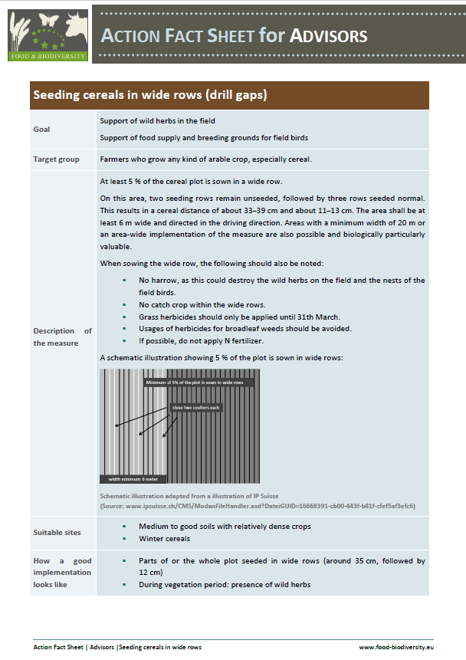
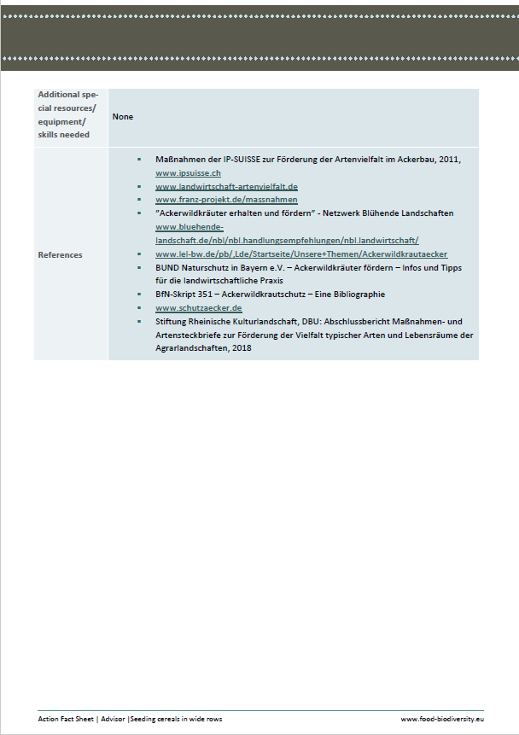
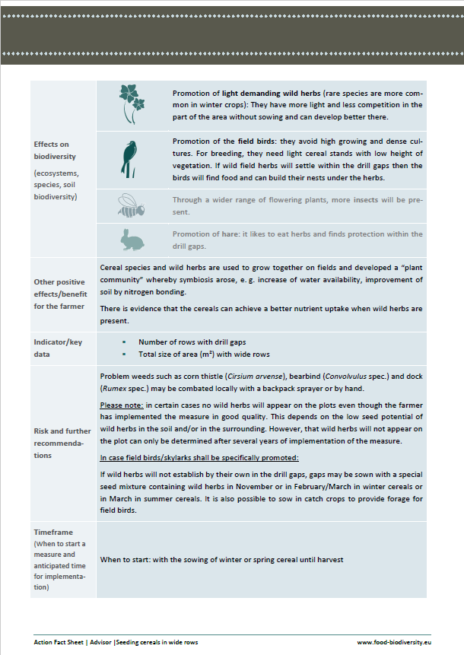
Action Fact Sheets

Slide 12
Thank you very much!
https://www.business-biodiversity.eu/en/life-food-biodiversity
  Knowledge Pool
  Action Facts Sheet
  User Manual
  Guidelines
  Easy Guide
  ……

