Slide 1
Biodiversity and Food Production in the European Green Deal
Web Series on Biodiversity and the Food Sector
Session III: Biodiversity in Food Production and Retail : Applying the Biodiversity Performance Tool
28 September 2020

Slide 2
CLIMATE
PACT AND CLIMATE
LAW
PROMOTING
CLEAN
ENERGY
INVESTING IN
SMARTER, MORE
SUSTAINABLE
TRANSPORT
PROTECTING NATURE
STRIVING
FOR GREENER
INDUSTRY
The European
Green Deal
FROM FARM
TO FORK
ELIMINATING
POLLUTION
LEADING THE
GREEN CHANGE
GLOBALLY
ENSURING
A JUST TRANSITION
FOR ALL
MAKING
HOMES ENERGY EFFICIENT
FINANCING
GREEN
PROJECTS

Slide 3
The EU Biodiversity Strategy
Enable Transformative Change
Protect Nature
EU For An Ambitious Global Agenda
Restore Nature

Slide 4
Why now?
Urgency:
Need to urgently address the biodiversity crisis
Our role in the world:
EU leadership towards CBD COP15
Recovery:
Need to mainstream into Recovery, MFF, CAP, etc…

Slide 5
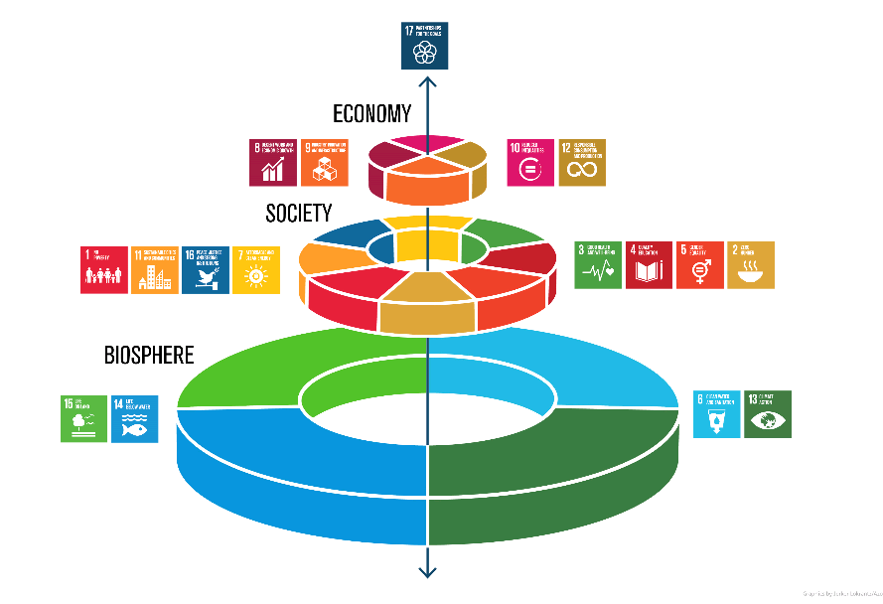
Biodiversity underpins sustainable development
Biodiversity loss: key threats for humanity
Almost half of global GDP is linked to nature
Interdependence between biodiversity loss and climate change, link to pandemics
Restoring biodiversity - core part of recovery

Slide 6
Restore Nature
EU Restoration Plan with 2030 commitments (1):
Legally binding targets to be proposed in 2021
No deterioration of any protected habitats and species by 2030: favourable status or positive trend for at least 30%
Agroecology: Organic farming ≥25%
Biodiverse landscape features ≥10%
50% reduction of use and risk of pesticides
Reduction of pollution from fertilisers by 50% and by ≥ 20% their use
Plant 3 billion additional trees respecting ecological principles
Reverse decline in pollinators

Slide 7
Restore Nature
EU Restoration Plan with 2030 commitments (2):
Remediate contaminated soil sites
Restore ≥ 25,000km free flowing rivers
New Urban Greening Platform: the Green City Accord
Halve the number of ‘red list’ species threatened by Invasive Alien Species
Reduction of damage to seabed, elimination/reduction of bycatch

Slide 8
Enable Transformative Change
Governance framework
Unlocking financing
Business engagement
Knowledge, education
Promotion of Nature-Based Solutions

Slide 9
The Farm to Fork Strategy
For a fair, healthy and environmentally-friendly
food system
Systemic changes over the whole food system
Ensuring sustainability and resilience
Leading a global transition

Slide 10
Challenges to the EU food system
SOCIAL SUSTAINABILITY
ENVIRONMENTAL SUSTAINABILITY
ECONOMIC SUSTAINABILITY
Healthier diets – reduce overweight
Improve
animal
welfare
Tackle climate
change
Protect the environment
Fairer incomes for farmers, fishers & aquaculture producers
Just
transition
Preserve biodiversity
Reduce food losses and waste
Social rights
workers in food
chain
Food
affordability
New business & job opportunities
Circular bio-based economy

Slide 11
Integrated approach from farm to fork needed
Farmers, fishers & aquaculture producers
European Union
Advisory services
Input industry
Research
International
Citizens --------------
Consumers
Food services / hospitality
Member States
Processors
Finance
Different levels of governance
Multiple instruments:
Legislation and regulation
Financial incentives
Education
Research and Innovation
Procurement
Voluntary commitments
Knowledge providers
Rural and coastal regions
Regions
Food manufacturers
Retailers
Cities

Slide 12
Food production objective
Neutral or positive environmental impact of food production
preserving and restoring the land and sea-based resources;
mitigate climate change and adapt to its impact;
protect land, soil, water, air, plant and animal health;
reversing the loss of biodiversity;

Slide 13
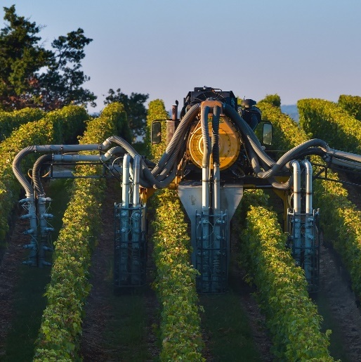
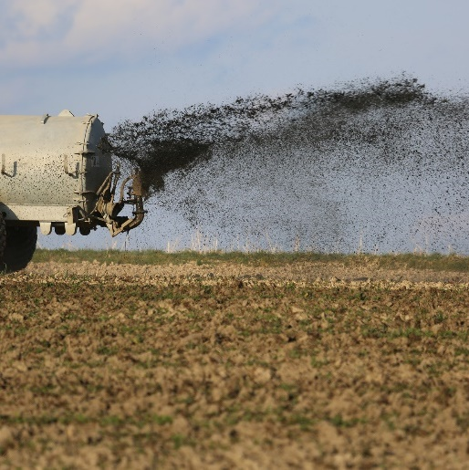
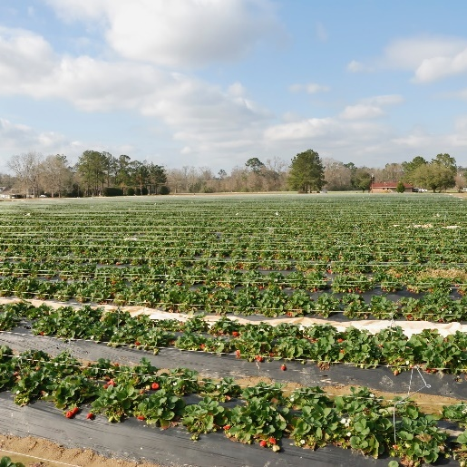
2030 Targets for sustainable food production
Reduce by 50% the overall use and risk of chemical pesticides and reduce use by 50% of more hazardous pesticides
Reduce nutrient losses by at least 50% while ensuring no deterioration in soil fertility; this will reduce use of fertilisers by at least 20 %
Reduce sales of antimicrobials for farmed animals and in aquaculture by 50%
Achieve at least 25% of the EU’s agricultural land under organic farming and a significant increase in organic aquaculture

Slide 14
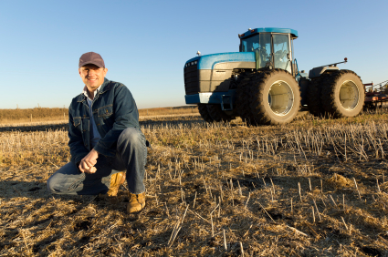
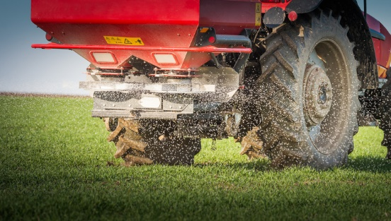
Actions to ensure sustainable food production (1)
Adopt recommendations to MS addressing the nine specific objectives of the Common Agricultural Policy (CAP), before submission draft CAP Strategic Plans (2020)
Revision of Sustainable Use of Pesticides Directive and enhancement of Integrated Pest Management (2022)
Revision of Regulations to facilitate plant protection products containing biological active substances (2021)
Action plan for the organic sector for 2021-2026 to stimulate supply and demand for organic products (2020)
Action plan for integrated nutrient management to reduce the pollution from fertilisers (2021)

Slide 15
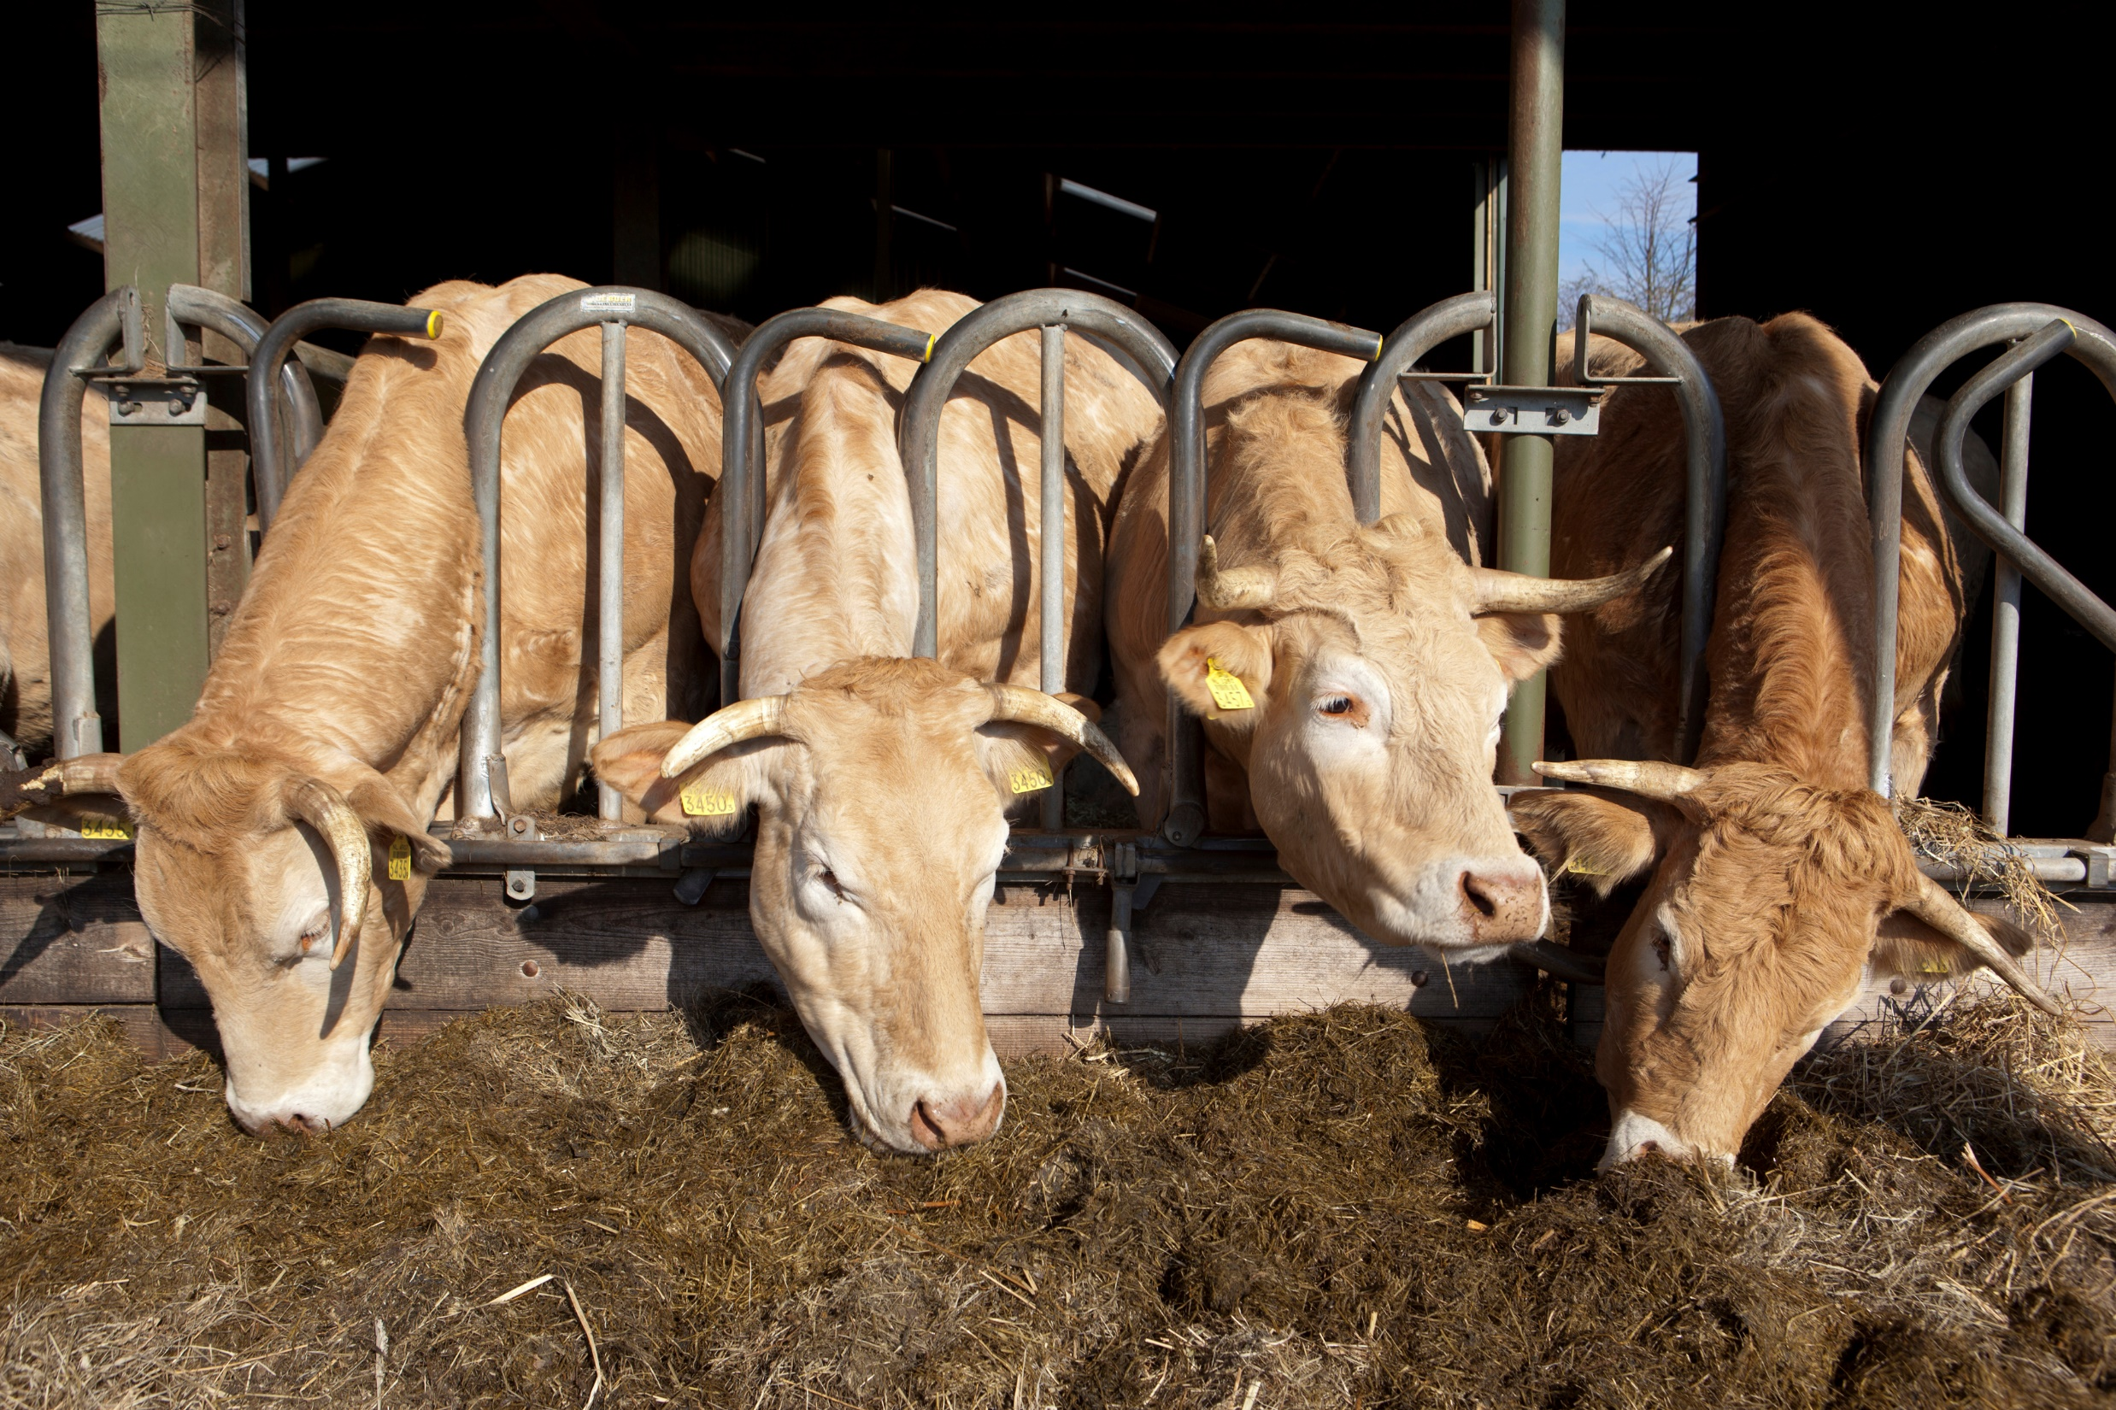
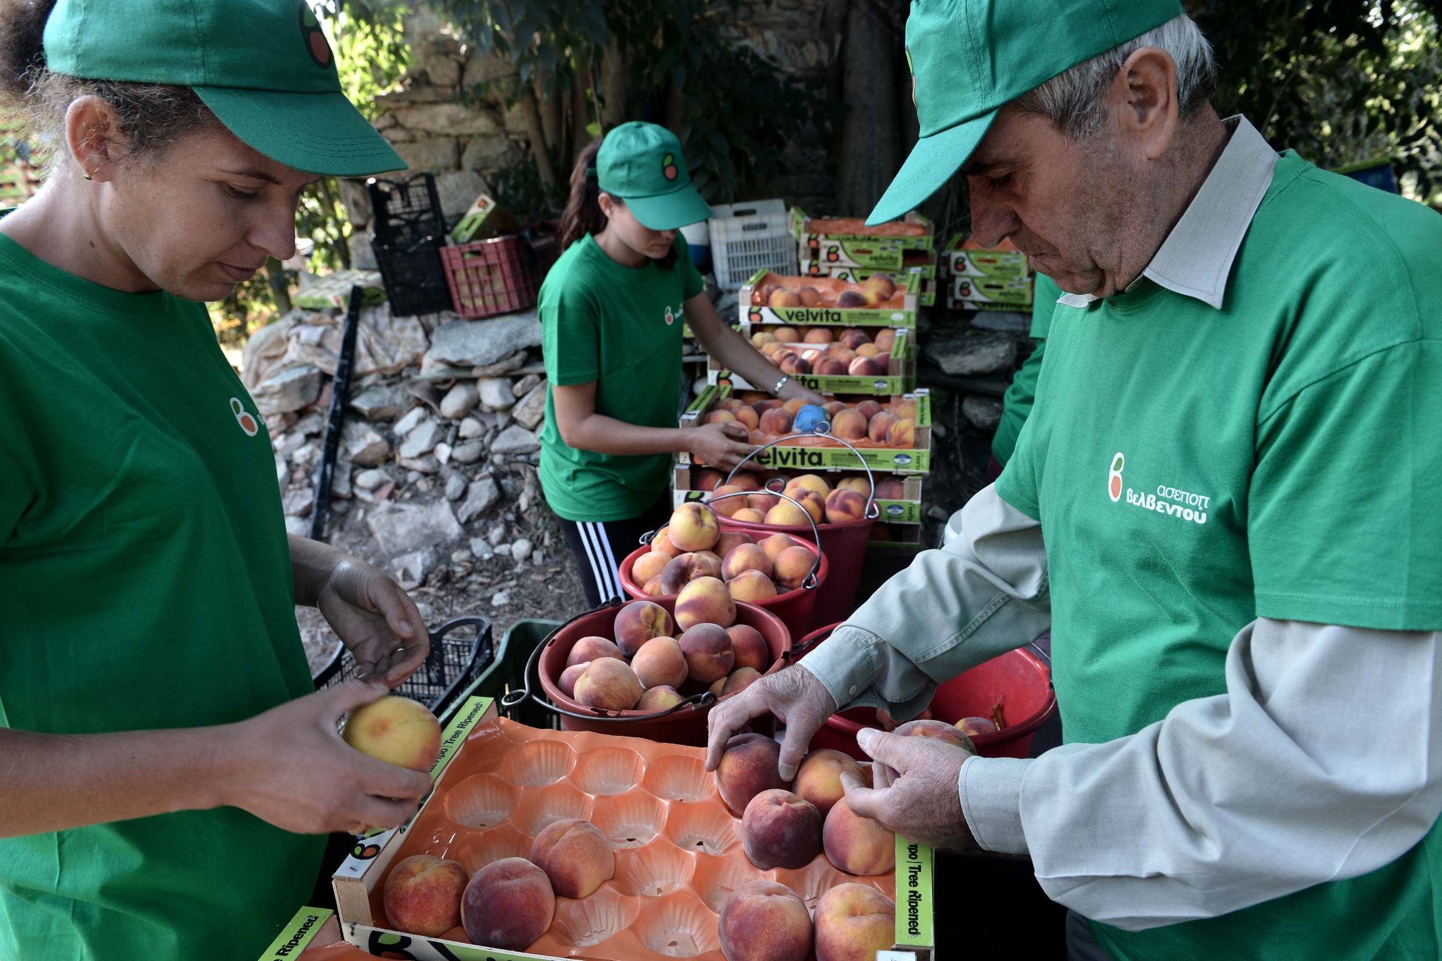
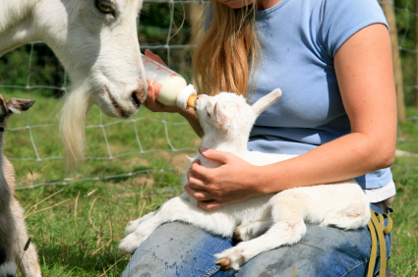
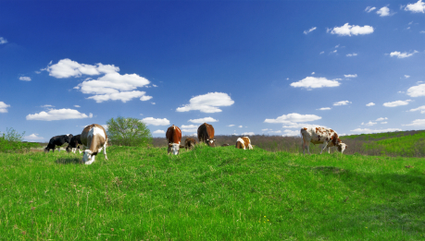
Actions to ensure sustainable food production (2)
Legislative initiatives to enhance cooperation of primary producers (support position in food chain) (2021-22)
Proposal for a revision of the existing animal welfare legislation, including on transport and slaughter (2023)
Clarification of the scope of competition rules with regard to sustainability in collective actions (2022)
Proposal for a revision of the feed additives Regulation to reduce the environmental impact of livestock farming (2021)
CO₂
CH₄
Proposal for a Farm Sustainability Data Network (data and advice on sustainable farming practices) (2022)
€
€

Slide 16
Enabling transition – Advice, knowledge & data
Advisory services, data and knowledge sharing
Member States will need to scale up support for objective, tailored advisory services targeted at sustainable farm management
Development of a Farm Sustainability Data Network: allow primary producers to monitor economic, environmental and climate performance
Support to SME food processors, small retail and food service operators with tailored solutions to promote new skills and business models

Slide 17
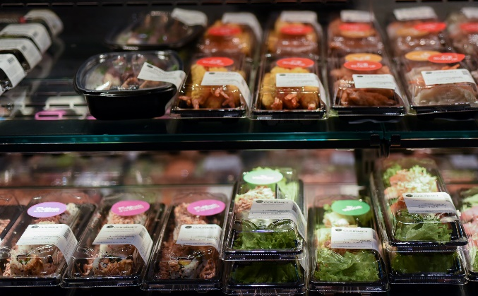
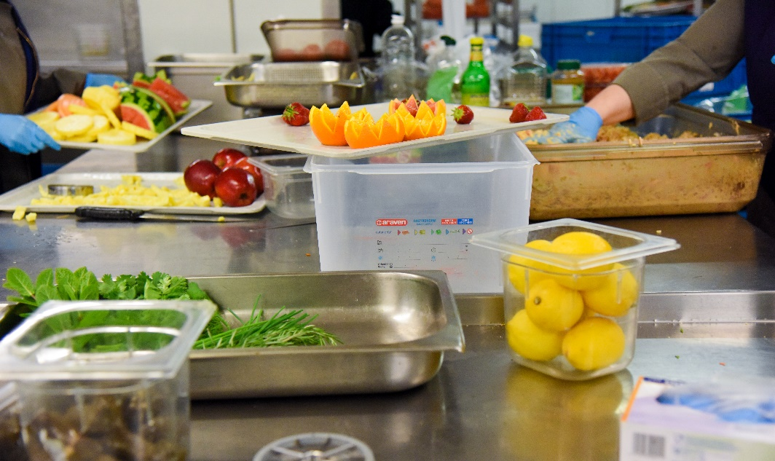
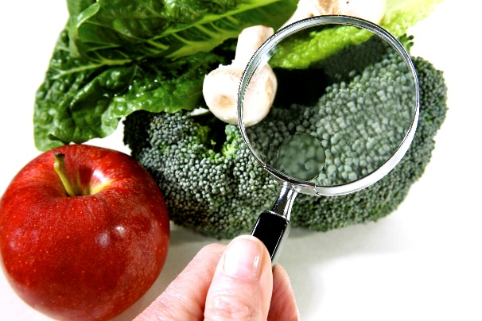
Actions to stimulate sustainable practices by food industry and retail, hospitality and food service
Initiative to improve the corporate governance framework (integrate sustainability into corporate strategies) (2021)
Set nutrient profiles to restrict promotion of food high in salt, sugar or fat (2022)
Proposal revision EU legislation on Food Contact Materials (food safety, environmental footprint) (2022)
Develop an EU code and monitoring framework for responsible business and marketing conduct in the food supply chain (2021)
Revision EU marketing standards for agricultural, fishery and aquaculture products (ensure uptake and supply of sustainable products (2021-22)
Stimulate reformulation of processed food, including setting of maximum levels for certain nutrients (2021)
Enhance coordination to tackle Food Fraud (2021-2022)

Slide 18
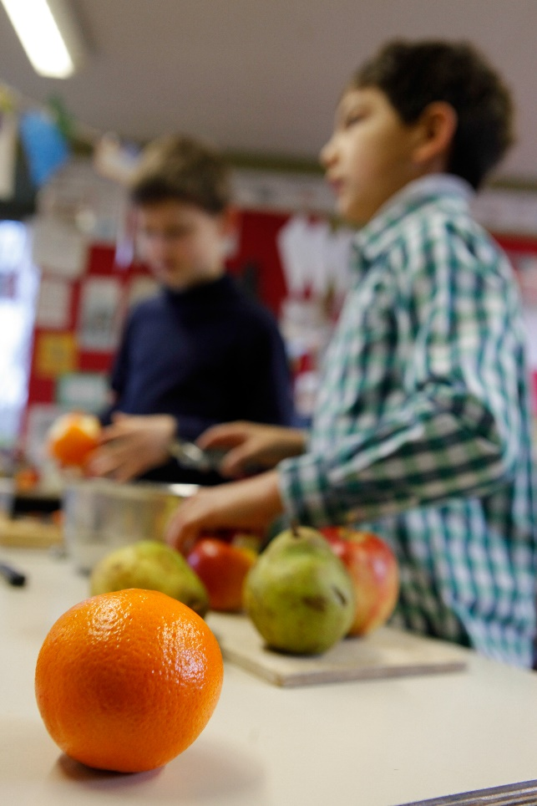
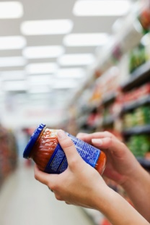
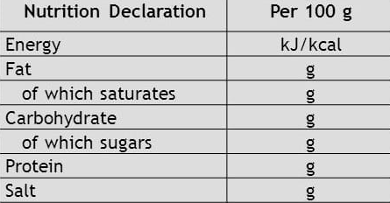
Actions to promote shift towards healthy, sustainable diets
Determine the best modalities for setting minimum mandatory criteria for sustainable food procurement (2021)
Proposal for a harmonised mandatory front-of-pack nutrition labelling to enable consumers to make health conscious food choices (2022)
Review of the EU school scheme legal framework: refocus on healthy and sustainable food (2023)
Proposal to require origin indication for certain products. (2022)
Review of the EU promotion programme for agricultural and food products (aimed at sustainable production and consumption) (2020)
Proposal for a sustainable food labelling framework to empower consumers to make sustainable food choices (2024)
Proposal VAT rates (currently being discussed in Council): could allow to make more targeted use of rates (e.g. to support organic fruit and vegetables).
Nutrition - health
Environment
Social

Slide 19
The importance of metrics and labels
“If you can’t measure it, you can’t improve it.” (Peter Drucker, business guru)
“If you can’t measure it, it does not exist”. (Joan Freeman, Professor of Psychology)
Easily understood but informative/objective
Widely recognized, harmonized methods
Can be used in public, private and individual decision-making

Slide 20
Related Initiatives
Circular Economy Action Plan:
Legislative proposal for a sustainable product policy initiative
Legislative proposal on substantiating green claims
Legislative proposal empowering consumers in the green transition
Updating the Circular Economy Monitoring Framework to reflect new policy priorities and develop further indicators on resource use, including consumption and material footprints
Taxonomy Regulation (in force since July)
rules on non-financial reporting / initiatives on sustainable corporate governance and on Natural Capital Accounting
Business and Biodiversity Platform

Slide 21
THANK YOU FOR YOUR ATTENTION!

