Slide 1
Portugal
22nd September 2020

Slide 2
What?
Call to action
for business in Portugal
Companies' commitments to reverse biodiversity loss and ecosystem degradation
international

Slide 3
Partners
Steering Committee
Advisory Board
Steering Committee
Business Associations
Sílvia Machado, CIP
NGO
Ângela Morgado, ANP-WWF Portugal
Domingos Leitão, SPEA
Government / Public Entities
Marisa Silva, MAAC
Nuno Banza, ICNF
Scientific Partners
Cristina Máguas, CE3C/FCUL
Rui Ferreira dos Santos, CENSE – FCT/UNL
José Lima Santos, CEF/ISA
Pedro Beja, CIBIO
Isabel Sousa Pinto, CIIMAR/Universidade do Porto
Tiago Domingos, IST
Teresa Pinto Correia, MED/UÉvora

Slide 4
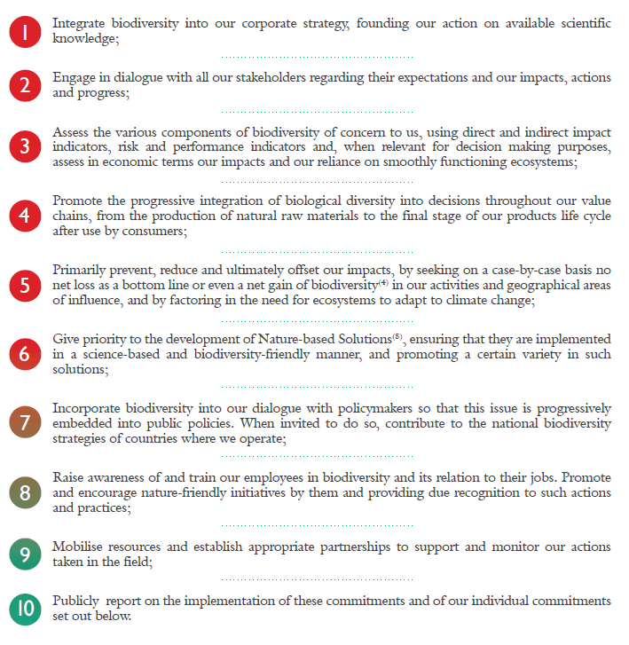
Commitments
10 COMMON
10 Common Commitments act4nature
+
SMART* Individual Commitments
[CEO]
*Specific, Measurable, Additional, Realistic and Time-bound

Slide 5
Who can commit?
Any size and activity sectors companies
No costs to become a signatory
Any company

Slide 6
2020 Calendar
75th UN General Assembly & Nature Summit, New York, USA
Webinar temático
Call to Action
22
MAI
15-30 SET
27 OUT
2020
1 SET
25 SET
26 NOV
1st Deadline for commitments
Online Conference
Webinar temático

Slide 7
Post 2020 Calendar
1st commitments update
act4nature Portugal
3rd commitments update
act4nature Portugal
2nd Deadline for commitments
tbd
tbd
2022
2026
2021
2030
tbd
tbd
2024
2028
Conferência BfB
2nd commitments update
act4nature Portugal
4rd commitments update
act4nature Portugal

Slide 8
2020 Commitments
3 Food sector companies
(retail, winemaking and meals/catering services)
Direct and indirect commitments
Sustainable Procurement
Support to conservation projects
Sustainable farming practices
Good management practices
for B&ES
Awareness for B&ES
Reporting on B&ES
16 companies

Slide 9
Thanks!
Mafalda Evangelista
mafalda.evangelista@bcsdportugal.org
act4natureportugal@bcsdportugal.org
www.bcsdportugal.org/act4natureportugal #act4natureportugal

Slide 10
www.bcsdportugal.org/act4natureportugal
Empresas pela biodiversidade

